Slide 1
Energy Oriented Business Administration
Prof. Dr. Johannes Kals
5.3 Ethics

Slide 2
Terms ethics and morality/ moral
Ethics means thinking about basic values – scientific view
Morality means values a person or an organization accepted as being true and worthwhile living accordingly – practical view
Etymology of ethics from the Greek language: habit, custom, practical usage

Slide 3
Basic ethical principles and values
Codified in laws and written rules
Business/ economic ethics
Branches
Global economy, „global village“
Corporate ethics (business ethics for a firm)
Codes, guidelines, visions – corporate culture
As habit, custom, cultural rule
Individual/ personal ethics
Professional ethics
In private life
National economy

Slide 4
Exemplary problems, applications, and fields of business ethics (economy as a whole, companies, and personal)
Environmental protection including energy and carbon
Behavior towards suppliers
Behavior towards customers
Short-term versus long-term profit maximization
Leadership and participation
Stakeholder value versus shareholder value
Corruption and bribery
Fair wages and equal pay
Credibility in marketing (versus “greenwashing”)
Work safety
“green” investment
Sustainable management

Slide 5
Can ethics be discussed scientifically?
Yes - Methodology of theory building
Value judgements forming the basis of the theory:
Decisions about objects of research, objectives, methods, range of time considered, idea of man and further premises (basic values)
Theory building in closer definition:
Formulation of hypotheses, data collection, logical conclusions develoption a comprising model and recommendation for a decision
In applied sciences:
Implementation of the decision, experiment.
Approval, review or rejection of theory
Notes:
Source: Kals, Johannes: ISO 50001 Energy Management Systems – What managers need to know about energy and
business administration, New York 2015, P.97.
Figure 11.2: Methodology of theory building.

Slide 6
Overview of import ethical theories for economy and business
Ethical theory
Utilitarianism
Communicative or discourse ethics
Ethics of duty (deontological ethics)
Legalism (laws as leading thought)
Religions
Corporate guidelines as application

Slide 7
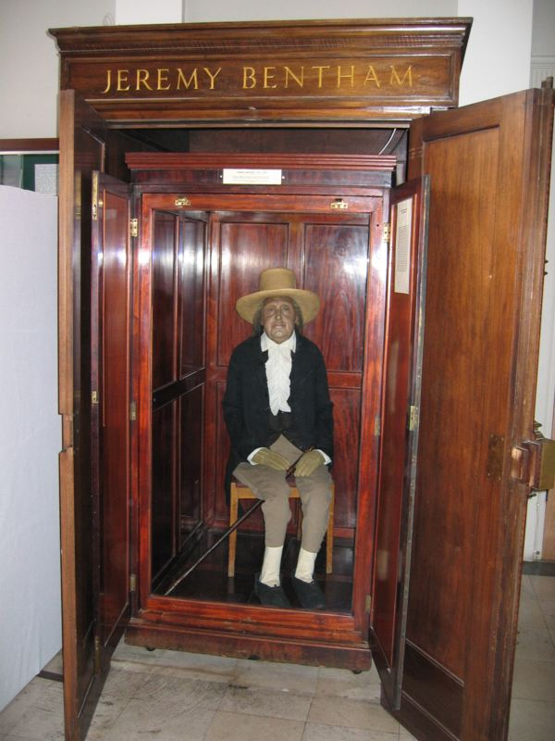
Utilitarianism
Greatest benefit of the greatest number
Self-interest coordinated by the invisible hand of markets
Best allocation of resources
Competition leads to growth and innovation
John Stuart Mill, 1806-1873 or Jeremy Bentham 1748-1832 (photo University College)
Crucial issue here: „prices have to say the truth“ – internalizing externalities
Wikipedia.org

Slide 8
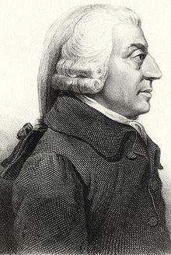
Adam Smith as founder of utilitarianism?
Not really, he was „moral philosopher“ or ethicist:
Before „Wealth of Nations“ 1776
he wrote
„Theory of Moral Sentiments“ 1759
https://commons.wikimedia.org

Slide 9
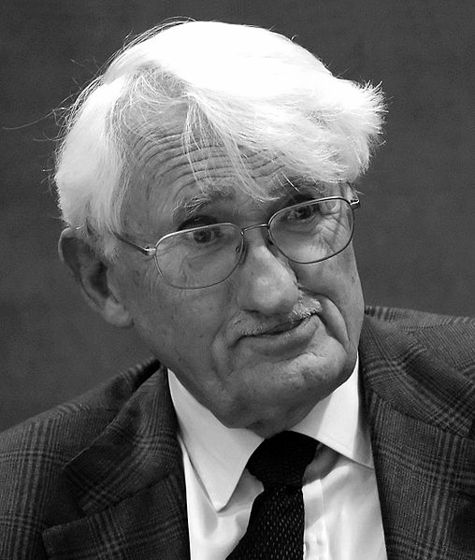
Communicative or discourse ethics
Rules and agreements are ethically justified, if they are reached in a discourse.
This communication has to involve all stakeholders of a conflict and it has to be free of domination.
It is a processual ethics, describing the way to reach agreements and not the contents (normative ethics).
Jürgen Habermas, geb. 1929
photographer: Wolfram Huke at en.wikipedia, http://wolframhuke.de - Transferred from en.wikipedia; Transfer was stated to be made by User:ojs., CC BY-SA 3.0, https://commons.wikimedia.org/w/index.php?curid=4437474

Slide 10
Important presupposition of a free discourse without domination:
no relevant argument is suppressed or excluded
no force except that of the better argument is exerted
everyone capable of speech and action is entitled to participate
everyone is equally entitled to introduce new topics or express attitudes, needs, or desires
no validity claim is exempt in principle from critical evaluation in argumentation
The next chart applies this theory to decision-making processes about energy and climate in companies.

Slide 11
 | Communication concerning the decision making process about climate decisions in companies („discourse“ as it takes place currently) | Minimal care for climate ethics | Maximal care for climate ethics
Shareholder (of an exchange traded company) | Supervisory board and general assembly of shareholders, assigning and controlling top management | Shareholders only striving for short-term profits | Shareholders as ethical investors open to lose profits in order to do good
Stakeholders: Managers and employees | Managers are part of the decision making process, but they are bound to the expectations of shareholders. Employees having little formal power | Only egoistic interest for personal career, payment of bonus, and workplace security | Persons striving to have an answer when grandchildren might ask: What did you do against climate change?
Stakeholders: Customers | Exercising influence through buying products | Buying the cheapest products regardless of the climate impact | Readiness to pay a higher price for eco-friendly products
Stakeholders: State, society, public | General laws, operation permits for companies | Traditional neoclassical approach of utilitarianism (without internalization tax) | Internalization tax as part of post-growth economy and sustainable globalization
Stakeholders: Coming generations suffering from the consequences of climate change | No institutionalized participation | Little interest because of lack of information or frustration | Claim that the current generation must stop spoiling the ecological basis of life irreversibly

Slide 12
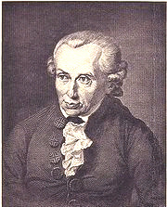
Ethics of duty (deontological ethics)
Duty has to be defined, a basic example Immanuel Kant, 1724- 1804, the „categorical imperative“:
„Act only according to that maxim by which you can also will that it would become a universal law.”
No escapes like „my contribution wouldn´t make a difference“
J. L. Raab, after a painting by Döbler - https://commons.wikimedia.org

Slide 13
Golden rule as a basic interpretation
of deontological ethics:
“treating others as one would wish to be treated”
Dating thousands of years to early Egypt, Confucian times, Persian, Greek, and Roman culture.

Slide 14
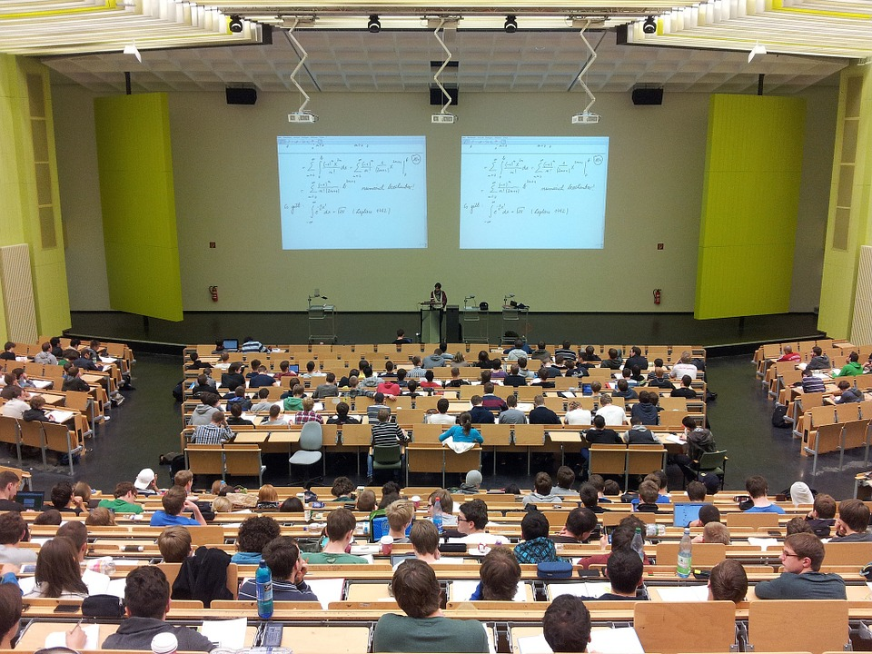
Legalisms, laws as leading thought
If something is not forbidden, it is ethical
Companies and managers are legal as long as they don´t offend laws
Compliance management, complying to all laws, acts, and regulation
What is thought in your program and what is practiced in your company?
What do you think: Is being legal enough to be legitimate?
(Legality versus legitimacy)
Nikolay Georgiev, Pixabay.com

Slide 15

Religions
Buddhism, Christianity, Hinduism, Islam, postmodern spirituality …
What are they saying to economic questions and preserving the environment?
Pixabay.com

Slide 16
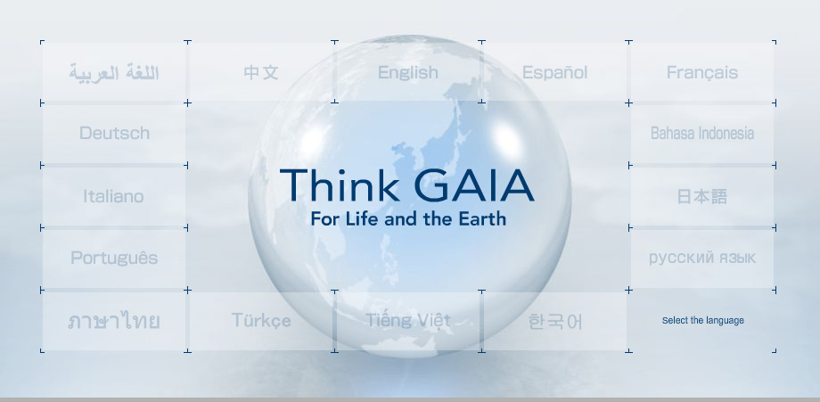
Corporate guidelines as application
How do we ensure that children for the future will have a beautiful planet to live on? For SANYO, the answer is to treat the Earth as a single living organism, and create the products we truly need to continue living in harmony with this precious planet. This is the conviction that inspires SANYO's vision, "Think GAIA."
https://www.panasonic.com/global/corporate/sustainability/pdf/kan2006_e.pdf, Abruf 22.1.18

Slide 17
Linking energy strategy to ethical theories
Different energy strategies taken from „5.2 Strategy“ | Utilitarianism (conventional interpretation) | Utilitarianism (internalizing externalities) | Legalisms | Ethics of duty | Communicative discourse ethics | Companies own „Code of Ethical Conduct“
Passive strategy
Short-term calculable strategy
Long-term strategy with difficult to calculate influencing factors
Offensive-ethical strategy: Realization of all economic energy saving measures

Slide 18


Hopefully it is still our choice …

