Slide 1
Energy-Oriented Business Administration
Prof. Dr. Johannes Kals
5.2 Strategy
Content
1.Strategy, Sustainability and Energy
2. Application of Selected Strategic Planning Methods

Slide 2
Levels of goal-setting, planning, and management
Normative Management (long range spanning generations in family businesses)
Strategic management (five years or more)
Operational management (less than one year)
Tactical management (two to four years)
Notes:
Source: Kals, Johannes: ISO 50001 Energy Management Systems – What managers need to know about energy and
business administration, New York 2015, P.95.
Figure 11.1: Levels of goal-setting, planning, and management.
There are five levels with various time ranges.
Organizations as lobbyers influencing legislation may exercise a considerable influence redesigning energy markets.
Normative management introduces basic values and the ethical dimension into organizations.
Strategic management has to bring values closer to action. The standard methods of strategic planning have to be applied and adapted to meet the upcoming energy challenges.
Tactical management has to be mentioned, but in business studies, and many companies, planning it is not visible by its own methods and tools. Consequently, this level will be merged with the strategic one.
Operative management and control cover energy planning activities with an impact lasting for less than one year.

Slide 3
What is a strategy?
Ultimately the answer to the question:
Which products does a company want to sell in the long term, in order to be profitable?
For this purpose many individual questions are to be answered, or rather sub-strategies are to be defined.

Slide 4
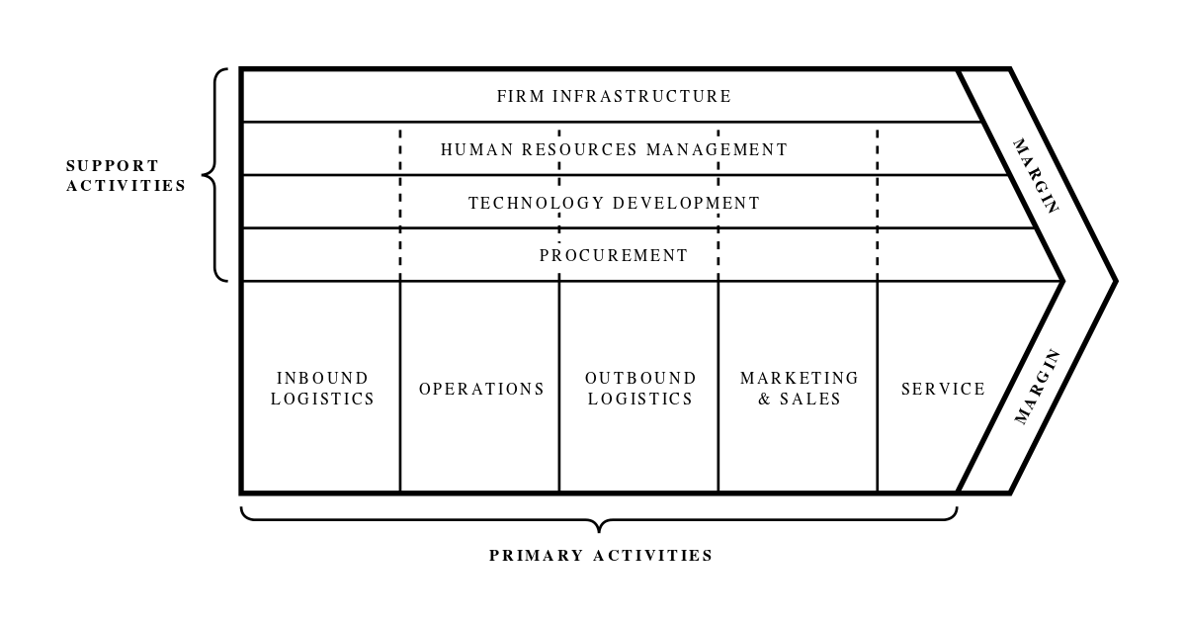
Exemplary fields of activity, for which sub-strategies have to be developed, according to Michael Porter’s (in-house) Value Chain Model:
Other cross-sectional and inter-company perspectives
Internationalization
Sustainability
IT / Technology
Co-operations, Supply Chains, Value Networks
Other
Wikimedia Commons By Denis Fadeev (own work)

Slide 5
General Corporate Strategy
Sustainability Strategy
Environmental Strategy
Energy and Greenhouse Gas Strategy

Slide 6
Similar to the energy strategy of Germany, Europe and the world
(see "02.2 Energy Transition")
Approaching an energy oriented strategy:
Differentiation between energy-related and non-energy-related products
Companies with products that consume energy, for example:
Does the automobile industry focus on combustion motors or e-cars or mobility solutions or others like financial products?
Energy strategy as a part of the product strategy
All companies:
Energy efficiency (technology) as well as energy mix and renewables (procurement, own production)
Energy strategy as a part of the production strategy

Slide 7








Examples for
(elements of) energy strategies:

Slide 8
So far, the energy strategy is above all a technology strategy derived from the general corporate strategy.
From business administration perspective additionally on the following slide:
Strategies defined according to planning timeframe and decision criteria for energy investments

Slide 9
Strategy | Typical profitability and amortization expectation for energy projects | Included expenses and income | Planning timeframe
Passive strategy | 25 percent, 4 years | Short term, quantifiable | No systematic planning
Short-term calculable strategy | 25 percent, 4 years | Short term, quantifiable | 1-5 years
Long-term strategy with difficult to calculate influencing factors | 5 to 10 percent 10 to 20 years | Quantitative and qualitative factors | decades
Offensive-ethical strategy: Realization of all economic energy saving measures | Weighted Average Cost of Capital (WACC) | Quantitative and qualitative factors | Decades / intergenerational
Source: Kals, Betriebliches Energiemanagement, 2010

Slide 10
Conclusions and recommendation - Preference for energy investments:
Profitability instead of amortization period (see “5.1 Profitability and Investment Appraisal")
Longer timeframe
Lower return on investment expectation (WACC only)
Include "soft" decision criteria (see “5.3 Ethics" - comprehensive target system with inwards-oriented motivation and outwards-oriented effects on LoHaS consumers – Lifestyle of Health and Sustainability)

Slide 11
Reasons, motivation, and targets for sustainability and energy strategies
Cost reduction
Revenue: new business models or sale promotion
Risk reduction
Beyond the economy: ethics and moral
Next chart: model of tangible and not tangible targets and objectives of a company

Slide 12
Green investments in R&D, production technology
Investments in sustainability communication in- and outside
Credibility, corporate culture, good image, valuable brands
Motivated staff, win „war for talents“
Higher product prices and new buyers
Reduced risks, strategic cost advantage
Attraction of ethical investors
Rise revenues
Cut costs
profits
Source: Kals, ISO 50001, p. 110
Notes:
Source: Kals, Johannes: ISO 50001 Energy Management Systems – What managers need to know about energy and
business administration, New York 2015, P. 110.
Figure 11.6: Hard and soft impact of sustainability on profits.
To have a complete picture of strategic energy decision making. It systemizes the intangible effects of sustainability energy strategy.

Slide 13
Content
1. Strategy, Sustainability and Energy
2. Application of Selected Strategic Planning Methods

Slide 14
Multitude of methods for
strategic planning/ management/ business strategy
Market research
Competitor analysis
Life-cycle models
Technology evaluation
SWOT-analysis (Strengths, Weaknesses, Opportunities, Threats)
Portfolio theory (BCG-and McKinsey matrix)
Risk assessment and management
Scenario techniques
Experience curve
Innovation management
Marketing mix (Product, Price, Promotion, Place)
Porter´s five forces and generic strategies
Illegal industrial spying
Organizational learning

Slide 15
Selected Strategic Planning Methods
Strengths-Weaknesses-Opportunities-Threats (SWOT-) Analysis
Scenario technique
Risk management

Slide 16
Strengths-Weaknesses-Opportunities-Threats (SWOT-) Analysis a foundry with energy focus
Strengths Long tradition and very loyal customer base Dedicated, competent, capable employees Sophisticated, reliable production processes of high quality including high energy efficiency (however based on coal) | Weaknesses High CO₂ emissions from the coal-based technology
Opportunities Massive reduction of CO₂ emissions and the possibility for load management by investing in new electric ovens | Threats Shift in energy prices or public subsidies Possible overburdening of the company by the investments
Following slide: Key figures and technology evaluation
as a part of a SWOT-analysis
Source: Kals, ISO 50001, 2015, p. 106

Slide 17
 | Very weak | Weak | Average | Strong | Very strong
Cost benchmarks
Energy costs
Change in energy costs in time
…
Energy key figures
Energy consumption per product
Energy consumption per m² of the hall
…
Technology comparison (see next slide too)
Regulated electrical power units
Passive house technology
…
Management system
Responsibilities assignment
Formulation of energy goals
…

Slide 18
Technology evaluation: Assessing how good (or bad) our company is?
Technology | Technologically mature? | Expected cost reductions for the technology? | Connection with other investments? | Profitability increase through further development? | Usage duration?
Motor technology passenger car / truck | No | Yes | Small | high | > 10
Passive house | Yes | Small | No | No | > 50
Regulated electric motors | Yes | Small | No | No | > 20
Gas power plant with cogeneration | Yes | Small | Yes | No | > 50
…

Slide 19
Selected Strategic Planning Methods
SWOT Analysis
Scenario technique
Risk management

Slide 20
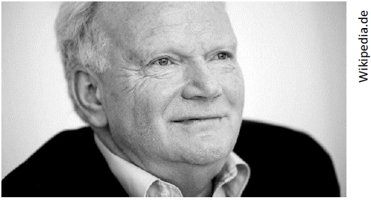
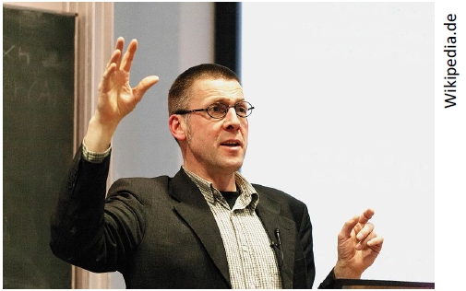
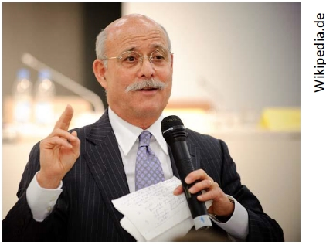
Scenario technique (including early warning with "weak signals and wildcards")
Ulrich Beck
„Brasilianisierung”
Nico Paech
Post-growth economy and sufficiency
General globalization scenarios
Jeremy Rifkin:
Zero marginal cost society

Slide 21
Exhausted from the futile stalk, they lean their rifles against a tree to refresh themselves at the nearby stream.
As soon as they reach the stream shore, a lion appears and cuts off their way back to the rifles. Immediately one of the managers starts taking off his boots.
Astonished, the other asks, "Do you think you can run away from a lion?“
The other answers: "No, I just have to run faster than you!"
Energy costs
Price x Quantity
Energy prices
Energy consumption (quantity)
Production volume
Energy efficiency and technology
Reach of resources
Political regulations
Renewables prices
World economy development
Two managers hunting in
Africa
What are the competitors doing?
Relative market position
National and international

Slide 22

Drilling further down to quantify coming energy prices,
looking at the reach of resources
$$reach of resources= \frac{geological stocks}{annual global consumption}$$
Rough estimates (almost constant over the time):
oil: decades
coal: centuries
gas: between oil and coal

Slide 23
Important driving variables for the reach of (energy) resources
Prices
Profitability of mining
Technological advances (mining)
Political crises
Regulation
Technological advances energy use

Slide 24
Selected Strategic Planning Methods
SWOT Analysis
Scenario technique
Risk management

Slide 25
Impact of future energy costs on the strategy
 | Energy costs rise moderately | Energy costs rise sharply | Energy costs explode and the supply is in danger
Product strategy (Who buys our products, at what price, with what value, with which alternatives?)
Production strategy (How do we produce, with which technologies, with what energy efficiency and which energy mix and at what cost?)

Slide 26
Risk identification using the methods and information above:
Risk matrix / portfolio / classification
High amount of damage
Medium amount of damage
Low amount of damage
 | Low occurrence probability | Medium occurrence probability | High occurrence probability

Slide 27
Risk Strategies
Avoid
(red)
Transfer / insure
(orange)
Reduce
(red-orange)
Accept (green)

Slide 28
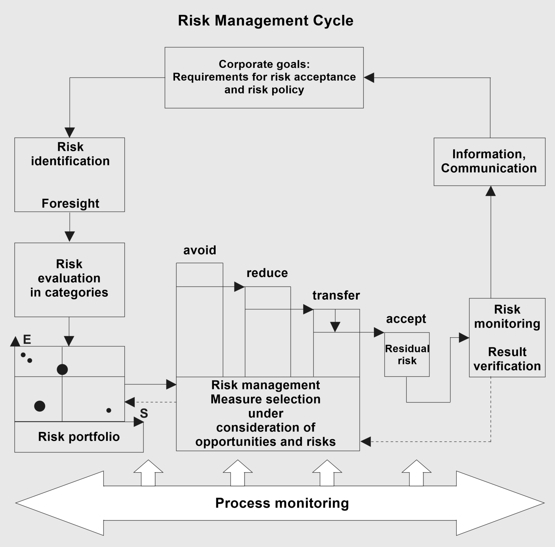
Springer Gabler Verlag (Publisher), Gabler
Wirtschaftslexikon, Key word: Risikomanagement, online
in Internet:
http://wirtschaftslexikon.gabler.de/Archiv/7669/risikomanagement-v11.html

Slide 29

Basic recommendation for corporate strategic planning:
As background and analogy: state / government energy policy goals
Economic efficiency
Supply security
Sustainability

