Slide 1
Energy Oriented Business Administration Prof. Dr. Johannes Kals 5.1 Profitability and Investment Appraisal

Slide 2
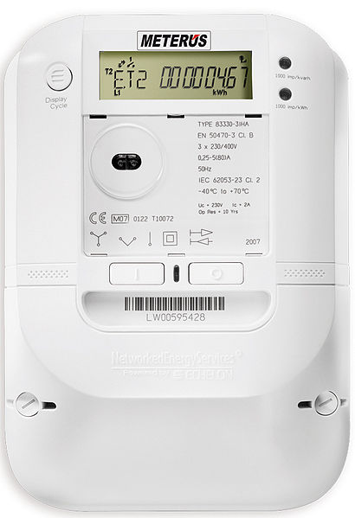
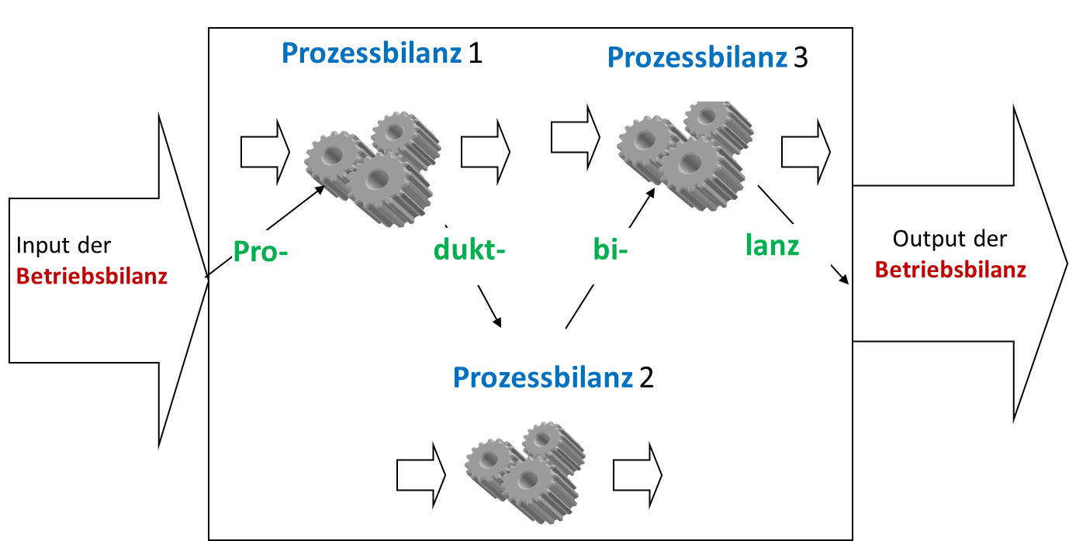
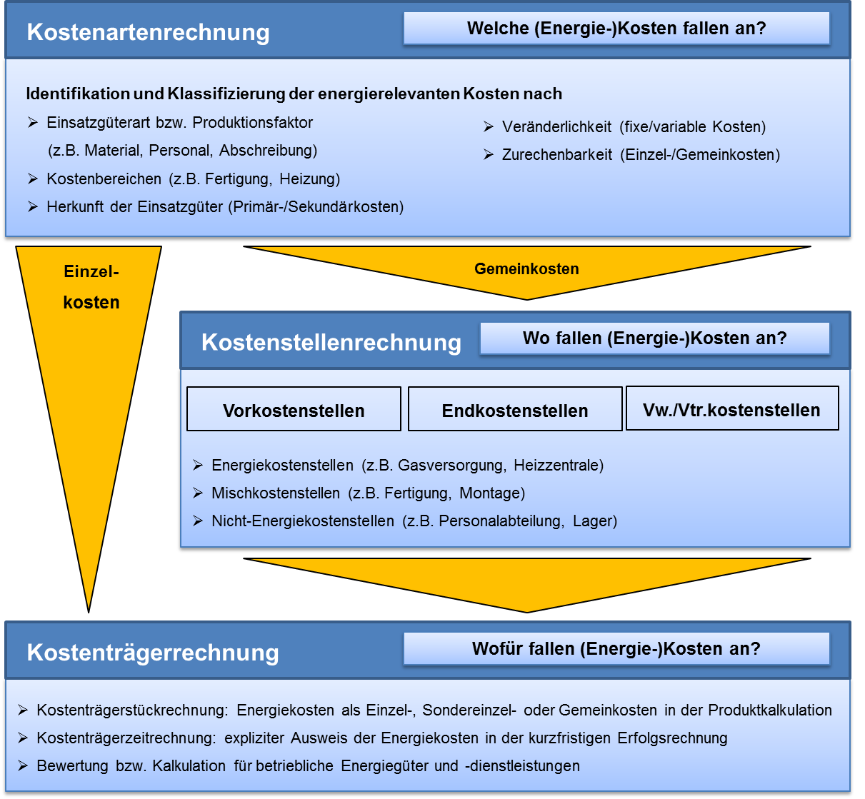
This presentation is based on balances, cost accounting, smart metering – basic knowledge of investment and finance is helpful, but not mandatory
Some tips and trick of investment appraisal for energy and carbon are pointed out.
Wikipedia.de
Own work
Krück, D. 2015

Slide 3
Content
Total Cost of Ownership (TCO) and Life Cycle Cost (LCC)
Pay-off Period versus Return on Investment
Optimal Replacement Time
Energy and Carbon Amortization
External Costs
Contracting
Sensitivity Analysis

Slide 4
Life-Cycle Cost (LCC) or Whole-Life Costs
Normally defined synonym to TCO. But exact would be TCO AND costs in other phases of life-cycle
Total Cost of Ownership (TCO)
All costs caused by ownership of an (investment) good/ asset
We assume here the TCO definition and consider the hard, quantitative, internal costs of an energy investment.

Slide 5
TCO was first defined for IT
For example the
„Hey Joe-Effect“
Pixabay.com

Slide 6
Here, correct calculation of investment goods with relation to energy:
Heating, air conditioning, vehicles, pumps, drives, machinery etc.
Mayor steps defining the TCO:
Preparation of procurement
Procurement, installation/ construction, test operation
Demolition, disposal, recycling
Operations, maintenance, refurbishment

Slide 7
60 to 95 percent of TCO of electric drives, pumps, heating, air conditioning etc. may be cost of energy!
Procurement, technical planning, management accounting have to fight against the predominance of investment expenses.
TCO in stead of expenditures of acquisition!

Slide 8
„visible“ direct costs
Acquisition
Capital
Infrastructure
Putting into service
„hidden“ indirect costs over lifetime
Energy
Personnel and training
Space
Maintenance and spare parts
Interruption of operations
End of life-cycle with decomposition/ deconstruction, hopefully recycling, cost of disposal and risk of pollution
Colourbox.de
Notes:
Intention beider Methoden ist es neben den offensichtlichen Kosten einer Investition auch die „verborgenen“ darzustellen, da diese oft einen wesentlich größeren Umfang besitzen und deshalb auch mit in die Entscheidung aufgenommen werden sollten.
Die Life Cycle Cost (LCC) Analyse ist weniger umfangreich, als die TCO Methode. Sie beginnt mit der Planung einer Investition und endet mit der Demontage. Sie bezieht sich also auf den Zeitraum in dem der Gegenstand dem Unternehmen zur Verfügung steht. Ziel ist es das Investitionsobjekt zu identifizieren, dass während seiner Verweildauer im Unternehmen die geringsten Kosten verursacht. Im Mittelpunkt der Betrachtung stehen die entsprechenden Leistungsarten.
Die Total Cost of Ownership Methode (TCO) ist ein Ansatz um die gesamten Kosten, die mit der Anschaffung und Nutzung eines Gegenstandes verbunden sind, strukturiert und transparent darzustellen. Im Vergleich mit den Life Cylce Cost (LCC) findet eine weitreichender Analyse statt, so werden auch Kosten in Betracht gezogen die beim Lieferanten entstehen. Dadurch wird eine umfassende Analyse und Bewertung der Kosten eines Wertschöpfungsprozesses ermöglicht.
Bildquelle: Colourbox
Darstellung in Anlehnung an:
Schweiger, Stefan: Lebenszykluskosten optimieren: Pradigmenwechsel für die Anbieter und Nutzer von Investitionsgütern, Wiesbaden 2009, S. 24 ff.
Krischum, Sascha: Total Cost of Ownership: Bedeutung für das internationale Beschaffungsmanagement, Hamburg 2010, S. 8 f.
Quellen:
Hofman, Erik; Maucher, Daniel; Hornstein, Jens; Den Ouden, Rainer: Investitionsgütereinkauf: erfolgreiches Beschaffungsmanagement komplexer Leistungen, Berlin/Heidelberg 2012, S. 67 ff.

Slide 9
Content
Total Cost of Ownership (TCO) and Life Cycle Cost (LCC)
Pay-off Period versus Return on Investment
Optimal Replacement Time
Energy and Carbon Amortization
External Costs
Contracting
Sensitivity Analysis

Slide 10
Important decision criteria and indicators of investment appraisal
Internal rate of return (how high may interest be to break-even?)
Pay-off/ -back period (investment divided by annual backflow)
TCO, LCC (just explained before)
End or capital value (value of investment calculating interest at the end or beginning)
Return on Investment (ROI – percent profit on capital invested per year)
Profitability (whole return flow through whole financial investment)

Slide 11
For long-term energy investments: profitability instead of pay-off!
Investment A:
Pay-back 10/2 = 5 years
Profitability of whole project 12/10 = 1,2
Assumption of many companies as dominant investment criterion: „we want our money back in five years!“ – Project accepted
t | 0 | 1 | 2 | 3 | 4 | 5 | 6 | 7 | 8 | 9 | 10 | 11 | 12 | 13 | 14 | 15 | 16 | 17 | 18 | 19 | 20
$ | -10 | 2 | 2 | 2 | 2 | 2 | 2 | 0 | 0 | 0 | . | . | .
Investment B:
Pay-back: 10/1 = 10 years
Profitability whole project: 20/10 = 2
Turning down of project because of exceeded pay-off!
t | 0 | 1 | 2 | 3 | 4 | 5 | 6 | 7 | 8 | 9 | 10 | 11 | 12 | 13 | 14 | 15 | 16 | 17 | 18 | 19 | 20
$ | -10 | 1 | 1 | 1 | 1 | 1 | 1 | 1 | 1 | 1 | 1 | 1 | 1 | 1 | 1 | 1 | 1 | 1 | 1 | 1 | 1

Slide 12
What is profitable (enough)?
Many companies:
4 years pay-off, 25 percent ROI, maximize profits quarterly
Privileging long term energy investments: 10-12 years pay-off, 5-10 percent ROI thinking for the next generation
Attention: the impact of interests, taxes, and energy price changes will be stronger in long-time planning horizons

Slide 13
Content
Total Cost of Ownership (TCO) and Life Cycle Cost (LCC)
Pay-off Period versus Return on Investment
Optimal Replacement Time
Energy and Carbon Amortization
External Costs
Contracting
Sensitivity Analysis

Slide 14
Technical useful life
Economic useful life
Optimal replacement point
Notes:
Der optimale Ersatzzeitpunkt einer Anlage wird von der technischen und der wirtschaftlichen Nutzungsdauer beeinflusst.
Technische Nutzungsdauer: Zeitraum innerhalb dessen eine Anlage ihre uneingeschränkte Leistungsfähigkeit erbringen kann. Durch den Leistungsverschleiß einer Maschine nimmt deren Leistungsbereitschaft stetig ab. Durch Instandhaltungsmaßnahmen lässt sich dieser Verschleiß ausgleichen, jedoch nehmen die Kosten für diese Maßnahmen im Laufe der Zeit stetig zu. Vor allem wird der technischen Nutzungsdauer durch veränderte Anforderung an die Anlage ein Ende gesetzt.
Wirtschaftliche Nutzungsdauer: Das Ende der Nutzungsdauer ist erreicht, wenn der Kapitalwert einer Investition das Maximum erreicht. Die Ein- und Auszahlungen werden gegenübergestellt und deren Maximum im Zeitverlauf ermittelt. Vor allem die steigenden Instandhaltungskosten machen aus wirtschaftlicher Sicht einen Ersatz notwendig.
Oftmals liegt die technische Nutzungsdauer über der wirtschaftlichen. Jedoch darf aus technischer Sicht nicht vernachlässigt werden, dass eine neue Ersatzmaschine in der Regel auch bessere Leistungszahlen und Qualität erbringt.
Quellen:
Wöhe, G.; Döring U.: Einführung in die Allgemeine Betriebswirtschaftslehre, München 2010, S. 548 f.
Hofman, E.; Maucher, D.; Hornstein, J.; Den Ouden, R.: Investitionsgütereinkauf: erfolgreiches Beschaffungsmanagement komplexer Leistungen, Berlin/Heidelberg 2012, S. 75 f.

Slide 15
Important methods
Calculating the replacement with a complete investment appraisal for each year of possible replacement
Marginal calculation: What would change in the next year? (Savings-method)

Slide 16
5 Aufgabe optimaler Ersatzzeitpunkt
Scheme to compare the marginal change in a year to come
Machine/ asset/ device | In service | New investment
Energy cost per year
Other operational costs
Depreciation, value consumed
Interest cost (what happens in the next years?)
Sum

Slide 17
Compressor for compressed air with the following operational data:
40 kW, 8 hours a day, 240 days a year
Power 68 Euro pro MWh
Construction 1997, completely depreciated, rest value equals demolition and recycling
Remaining technical useful life 5 years
Investment to replace the old compressor is 10.000 Euro
Useful life of new asset and linear depreciation 20 years
Better energy efficiency and control reduces 40 percent power demand
Other operational costs remain 300 Euro
Interest 5 percent
Calculate with the given table if the replacement makes sense.

Slide 18
5 Aufgabe optimaler Ersatzzeitpunkt
Scheme to compare the marginal change in a year to come
Machine/ asset/ device | In service | New investment
Energy cost per year | 5,222 | 3,133
Other operational costs | 300 | 300
Depreciation, value consumed | 0 | 500
Interest cost (what happens in the next years?) | 0 | 500
Sum | 5,522 | 4,433

Slide 19
Content
Total Cost of Ownership (TCO) and Life Cycle Cost (LCC)
Pay-off Period versus Return on Investment
Optimal Replacement Time
Energy and Carbon Amortization
External Costs
Contracting
Sensitivity Analysis

Slide 20
Energetic amortization – two variations of definition
Energy investment for a plant to generate renewable energy
divided by
Annual energy generation
Energy investment for a measure of energy efficiency
Divided by
Annual energy savings

Slide 21
Examples:
Thermal solar cell: 4 years
Photovoltaic cell: 2 (currently), old devices up to 6 years
Wind power plants: 4 to 6 month
Gray energy and cumulated energy demand (CED) of measures of energy efficiency often difficult to calculate.

Slide 22
Related indicator:
Energy Returned on Energy Invested, ERoEI
sometimes EROI
Whole energy generated by a device generating renewable energy
Divided by
Energy invested into the device
Example: How often does a wind power station generate the energy need for its construction and installation?
Whole energy saved by a measure of energy efficiency
Divided by
The CED of the investment
Often difficult to calculate

Slide 23
Exemplary ERoEI:
Wind energy plants: 16 to 51
Photovoltaics: 4 to 7
Solar thermal devices: 21
Water power stations: 50
Applying ERoEI on fossil power plants has to be seen critically: Only the CED for construction of the plant is considered, not the fossil energy carrier with its heating factor – a complete calculation would turn this indicator into negative.

Slide 24
Different views in energy-related investments
Costs – „classical“ investment appraisal
Energy – just explained
Carbon – analog to energy, just apply the known emission factors
other greenhouse

Slide 25
Content
Total Cost of Ownership (TCO) and Life Cycle Cost (LCC)
Pay-off Period versus Return on Investment
Optimal Replacement Time
Energy and Carbon Amortization
External Costs
Contracting
Sensitivity Analysis

Slide 26
External costs – basis of a Pigou-/ internalization-tax
Energy carriers to generate power | External costs in Eurocent per kWh
Brown coal | 11,5
Black / fat coal | 9,5
Heating oil | 6,1
Non-compressed natural gas | 5,2
Water power | 0,2
Photovoltaics | 1,3
Wind power | 0,3
Nuclear energy | 11,5-34,0
Average fossil energy carriers | 7,0
Own compilation from http://www.umweltbundesamt.de/uba-info-presse/hintergrund/externekosten.pdf.
(Bewertung von Treibhausgasemissionen mit 70 €/t CO2).
and
Umweltbundesamt 2007, unter Berücksichtigung der Inflationsrate, FÖS: Was Strom wirklich kostet. Berlin 2015, (PDF) S. 12

Slide 27
What does this mean? Rough-cut calculation:
Heating oil or diesel has a heating factor of about 10 kWh per liter
6 cent/kWh * 10 kWh/liter = 60 cent per liter
10 kWh per day average electricity consumption in a four persons household,
Brown coal power causes 11 cent pro kWh, results in 1,1 Euro per day
CO₂-prices may be considerably higher when changing assumptions of climate change and loss of lives!

Slide 28
Why should companies calculate the effect of an internalization tax on their business model?
Strategic planning
Scenario techniques
Business ethics
Caution and curiosity
Wildcards
Risk management

Slide 29
Content
Total Cost of Ownership (TCO) and Life Cycle Cost (LCC)
Pay-off Period versus Return on Investment
Optimal Replacement Time
Energy and Carbon Amortization
External Costs
Contracting
Sensitivity Analysis

Slide 30
What is Contracting?
Cooperation between a (mostly industrial) company and utility company.
The utility invests into the energy supply of the client,
e.g. constructs a new heating into the basement, operates it, and sells the energy to the industrial company.

Slide 31
Traditional: Utility company supplies customer with oil, gas, electricity etc., the customer operates his own heating, air conditioning, compressor, etc.
New business model: Utility company sells end-use energy to customer (heat, steam, compressed air, cooling etc.) and operates own assets in the building of the customer.

Slide 32
Parts or all steps in the life-cycle of a plant may be sourced out (from the view of the industrial company) to be operated by the utility firm.
Finance
Planning
Operation and mainte-nance
De-constrution
Construc-tion

Slide 33
7 Contracting
Forms of contracting
 | Finance | Planning and construction | Operation | Income of utility dependent on energy conservation and cost cut
Energy delivery contracting | x | x | x | (x)
Finance contracting | x | (x) |  | (x)
Operation contracting |  |  | x | (x)
Savings contracting | x | x | x | x

Slide 34
Baseline,
Point of investment
time

Slide 35
Most important
advantages and
disadvantages
Industry company (customer) may concentrate on core business and benefits from the expertise of utility company. Often remote control of assets. Energy and carbon saved for the benefit of the environment.
Mutual long-term dependency and list of possible conflicts and risks: Access to plant, safety, compliance, service level , inflexibility, blockage of technical progress …

Slide 36
Content
Total Cost of Ownership (TCO) and Life Cycle Cost (LCC)
Pay-off Period versus Return on Investment
Optimal Replacement Time
Energy and Carbon Amortization
External Costs
Contracting
Sensitivity Analysis

Slide 37
Sensitivity analysis shows how sensitive a dependent variable reacts while an independent variable changes. Often, investments or cost cuts are hard to quantify and my be subject to change. Sensitivity analysis evaluates the consequences.
Applying in the energy investment field:
Investment expenditure (I)
Cost savings per year in Euro (E)
Pay-off/ Pay-back, amortization (A)
Starting with the definition of pay-off, amortization:

Slide 38
Cost reduction Euro (E)
Pay-off in years (A)
Pay-off in years (A)
1,000
Pay-off 1 year
Cost reduction per year 250 Euro
4
4
750
3
3
500
Cost reduction per year 500 Euro
2
2
250
1
1
Pay-off 4 years
250
500
750
1,000
250
500
750
1,000
250
500
750
1,000
Investment in Euro (I)
Investment in Euro (I)
Cost reduction per year (E)
Cost reduction is dependent variable, investment independent variable. For pay-off periods of 1 und 4 years (as figure in the formula) graphs are shown.
Pay-off as dependent variable, investment independent variable. Graph is shown for fixed annual cost reductions (250 and 500 Euros) as figures in the formula.
Pay-off as dependent variable, cost reduction independent variable. Investment as fixed figure in the formula and exemplary graph for 1,000 Euro.
Source: Kals, Betriebliches Energiemanagement, 2010, p. 176-179

Slide 39
Concluding questions and further discussion:
Why is the term „investment cost“ wrong?
Why is the pay-off period an indicator of risk and not profitability?
Pay-off is nevertheless very popular in companies. Why is the pay-off time in companies often very short (less than 10 year, which we as private persons would welcome enthusiastically). Use the concept of opportunity/ alternative costs or shadow prices.
Do you know examples for amortization expectancies in practice? May moral considerations be involved?
What would change calculation the replacement time if old assets are not fully depreciated? (Think of sunk Costs.)
Why do interests and energy prices become more important in long-term calculations?
Make plausible that influential factors like height of energy investment, savings, energy cost may be volatile in long-term planning?
What is an own example of a sensitivity analysis, maybe beyond energy?

Slide 40
This chart from above shown again reminds us of the scope of this presentation: hard calculation of energy investment
Important decision criteria and indicators for investment appraisal
Internal rate of return (how high may interest be to break-even?)
Pay-off/ -back period (Investment divided by annual backflow)
TCO, LCC (just explained before)
End or capital value (Value of investment calculating interest at the end or beginning)
Return on Investment (ROI – percent profit on capital invested per year)
Profitability (whole return flow through whole financial investment)
In the next presentations:
Investment decisions
are evaluated additionally with qualitative, soft, non-tangible information
while
introducing the
strategic and ethical view!

Slide 41
Quellen
Bea, F.X.; Schweitzer M.: Allgemeine Betriebswirtschaftslehre, 7. Auflage, Stuttgart 2009
Becker, Hans Paul: Investition und Finanzierung: Grundlagen der betrieblichen Finanzwirtschaft, Wiesbaden 2016
Hofman, Erik; Maucher, Daniel; Hornstein, Jens; Den Ouden, Rainer: Investitionsgütereinkauf: erfolgreiches Beschaffungsmanagement komplexer Leistungen, Berlin/Heidelberg 2012, S. 67 ff.
Kals, Johannes: ISO 50001 What managers need to know about energy and business administration, New York 2015
Krischum, Sascha: Total Cost of Ownership: Bedeutung für das internationale Beschaffungsmanagement, Hamburg 2010
Schweiger, Stefan: Lebenszykluskosten optimieren: Paradigmenwechsel für die Anbieter und Nutzer von Investitionsgütern, Wiesbaden 2009
Thommen, Jean-Paul; Achleitner, Ann-Kristin: Allgemeine Betriebswirtschaftslehre: Umfassende Einführung aus managementorientierter Sicht, 7. Auflage, Wiesbaden 2012

