Slide 1
Energy Oriented Business Administration
Prof. Dr. Johannes Kals
4.7 Maintenance
Content
Definition and Basic Concepts
Organization

Slide 2
Maintenance
(example car)
Inspection - How is the condition? Check list if anything needs repair or replacement? Break disks, leaks oil or water …
Standard service measures – changing motor oil, air filter, cambelt etc. according to plan
Repair, corrective measures
- if defects are detected in operations or inspection, any sort of fixing
Improvement: e.g. replacing of exhaust filter in recall of car manufacturer
Definition and tasks according to German industrial standard
DIN 31051 „Basics of Maintenance“

Slide 3

Vehicle fleet
Cars
trucks
forklifts
Motor
Air filter
Cooler
…
Chassis
…
Objects of maintenance in details: analysis, capturing and structuring all objects within a device, machine, or whole plant which needs separate maintenance measures
(100.000 in a mid-size power plant)
Pixabay.com

Slide 4

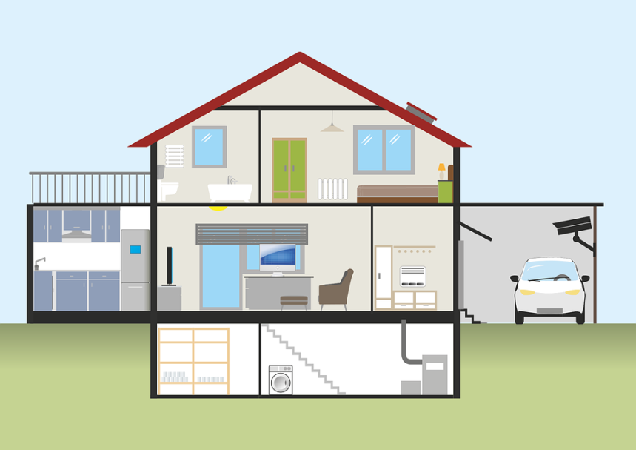
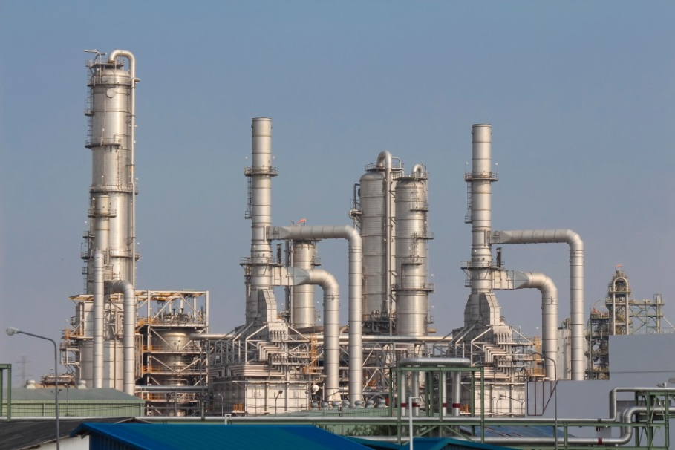
Exercise: structure maintenance objects of a technical device of your choice (bicycle, house or heating, refinery/ steam cracker …)
Pixabay.com
Pixabay.com
Colourbox.de

Slide 5
Strategies of maintenance
Incidence based maintenance (act only if something does not function or breaks down, example: most domestic appliances, refrigerator, vacuum cleaner, mixer …)
(pre)cautionary, preventive, reliability based, periodic maintenance (replacing periodically all parts that could obstruct the function of machine or plant, example: Primary cooling system of nuclear plant)
Predictive maintenance (PdM) condition based maintenance (inspect, measure, calculate, and meter the technical condition of maintenance objects and act accordingly, example: sensors for air pressure in tires, operating hours of tools in automated machines)

Slide 6
Costs of omitted/ neglected maintenance
Costs of
maintenance
Minimal maintenance
(incident-based strategy)
Maximum maintenance (precautionary,
reliability-based strategy
Find examples of cost-types for different maintenance objects!

Slide 7
Internet of Things, Industry 4.0
are pushing
predictive maintenance (PdM)/ condition-based maintenance (CBM):
Detecting the technical condition
becomes a low-cost by-product of automation and digitalization!
(see next two charts)

Slide 8


Game Changer (chart from presentation “4.1 Green IT”):
Production data acquisition with Industry 4.0 (I4.0), Internet of Things (IoT), Internet of Energy
Pixabay.com
Examples of data acquisition within the company through
Automation of machines of all kinds
Robotics
Artificial intelligence
GPS
Smart Metering
Radio chips (RFID)
Etc.
Data processing via In-Memory Databases (IMDB), e.g. SAP HANA
Pixabay.com

Slide 9
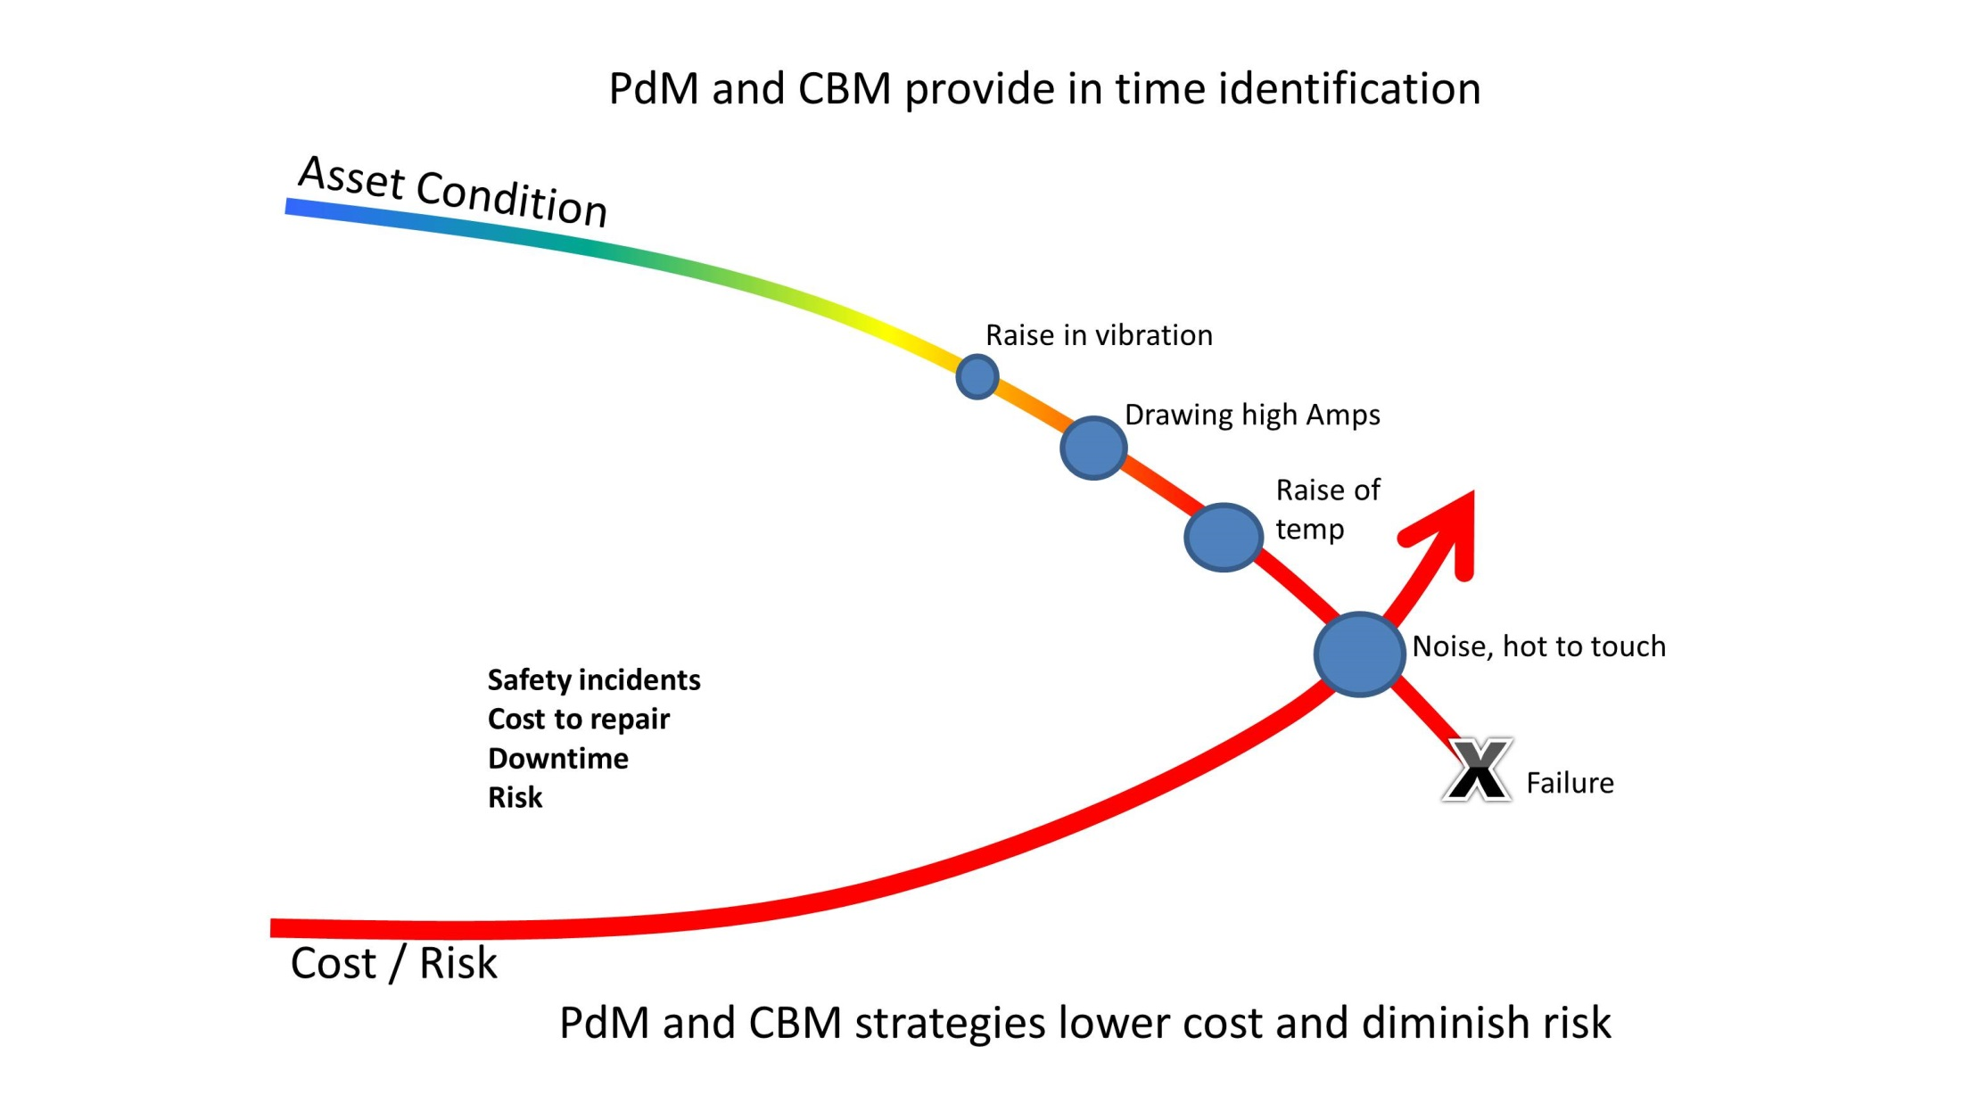
Source: Own drawing in the style of: http://www.assetpoint.com/capabilities/eam-predictive-maintenance-cmms

Slide 10
Which maintenance strategy for which object, with and without digitalization?
Burner in gas heating
Tires (and air pressure, see video)
Revision of large integrated plant (refinery)
Light of bicycle
Coffee machine (household an in café)
Compressor and pipes of compressed air (already discussed in „4.6 production planning“)
IT-infrastructure and date security measures
…

Slide 11
Problem of resilience and redundancy of critical infrastructure IT, energy (blackout), circulation …
Private household
Company
Country
Global village

Slide 12
Exemplary impact of maintenance on energy efficiency and conservation
Facility Management
Burner of heatings
Leak of buildings (lower door test)
Filter of air conditioning and ventilation
Isolation or leaks of energy tubes (warm water, steam, cold water or air, compressed air)
Logistics and transportation
Spark pugs in gasoline cars
Air pressure in tires
Frozen over refrigerators or cool warehouses
Production
Isolation of furnaces and ovens
Low-friction oil
Hydraulics with leaks need more power and pollute
Blunt tools need more power and reduce quality
Maintenance itself and its data logging: meters, data transmission, calibration, etc. (avoiding garbage in, garbage out decision-making)
Source: Kals, Betriebliches Energiemanagement, 2010

Slide 13
Content
Definition and Basic Concepts
Organization

Slide 14
Maintenance is cross-functional and cross-company
User, operator
Internal maintenance
Producer of asset
Sub-(Sub-) … supplier of maintenance services
Authority, third-party certifier (e.g. chimney sweeper)
Other

Slide 15
Maintaining any assets in plants with links machinery and operations needs
work-clearance and thorough preparation.
It may be costly or risky just to shut-off a
Scheduled machine in a workflow
heating, cooling, or ventilation
Means of logistics, forklifts, conveyers, trucks
Etc.
ISO management standards may help to implement procedures

Slide 16
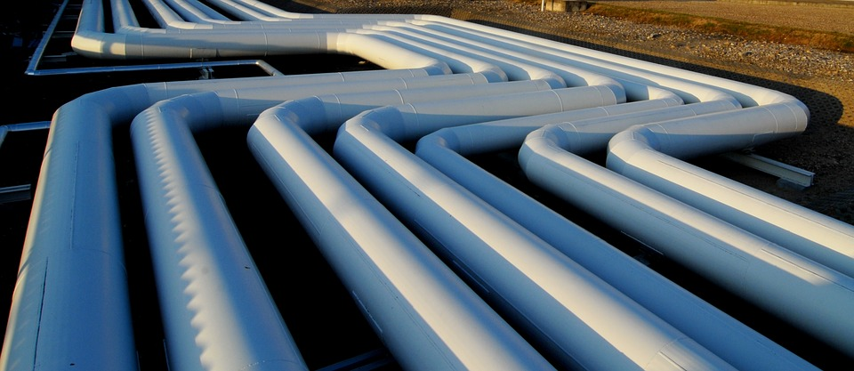
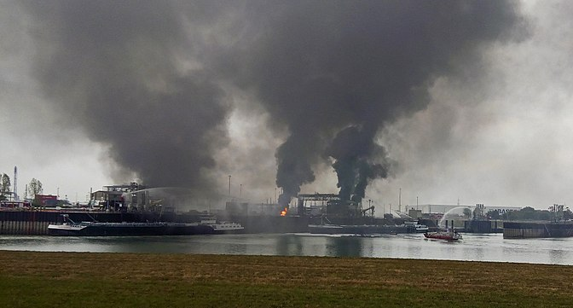
(Chart from “4.2 Facility Management”)
Why is it that important?
Accident BASF 2016,
A subcontractor cuts the wrong pipeline
Pixabay.com
Commons.wikimedia.org
Wikipedia.org

