Slide 1
Energy oriented Business Administration
Prof. Dr. Johannes Kals
4.4 Procurement of Energy
Content
Core Problem and Chances
Comprehensive Electricity Supply
Purchasing Electricity at the Energy Exchange
Intermediate Forms
Electricity and other Forms of Energy

Slide 2
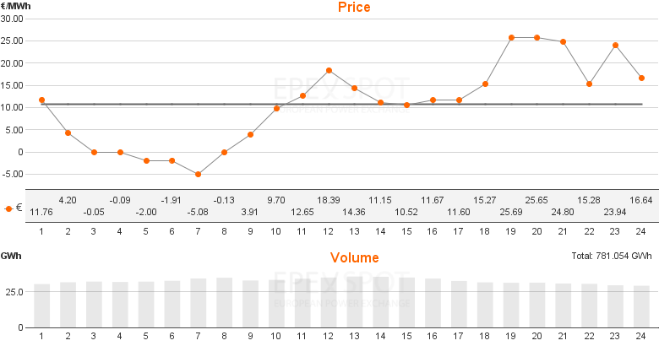
First concentration on electricity as pivotal energy form for the transition:
What are the problems and chances?
Volatility of electricity prices at the European Energy Exchange (EEX) in Leipzig, Germany, exemplary chart to show negative prices.
Source: EPEX Spot SE / Intradaymarkt 09.06 – 10.06.2016
Notes:
Quelle: http://www.epexspot.com/en/market-data/dayaheadauction/chart/auction-chart/2015-03-01/DE, Abruf: 31.01.2017

Slide 3
Ernst-Ulrich von Weizsäcker: Prices have to tell the (ecological) truth, two interpretations:
General: CO₂-tax or fee
(Pigou-tax)
(see Presentation „2.2 Energy Transition“)
Transfer of exchange prices over utility companies to consumers (companies and private). Exchange prices are a signal of scarcity. If they show up as costs in internal accountancy, load management becomes profitable and the power grids may be balanced.

Slide 4
Repeating from presentation “2.3 Digitalization”:
Players in a new energy market
Demand
Trade and transmission
Supply/ Generation
Companies as part of supply chains and value networks
Quantities: Grid managing companies, smart grids, internet of energy
Utility companies with large plants, micro generation of other companies and households as prosumer, energy associations of citizens
Energy project developer etc..
Procurement and selling of energy, load and demand side management, , storage, procurement services, IT-providers
Price and costs: Energy exchange and energy trade
Source: Kals, ISO 50001, 2015, P. 58
Notes:
Source: Kals, Johannes: ISO 50001 Energy Management Systems – What managers need to know about energy and
business administration, New York 2015, P. 58.
Figure 6.3: Actors in new energy related markets
Important players in the new rising markets an their interaction. Nonutility companies act on three sides. First on the demand side, like traditional energy markets.
Second, they appear on supply side as prosumers. Third, they have a chance to balance supply and demand through demand-side management, load management
Or energy load balancing.

Slide 5
Full electricity supply from one utility company (next section 2)
Intermediate forms of electricity procurement (section 4)
Trading at the exchange (section 3)
What does that mean for the procurement of a company?

Slide 6
Companies and even households are growing into their role of prosumers (production and consumer), they are getting the choice between make-or-buy.
Make:
Small and medium size combined heat- and power-plants, photovoltaic modules, energy storage, load management, Power-to-X …
Or Buy:
Energy procurement as explained in this presentation.

Slide 7
Content
Core Problem and Chances
Comprehensive Electricity Supply
Purchasing Electricity at the Energy Exchange
Intermediate Forms
Electricity and other Forms of Energy

Slide 8
End-use customer concludes a contract with a utility company:
Period of validity
Approximate quantity
Price constant at any time of use
Utility company generates the energy themselves (own power plants) or buys at the exchange
At the exchange ideally the physical scarcity in the power grids is reflected balancing demand and supply

Slide 9
Advantages | Disadvantages
Fixed prices over whole duration of contract, no risk of rising costs | Risk to miss sinking prices at the exchange
Easy and established, low purchasing costs | Dependency on one supplier during contract period
No load curve or prediction of demand necessary | No chances of low prices and trading activities at the exchange
 | No financial incentives for load management – prices don´t tell the truth
Notes:
Eigene Darstellung

Slide 10
Content
Core Problem and Chances
Comprehensive Electricity Supply
Purchasing Electricity at the Energy Exchange
Intermediate Forms
Electricity and other Forms of Energy

Slide 11
Measuring the demand:
Load curve and energy consumption
Load in kW or MW
Mathematical integral represents physical work (energy)
Load in kW * time in h = kWh
Time
Notes:
Source: Kals, Johannes: ISO 50001 Energy Management Systems – What managers need to know about energy and
business administration, New York 2015, P.179.
Figure 20.1: Load curve and energy demand.
The figure serves as a graphical presentation of the load over a working day.

Slide 12
Portfolio management in energy procurement
Balance energy, unscheduled power flows (peak load)
Load
in kW
Block contracts
Hour-/block contracts (peak load)
Baseload
Time
Source: Kals, ISO 50001, 2015, P.180
Notes:
Source: Kals, Johannes: ISO 50001 Energy Management Systems – What managers need to know about energy and
business administration, New York 2015, P.180.
Figure 20.2: Portfolio management in energy procurement.
The figure shows different types of procurement methods or contracts available; they are bundled in portfolios (portfolio management).

Slide 13
Load curve or profile, example bakery
Leistung
[kW]
4,0
3,0
2,0
1,0
00:00
06:00
12:00
18:00
00:00
Uhrzeit
Own representation according to the standard load profile of the TU Munich for electricity for the BDEW (Bundesverband der Energie- und Wasserwirtschaft).
Notes:
Quelle: Eigene Darstellung in Anlehnung an die Standardlastprofile der TU München für Strom für den BDEW (Bundesverband der Energie- und Wasserwirtschaft).
Typischer Lastverlauf einer Bäckerei mit eigener Backstube (Lastprofil G5)
Höchste Last in den Morgenstunden während des Backens
Lastabfall über den Tag

Slide 14
Example one shift industrial small business
Leistung
[kW]
4,0
3,0
2,0
1,0
Uhrzeit
00:00
06:00
12:00
18:00
00:00
Own representation according to the standard load profile of the TU Munich for electricity for the BDEW (Bundesverband der Energie- und Wasserwirtschaft).
Notes:
Quelle: Eigene Darstellung in Anlehnung an die Standardlastprofile der TU München für Strom für den BDEW (Bundesverband der Energie- und Wasserwirtschaft).
Typischer Lastverlauf eines Gewerbetreibenden wie z.B.: Friseur (Lastprofil G1)
Höchste Last während den Öffnungszeiten des Betriebs

Slide 15
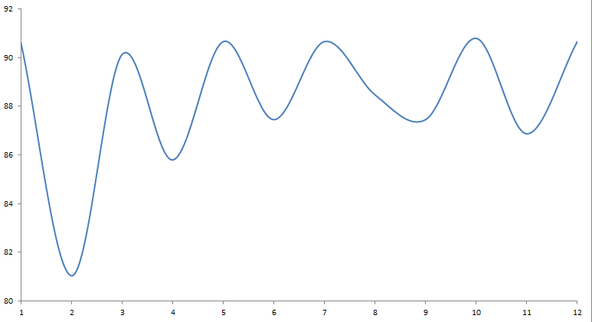
Options of long-term trading
Spot clearing
Short-Position
Spot clearing
Long-Position
Load curve
1 MW
Jul 17
1 MW Oct 17
1 MW May 17
1 MW
Jul 17
1 MW Oct 17
1 MW Mar 17
1 MW May 17
1MW Q3/17
1 MW Sep 17
1 MW Óct 17
1 MW Mar 17
1 MW May 17
1MW Q3/17
1MW Q4/17
1MW Q2/17
1MW Q3/17
1MW Q4/17
1MW Q2/17
1MW Q3/17
1MW Q4/17
1MW Q2/17
1MW Q3/17
1MW Q4/17
1MW Q2/17
1MW Q3/17
1MW Q4/17
1 MW Feb 17
1MW Q2/17
1MW Q3/17
1MW Q4/17
1 MW Year 2017
Jan
Feb
Mar
Apr
May
Jun
Jul
Aug
Sep
Oct
Nov
Dec
= Week
Source: Scheib, Christian: Beschaffungsvarianten für Energie (non-published master thesis)

Slide 16
Trading forms at the EEX
Bilateral power trade (OTC – over the counter – platform). Bilateral contracts between power producer and customer. The EEX just offers the platform for individual bargaining and contracting.
Spot market or day-ahead-market: Physical trade, because typically a day ahead electricity flows. Prices are fixed by the EEX in analogy to the stock exchange. Market participants don´t need to know their trading partners.
Futures: Hedging and speculative trade for long-term electricity. EEX provides transparence. Normally no physical flows, but financial transactions.

Slide 17
Advantage | Disadvantage
Highest transparence of costs, all components are known. „Prices are saying the truth“ and load management is remunerated | Many risks of bad contracts, rising prices, bad speculation
Flexibility and long-term budgeting of energy costs attainable | High know-how and information required, dependency on key specialists
Professionalization of energy trade, benefiting from decreasing costs at the exchange because of the energy transition | High pressure for success, because considerable costs have to be payed-off
Notes:
Eigene Darstellung

Slide 18
Content
Core Problem and Chances
Comprehensive Electricity Supply
Purchasing Electricity at the Energy Exchange
Intermediate Forms
Electricity and other Forms of Energy

Slide 19
First option between standard contract and portfolio management at the exchange:
(Individual) power contract, what has to be considered:
Maximum load: Sum of all electric devices has to flow in – in times of volatility and load management no more reasonable!
Basic price (depending on maximum load)
Demand charge (price per kilowatt-hour consumed). First differentiation high- und low-tariffs (day and night). Smart metering will allow for price fixing in 15-minutes intervals.
Some technical details, e.g. a compensation for idle or reactive currents
Contract duration, price change options, liability, place of jurisdiction etc.

Slide 20
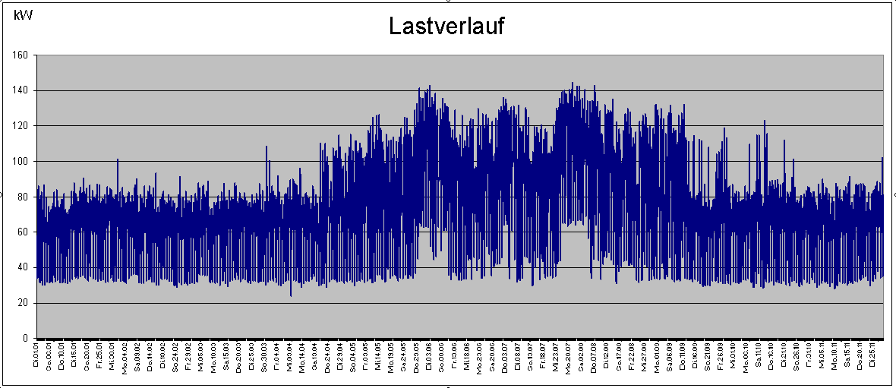
Second option between standard contract and portfolio management at the exchange:
Energy procurement service company, example ENOPLAN
Additional service energy management accounting, analysis of load curve
Irregularities in the night shows that devices are not shut off: identify, adjust, and cut costs – see next chart.
Quelle: Vortrag Enoplan-Geschäftsführer Ralf Schade
Notes:
20

Slide 21
Little check list for load curve analysis conclusions:
  Air conditioning and ventilation – no separation possible
  Air conditioning not shut off in wintertime
  Heating operates in summertime
  Clock timer not existent or not adjusted properly, for machinery, media supply, or lighting
  Light sensors not existent or not operating properly

Slide 22
Content
Core Problem and Chances
Comprehensive Electricity Supply
Purchasing Electricity at the Energy Exchange
Intermediate Forms
Electricity and other Forms of Energy

Slide 23
Energy forms and carriers
Electricity, power
Gas
Heating oil
Diesel and Gasoline
Long-distance heat
Energy services, contracting
Procurement of electricity is most complex, but has to be embedded – see next chart for selected energy forms.
Notes:
Eigene Darstellung
Quelle: Kals, Johannes: Betriebliches Energiemanagement. Eine Einführung, Stuttgart: 2010, S. 113
Energieformen und Energieträger, die Unternehmen als Bezugsenergie benötigen:
Elektrische Energie (z.B. für Licht, Heizung, Prozesswärme oder elektrische Verbraucher in der Produktion)
Gas (Heizung, Prozesswärme)
Öl (Heizung, Produktionsprozesse)
Treibstoffe für den Fuhrpark (Diesel, Benzin)
Fernwärme (Heizung)
Energiedienstleitungen (Wärme, Kälte, Druckluft etc bereitgestellt durch Contracting)

Slide 24
 | Current costs | Future role in energy mix of company | Physical storage | Other options against price hikes | Influence of procurement on CO2-emissions
Electrical energy | See data of cost-type accounting | Depending on energy and technology strategy | Difficult, rechargeable batteries, buffer for compressed air, …. Better options for utility companies. | Futures at the exchange and long-term contracts | Up to 100 Percent
Gas |  |  | Good, gas storage tanks and the grid itself | Exchange trade and long-term contracts | Increasing (e.g. Biogas or Power-to-Gas)
Oil |  |  | Good, tanks | Exchange trade and long-term contracts | Power-to-Liquid, biofuels disputed
Long-distance heating |  |  | Tanks operated by utilities | Depending on contracts | Depending on utility company
Notes:
Quelle: Kals, Johannes: Betriebliches Energiemanagement. Eine Einführung, Stuttgart: 2010, S. 114
Die Tabelle zeigt Einflussfaktoren nach den einzelnen Energieformen, die Unternehmen bedenken sollten, wenn sie Umfang und Art der Energiebeschaffung festlegen wollen.
Grundsätzlich sollten sich Unternehmen darüber bewusst werden, wie aufwändig sie die Energiebeschaffung gestalten wollen. Dies ist auch abhängig von den Einkaufvolumina der einzelnen Unternehmen: Für Unternehmen mit geringeren Volumina kann es ausreichend sein, wenn durch den Einkauf mittel- oder langfristige Verträge mit EVU abgeschlossen werden.
Einsparpotentiale bestehen für jedes Unternehmen dann, wenn zum richtigen Zeitpunkt (also zum günstigsten Preis) der benötigte Energieträger eingekauft werden kann. Dafür müssen die Preise aber längerfristig beobachtet werden, was wiederum mit Aufwand und Expertise verbunden ist.
Bei großen Unternehmen gibt es daher mittlerweile Experten, die die Entwicklungen an den Rohölbörsen und der EEX verfolgen und die Energiebeschaffung als eigenständiges Geschäftsfeld im Unternehmen ansehen.

