Slide 1
Energy oriented Business Administration
Prof. Dr. Johannes Kals
4.3 Logistics
Content
Definition, Tasks, and Importance
Evaluation of Transports and Indicators
Technical Options and Scenarios for the Future

Slide 2
„Six R“ do define logistics
Quantity
Object
Time
Quality
Costs
Place
„The right quantity of the right objects/ materials have to be at the right time at the right place with the right quality meeting the right costs.“
Notes:
Quelle:
Eigene Darstellung in Anlehnung zu Kals, Johannes: Betriebliches Energiemanagement. Eine Einführung. Stuttgart: 2010, S. 94-95.

Slide 3
To meet the requirements of „six R“, many departments contribute to logistics:
Disposition
Purchasing, procurement, sourcing
Operations
Internal Transport
Facility Management
Maintenance
Warehouse
Etc.
Operations scheduling
Marketing and distribution
Import-/ export
Truck and car fleet
Industrial Engineering
IT
Law department
Management Accounting

Slide 4
Tasks of energy oriented logistics
Fields of action | Procedures | Equipment and vehicles
Inbound material management, storage, and transport | Warehouse management, storage, goods received and dispatched, in-plant transport, material handling and commissioning, quality control, maintenance, good housekeeping | Conveyers, forklifts, handling and commissioning equipment, stores and warehouses, receipt and dispatch halls with all infrastructure as heating, cooling, compressed air, pumps, and so forth
Procurement, purchasing, sourcing | Purchase of goods including energy Purchase of logistics services | IT-equipment of offices
Outbound material management or SCM: own vehicle fleet management or logistics provider | Selection of transportation means, route planning, transportation itself, recycling, and reverse logistics | Means of transportation (truck, ships, railway)
Notes:
Source: Kals, Johannes: ISO 50001 Energy Management Systems – What managers need to know about energy and
business administration, New York 2015, P. 188.
Table 23.1 Overview of the tasks of energy-oriented logistics focusing on an industry company

Slide 5
Different levels of understanding
Value creation networks towards a circular economy
Supply-Chain Management (SCM) as cross-company optimization of logistics (next chart)
Logistics defined as „six R“
Logistics branch as carrier, fright forwarder, shipper, haulage contractor

Slide 6
Supply Chain Management
Process-oriented approach to optimize cross-company operations
Original Equipment Manufacturer OEM
Assembled parts/ modules
Wholesale distribution hubs
Raw material
Parts
Retail
Customer, user of product
Own figure according to Schulte, Christof: Logistik: Wege zur Optimierung der Supply Chain, 2008, S. 15.
Material
Information
Notes:
Im Zuge der zunehmenden Digitalisierung, werden auch Logistik und Supply Chain Management komplexer. Die Energiethematik trägt zu dieser Entwicklung erheblich bei (steigende Energiekosten, Energiewende, neue Mobilitätskonzepte, neue Antriebe, mehr Daten und bessere Überwachung aller Prozesse). Darum muss das Supply Chain Management, also das Management der Logistikkette, unternehmensübergreifenden Transport- und Informationsfluss optimieren.
Quelle:
-Eigene Darstellung in Anlehnung zu Schulte, Christof: Logistik: Wege zur Optimierung der Supply Chain, 2008, S. 15.
- Vgl. Kals, Johannes: ISO 50001 Energy Management Systems – What managers need to know about energy and business administration, New York 2015, S. 187.

Slide 7
Logistics focuses on materials including energy and persons
Not capital or information

Slide 8
Energy logistics comprises three fields:
Its part of green logistics ( core idea: improving environmental efficiency of transports)
Energy for logistics: procurement of energy and choice of energy carriers for transportation
Logistics of energy: energy supply chains are becoming more complex through smart grids, prosuming, load management etc.

Slide 9
Green logistics, eco-logistics, energy-efficient logistics is intrinsic, because energy causes costs.
Yet: Conflicts between cost reduction and cutting greenhouse gases are frequent.
Avoiding transportation
Reduction of distance
Example: local sourcing (apple instead of mango)
Choice of means of transportation
Example:
train
better than truck better than plane
Example: video conferencing instead of business trip

Slide 10
External environmental costs of different means of transportation
Means of transport | Environmental costs in Eurocent
Car (diesel) | 4,0 Cent per kilometer per person
Car (gasoline) | 3,1 Cent per kilometer per person
Light truck (diesel) | 16,2 Cent per kilometer per ton
Light truck (gasoline) | 12,1 Cent per kilometer per ton
Heavy truck (diesel) | 2,4 Cent per kilometer per ton
Bus (diesel) | 2,2 Cent per kilometer per person
motorcycle (gasoline, 4-tact) | 3,2 Cent per kilometer per person
Motorcycle (gasoline, 2-tact) | 3,3 Cent per kilometer per person
Passenger train (diesel) | 8,1 Cent per kilometer per person
Passenger train (electric) | 0,8 Cent per kilometer per person
Fright train (diesel) | 3,2 Cent per kilometer per ton
Fright train (electric) | 0,3 Cent per kilometer per ton
Quelle: Umweltbundesamt (2014):
Notes:
Quelle:
Umweltbundesamt (2014): Schätzung der Umweltkosten in den Bereichen Energie und Verkehr, https://www.umweltbundesamt.de/sites/default/files/medien/378/publikationen/hgp_umweltkosten_0.pdf [Webseite, Zugriff 3.12.2016].

Slide 11
Total freight: breakdown of CO₂ emissions according to different means of transport
Own calculation based on data of German Statistical Agency (statistisches Bundesamt) and German Environmental Agency (Umweltbundesamt)
Notes:
Eigene Darstellung
Das statistische Bundesamet erfasst jährlich welches Warenaufkommen transportiert wurde und unterscheidet dieses zusätzlich nach den Transportmitteln. Daraus kann der jährliche Ausstoß der verschiedenen Transportmitteln berechnet werden. Die Grafik verdeutlicht die CO2 Belastungen der Logistikbranche innerhalb Deutschlands.
Eigene Berechnung auf Grundlage der der Zahlen des statistischen Bundesamtes und des Umweltbundesamtes mit folgender Formel berechnet:
CO2 Emission/Jahr = Tonnenkilometer/Jahr x CO2 Emission/Tonnenkilometer
Quellen der Berechnung:
Umweltbundesamt: Daten zum Verkehr. Ausgabe 2012, Bonn 2012
Statistisches Bundesamt: Zahlen und Fakten – Wirtschaftsbereich – Verkehr – Güterverkehr: https://www.destatis.de/DE/ZahlenFakten/Wirtschaftsbereiche/TransportVerkehr/Gueterverkehr/Tabellen/GueterbefoerderungLR.html;jsessionid=910877A0F14FE4BC56C25B76055D58CA.cae1, Abruf 27.01.2017

Slide 12
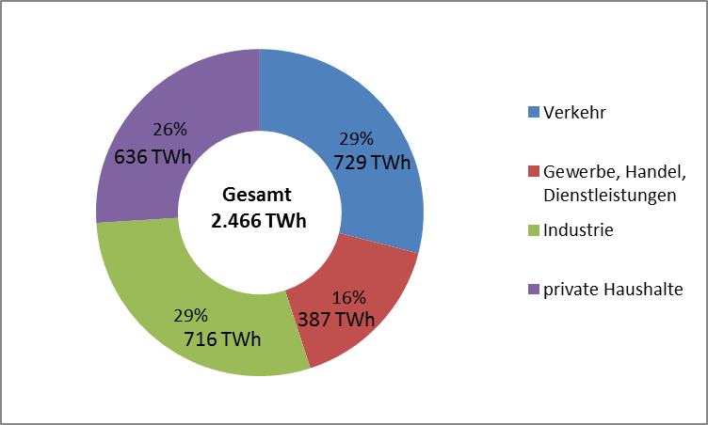
End-use energy according to sectors
29 percent energy consump-tion due to circulation (individual traffic and freight)!
Quelle: Arbeitsgemeinschaft Energiebilanzen e.V.
Notes:
Endenergie ist die Energie, die aus Primärenergieträgern wie z.B. Braunkohlen, Steinkohlen, Erdöl, Erdgas, Wasser oder Wind durch Umwandlung gewonnen wird.

Slide 13
Content
Definition, Tasks, and Importance
Evaluation of Transports and Indicators
Technical Options and Scenarios for the Future

Slide 14
Demonstration
Evaluation of freight transport with
EcoTransIT.de
Application of already known indicators in logistics (energy content/ heating factor, CO₂-coefficient, cumulated energy demand and gray energy …
Also part of energy oriented management accounting.

Slide 15
Evaluation of sample means of transport
- chart may be skipped when having played around with EcoTransIT World
Notes:
Source: EcoTransIT.org
Figure 23.1: Evaluation of sample means of transport.
The figure compares the primary energy consumption in Kwh and carbon emission in tons. The lower shade represent grey energy or carbon, while the upper
Part shows the consumption of transport itself.

Slide 16
Practical example to introduce transport of persons: business trip or video conference
Costs
Energy consumption
CO2-Emissions
Comprehensive evaluation of meeting
Notes:
Das Beispiel soll zeigen, wie hoch die Kosten, der Energieverbrauch und die CO2 Emissionen für ein Meeting von 6 Personen sind, die aus unterschiedlichen Standorten anreisen.
Überlegungen zu Kosteneinsparungen und Reduzierungen des Energieverbrauchs sollen in diesem Zusammenhang diskutiert und dargestellt werden.
Quelle:
Kals, Johannes: Betriebliches Energiemanagement. Eine Einführung. Stuttgart: 2010, S. 103f.

Slide 17
Exemplary calculation
Our company Highestec has sales staff in different cities. The head of the sales department works at the headquarters and calls for a meeting.
Calculate
Travel expenses/ costs,
Energy consumption and
Emissions of carbon dioxide
For six persons with the data on the following charts.
(Based on Kals, Betriebliches Energiemanagement, Stuttgart 2010).
Notes:
Übungsaufgabe Personenlogistik mit Lösung
Quelle:
Kals, Johannes: Betriebliches Energiemanagement. Eine Einführung. Stuttgart: 2010, S. 104-107.

Slide 18
Person | Distance from headquarters in kilometers | Means of transport | Duration of travel
Head of department | 0 | - | -
Staff A | 200 | Diesel car | 4
Staff B | 200 | Gasoline car | 4
Staff C | 200 | train | 4
Staff D | 400 | airplane | 6
Staff E | 5 | Bicycle | 0,5
Notes:
Quelle:
Kals, Johannes: Betriebliches Energiemanagement. Eine Einführung. Stuttgart: 2010, S. 104.

Slide 19
Additional data and assumptions
Airplane→ about 6 liters kerosene per 100 km and person
Train → 10 kWh/km per Person,
German power mix around 0,5 kg CO₂/kWh
Diesel car → 6 l / 100 km
Gasoline car → 7 l / 100 km
Heating factor / energy content of 1 Liter fuel (diesel or gasoline) about 10 kWh
Carbon emission coefficients of energy carriers , see following table from presentation 3.1
Notes:
Personenlogistik
Technische Möglichkeit: Videokonferenzen statt (mehrtägigen) Dienstreisen an einen anderen Standort.
Quelle:
Kals, Johannes: Betriebliches Energiemanagement. Eine Einführung. Stuttgart: 2010, S. 104.

Slide 20
Carbon emission coefficients of energy carriers
Energy carriers | Emissions of carbon dioxide carbon emission factors
Electric energy in kilowatt hours (kWh) | Zero when used. Generation varies considerably: 1.2 kg/kWh for generation with brown coal, 0.02 kg (20 grams) per kWh for wind energy
Heating oil or diesel (liter) (specific weight is 0.820 to 0.860 kg/L) | 2.6 kg carbon dioxide per liter when burned plus gray carbon/ energy
Gasoline (liter) (specific weight 0.720 to 0.775 kg/L) | 2.3 to 2.4 kg carbon dioxide per liter when burned, plus gray carbon/ energy
Kerosene-based jet fuel for airplanes, similar to diesel (liter) | 2.6 kg carbon dioxide per liter plus gray carbon/ energy. When emitted in great height, an additional factor up to 3 necessary (disputed)
Natural gas not compressed (cubic meter) | 1.8 kg carbon dioxide per cubic meter plus gray carbon/ energy
Bioethanol and biodiesel (liter) | Far differing numbers, from 70% savings compared with fossil fuel to negative effects because of deforestation of jungle and monocultures. One tank consumes the corn needed as food for one person for one year.
Compressed natural gas (CNG), liquefied natural gas (LNG), liquefied propane gas (liter) | 2.3 to 2.7 kg carbon dioxide per liter plus gray carbon/ energy
Coal | 2.5 to 3.7 kg carbon dioxide per kg plus gray carbon/ energy
Notes:
Source: Kals, Johannes: ISO 50001 Energy Management Systems – What managers need to know about energy and
business administration, New York 2015, P. 18.
Table 2.1: Carbon emission factors of selected energy carriers.

Slide 21
Solution – costs for transportation and time of staff
Person | Costs of transportation | Costs of time of staff | Sum
Team leader | 0 | 0 | 0
Staff A | 400 km x 0,3 euro/km = 120 euro | 4 h x 50 euro/h = 200 euro | 320 euro
Staff B | 400 km x 0,3 euro/km = 120 euro | 4 h x 50 euro/h= 200 euro | 320 euro
Staff C | Depending on ticket price 120 euro | 4 h x 50 euro/h = 200 euro | 320 euro
Staff D | Depending on ticket price 240 euro | 6 h x 50 euro/h = 300 euro | 540 euro
Staff E | 0 | 25 euro | 25 euro
 |  |  | Total 1.525 euro
Notes:
Zur Vereinfachung werden in dem Beispiel vereinfachte Werte benutzt. Es wird u.a. auf die Erhebung differenzierter Personalstundensätze, Preisschwankungen bei der Buchung von Flug- und Zugfahrten, Energiepreisschwankungen, Kostenerstattungen bei der Nutzung eines privaten PKWs u.ä. Faktoren verzichtet.
Bei den Transportkosten wird von Kosten von 0,30 Euro/km ausgegangen. Die Personenkosten beziehen sich nur auf die Reise (Hin- und Rückreise), nicht auf die Stunden, die für die Besprechung anfallen.
Quelle:
Kals, Johannes: Betriebliches Energiemanagement. Eine Einführung. Stuttgart: 2010, S. 104.

Slide 22
Solution – energy consumption and carbon dioxide emissions
Person | Energy consumption | CO2 emission factor | CO2 emission sum
Head of department | 0 | 0 | 0
Staff A | 4 x 100 km x 6 l/100 km = 24 l | 2,65 kg/l | 63,60 kg
Staff B | 4 x 100 km x 7 l/100 km = 28 l | 2,36 kg/l | 66,08 kg
Staff C | 4 x 100 km x 10 kWh/100 km = 40 kWh | 0,5 kg/kWh | 20 kg
Staff D | 800 km x 6 l/100 km = 48 l | 2,6 kg/l (factor 3 for great height) | 125 to 375 kg
Staff E | 0 | 0 | 0
 |  |  | 275 kg to 525 kg
Notes:
Energieverbrauch schwankt stark je nach genutztem Transportmittel, zurückgelegter Strecke und der Anzahl der Mitreisenden / bzw. der Beladung des Fahrzeugs/des Transportmittels.
Die Angaben zu den spezifischen CO2 Emissionen wurden aus der Tabelle „Umrechnungsfaktoren von Energieträgern zu Kohlendioxidemissionen entnommen.
Quelle:
Kals, Johannes: Betriebliches Energiemanagement. Eine Einführung. Stuttgart: 2010, S. 106.

Slide 23
Video conference:
No travel expenses,
Almost no consumption of energy,
Almost no carbon emissions
Meeting in person:
1.525 euro travel costs,
100 Liter fuel and 40 kWh power,
275 to 525 kg carbon dioxide emissions

Slide 24
Content
Definition, Tasks, and Importance
Evaluation of Transports and Indicators
Technical Options and Scenarios for the Future

Slide 25
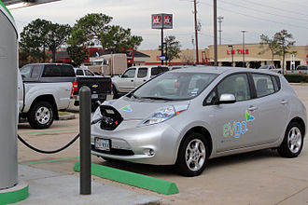
Example electro car (e-car, see additional video)
Will supply of electricity be sufficient given an all-electric car mobility?
Yes!
100 percent electrification of individual traffic needs a maximum of 20 percent of current total power demand. This can be handled. Additional argument: Power-to-Vehicle (P2V), the rechargeable battery of cars may help to balance power grids.
Key word coupling sectors and mobility turnaround
Wikipedia.de

Slide 26
Exercise to sum up: Calculation of a holiday or business trip
(Playing around with coefficients and magnitudes for professional and private use)
Frankfort– Barcelona, outward and return trip, four persons,
Calculation of energy consumption and CO₂-emissions
For combustion car, e-car, railway and airplane
Background data:
Consumption e-car 15 kWh on 100 km (we observe here the high efficiency of electric engines of 60-90 percent in comparison to combustion motors weight 45-45 percent)
Heating factor gasoline or diesel in a rough-cut calculation about 10 kWh per liter
CO₂-emission per liter diesel 2,6 kg (same as kerosene for airplanes)
CO₂-emission per kWh: 20 grams wind power, 500 grams German average, 1,200 grams brown coal. (Deutsche Bahn claims a CO₂₋ neutral voyage for a little fee.)
Modern airplanes need per seat and distance as much as a modern small car, 4 liter on 100 km, disputed factor for CO₂-emissions in great heights up to 3.

Slide 27
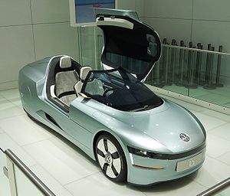
Example: one-liter car
Consumption 0,9 liter diesel per 100 km (36 grams of CO₂ on 100 km)
Maximum speed limited on 160 km/h
Weight 380 kg
Length 3,81 m, width 1,2 m und heights 1,14 m
Hybrid with two cylinder diesel motor with 800 cm³ and an electric drive.
Power 29 kW/39 PS
Acceleration 0-100 km/h in 14,3 sec
Reach 720 km
Wikipedia.de
Notes:
Quelle:
http://www.auto-motor-und-sport.de/einzeltests/vw-xl1-limitierter-supersparwagen-8577142.html, [Webseite, Abruf 02.02.2017]
Bild von Rudolf Simon (2010):Volkswagen L1, CC BY-SA 3.0: https://de.wikipedia.org/wiki/VW_XL1#/media/File:VW_L1.JPG [Webseite, Zugriff 02.12.2016].

Slide 28
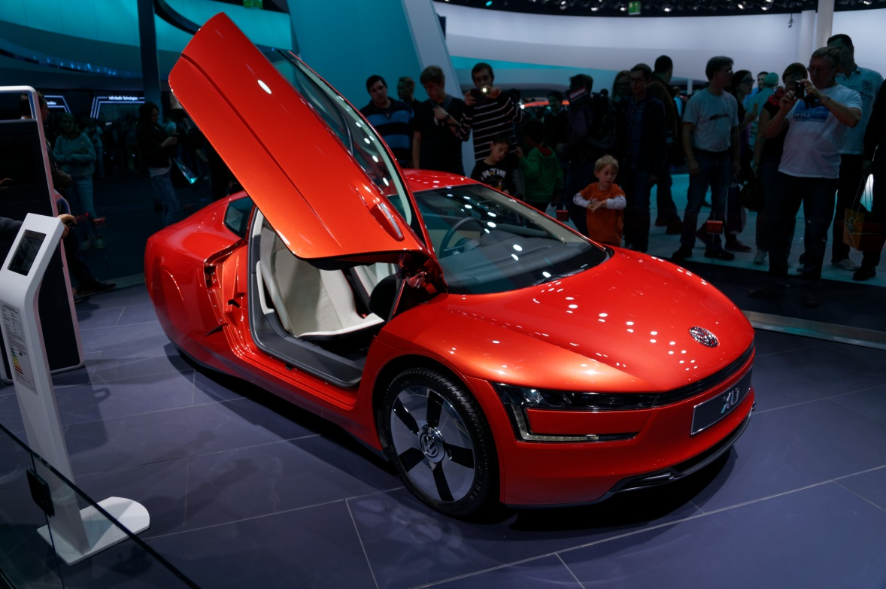
Presentation on IAA in Frankfort in 2009
Predecessor model 2002!
Never built in series
By youkeys (DSC01960_DxO) [CC BY 2.0 (https://creativecommons.org/licenses/by/2.0)], via Wikimedia Commons
„Green propaganda”: It is now 18 years since the VW-boss Ferdinand Piech announced: „After a three-liter car it is the one-liter car!“. 2002 the one-liter car was presented to the public, but it was not to buy … Those who keep asking are told that only 300 are built per year.” Alt, Franz: Grüne Propaganda, VW kündigt das Einliterauto an – mal wieder, in: Publik Forum, Heft 3, 2011, S. 11

Slide 29
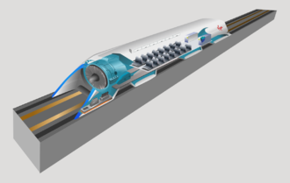
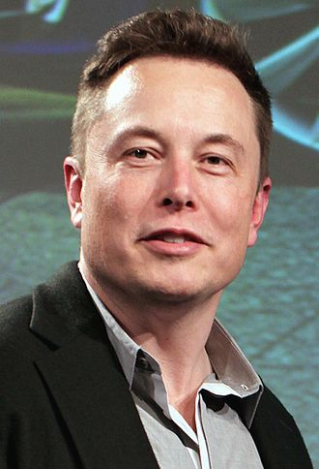
Example Hyperloop:
Sub terrestrial tubes, vacuum, more than 1,000 km/h
A company of Elon Musk (like SpaceX, Tesla, Solarcity)
Wikipedia.de
Wikipedia.de

Slide 30
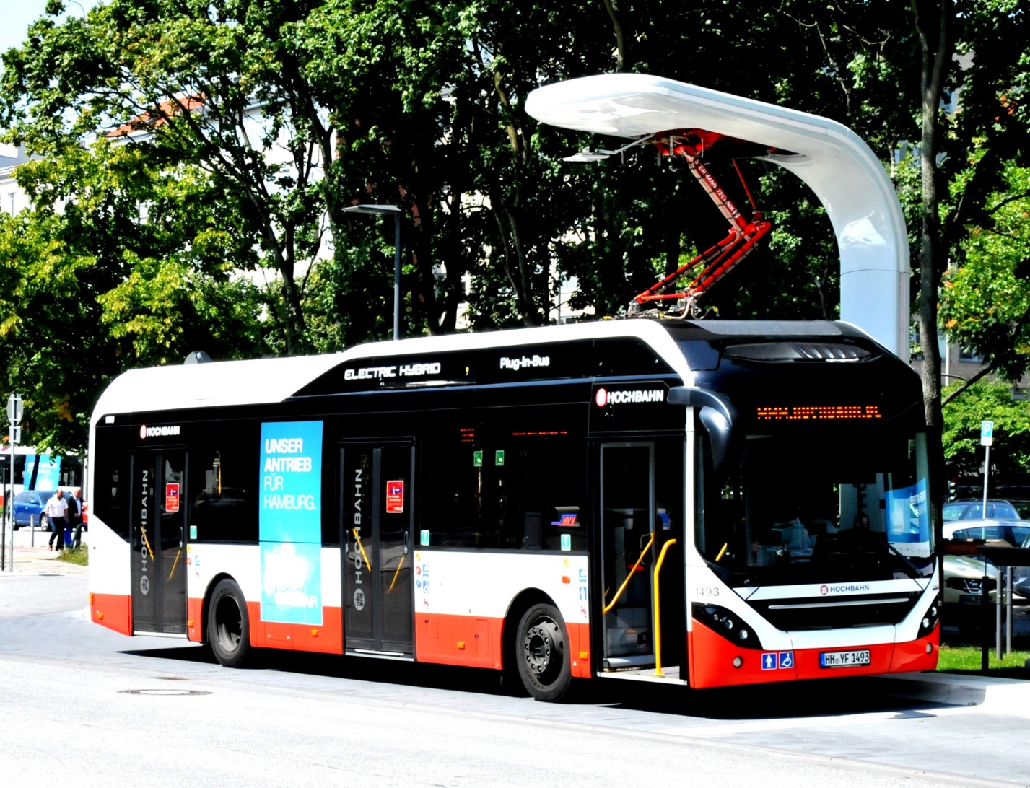
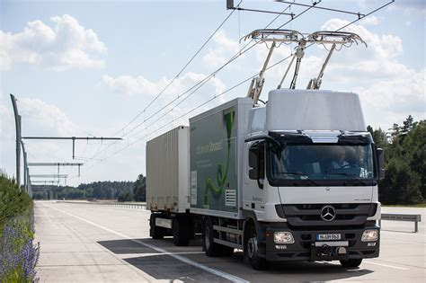
Example: e-mobility of buses or trucks
Siemens.de
Jan Oosterhuis [GFDL (http://www.gnu.org/copyleft/fdl.html) or CC BY-SA 3.0 (https://creativecommons.org/licenses/by-sa/3.0)], via Wikimedia Commons

Slide 31
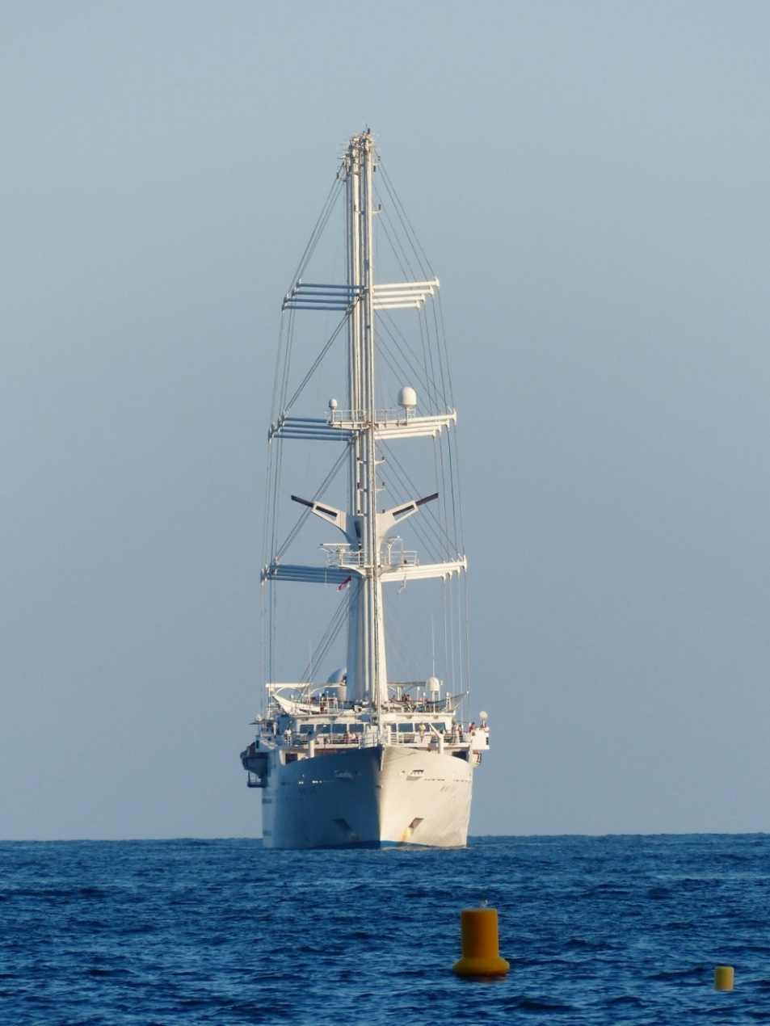

Example: sails for large ships
( instead of „diesel for ships“ which is actually heavy oil, which needs 40 degrees Celsius to allow for pumping and causes strong emissions)
pxhere.com
pxhere.com

Slide 32
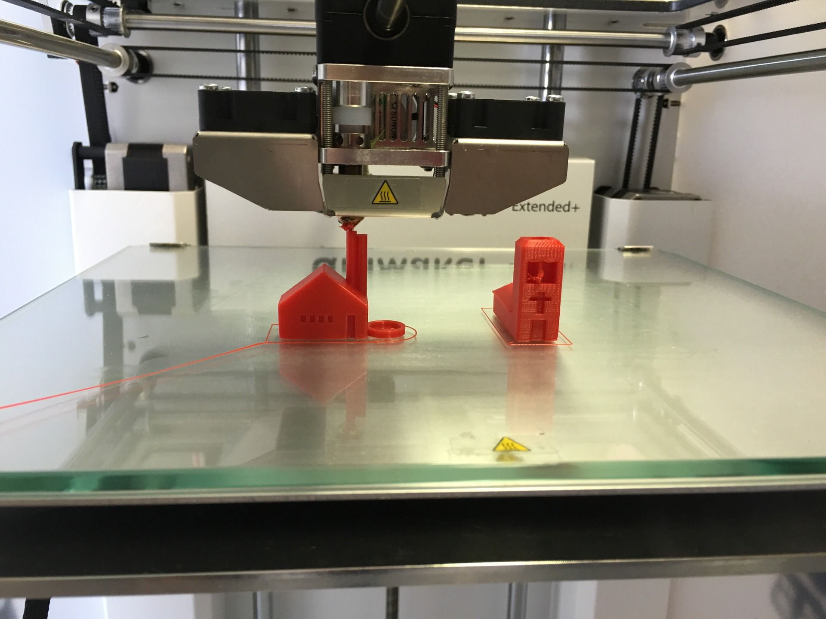

Example: 3-D-Printer
Localization of production, avoiding transports and storage, mass-customization. New chances for industrialized countries with high wages – on the other hand element of digitalization and automation with loss of workplaces.
www.pixabay.com
www.pixabay.com

Slide 33
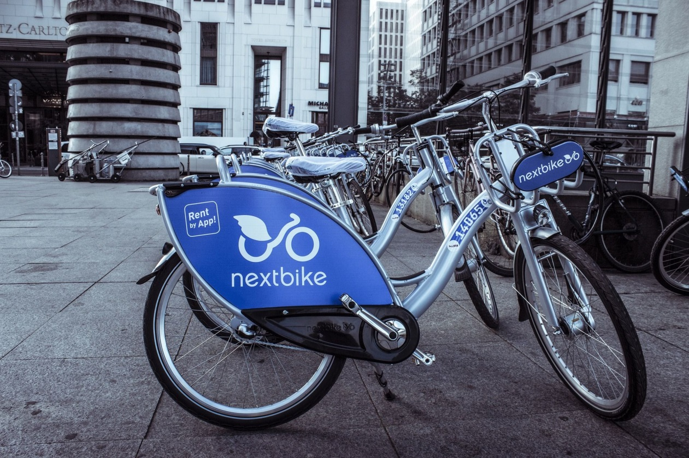
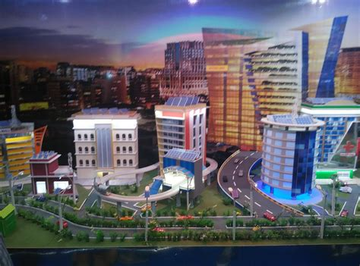
Example: Smart city und sharing economy
Pixabay.com
Wikipedia.de

Slide 34
Critical questions, is it really reasonable:
Plastic toys from the far east as give-away in European fast-food-restaurants ending up as plastic waste in our oceans?
A shopping weekend trip to New York?
Online-shops, small trucks jamming cities and causing heaps of packaging waste?
Table pepper mill, battery driven and with integrated light?
20.000-km T-shirt?

Slide 35
Key words indicating future developments
Post-growth economy (Nico Paech), de-growth
Zero marginal cost economy (Jeremy Rifkin)
De-materialization
Glocalisation
Resilience and subsistence

Slide 36
Styles of thinking, basic approaches, and scenarios of our future
Efficiency and growth (conventional)
Subsistence (existence and survival)
Sufficiency and de-growth
Efficiency and growth (climate-neutral)

Slide 37
Literaturquellen
Alt, Franz:
Grüne Propaganda, VW kündigt das Einliterauto an – mal wieder, in: Publik Forum, Heft 3, 2011.
Arnolds, Heege, Röh, Tussing:
Materialwirtschaft und Einkauf: Grundlagen – Spezialthemen – Übungen, 13. Auflage, Wiesbaden 2016
Bloech, Bogaschwesky, Buscher, Daub, Götze, Roland:
Einführung in die Produktion, 7. Auflage, Berlin Heidelberg 2014
Kals, Johannes:
Betriebliches Energiemanagement. Eine Einführung. Stuttgart: 2010.
Kals, Johannes:
ISO 50001 Energy Management Systems – What managers need to know about energy and business administration, New York 2015.

Slide 38
Klug, Florian:
Logistikmanagement in der Automobilindustrie: Grundlagen der Logistik im Automobilbau. Berlin/Heidelberg: 2010, S. 299.
Schulte, Christof:
Logistik: Wege zur Optimierung der Supply Chain, letzte Auflage
Stieglitz A.:
Erfolgsfaktoren von eProcurement-Tools in der Beschaffung, in: Merkel, H./Bjelicic, B. (Hrsg.): Logistik und Verkehrswirtschaft im Wandel, Festschrift für G.B. Ihde, München, 2003.
Wafi, Ricardo:
Energiemanagement im Rahmen einer nachhaltigen Unternehmensführung - Sensibilisierung durch die Entwicklung von Weiterbildungen für Entscheider (Masterarbeit), Bensheim/Ludwigshafen: 2016.
Wirtz, B.W./Eckert, U.:
Elecronic Procurement. Einflüsse und Implikationen auf die Oragnisation der Beschaffung, 2001.
Wannenwetsch, Helmut:
Integrierte Materialwirtschaft und Logistik: Beschaffung, Logistik, Materialwirtschaft und Produktion, 4. Auflage, Heidelberg 2010

Slide 39
Internet
Bild von RudolfSimon (2010):
Volkswagen L1, CC BY-SA 3.0: https://de.wikipedia.org/wiki/VW_XL1#/media/File:VW_L1.JPG [Webseite, Zugriff 02.12.2016].
Colourbox:
www.colourbox.de
EcoTransIT (2016):
Berechnungsparameter, http://www.ecotransit.org/calculation.de.html# [Webseite, Zugriff 02.12.2016].
Google Maps:
https://www.google.de/maps

Slide 40
Rodt, Stefan; u.a.:
Umweltbundesamt (2010): CO2-Emissionsminderung im Verkehr in Deutschland. Mögliche Maßnahmen und ihre Minderungspotenziale. Ein Sachstandsbericht des Umweltbundesamtes, https://www.umweltbundesamt.de/sites/default/files/medien/461/publikationen/3773.pdf [Webseite, Zugriff 02.02.2016].
Umweltbundesamt (2014):
Schätzung der Umweltkosten in den Bereichen Energie und Verkehr, https://www.umweltbundesamt.de/sites/default/files/medien/378/publikationen/hgp_umweltkosten_0.pdf [Webseite, Zugriff 3.12.2016].
Auto Motor und Sport (2014):
http://www.auto-motor-und-sport.de/einzeltests/vw-xl1-limitierter-supersparwagen-8577142.html [Webseite, Zugriff 02.02.2017]

