Slide 1
Energy Oriented Business Administration Prof. Dr. Johannes Kals 4.1 Green IT
Content
Green IT (narrow definition)
IT as an enabler

Slide 2
(Green) IT
IT as an enabler
Narrow definition– sustainable hard- (and soft-)ware
Notes:
Source: Kals, Johannes: ISO 50001 Energy management systems - What managers need to know about energy and business administration, New York 2015, p. 213 – 215
Energy-related IT can be seen in two different ways, which are presented in the following.
In the narrower sense, it is about the environment and resource-saving design of information technology, its handling in the company and its disposal. Green IT in the context of operation means the use of energy efficient devices.
In a broader sense, IT - also in the context of the increasing digitization, the increasing possibilities which technologies offer today and in the future and the data generated thereby - is an enabler (ie a pioneer) for future developments and possibilities. What kind of developments and possibilities exist, is presented in this presentation.

Slide 3
Green IT (narrow definition): sustainable hard- (and soft)ware Following the life-cycle of a device:
Production
Waste disposal
Operation

Slide 4
Production – example
1,6 kg fossil fuels
72 g chemicals
32 l water
Computerchip (Weight 2 grams, size 1.2 cm²)
Notes:
Cf. http://www.heise.de/tp/artikel/13/13565/1.html, Access 08.09.2016
Source: Kals, Johannes: ISO 50001 Energy Management Systems – What managers need to know about energy and business administration, New York 2015, p. 213
These numbers make it clear that only a fraction of the resources used actually end up at the end where the chip is used.
The high energy consumption is generated by the production of semiconductors, which go through up to 400 process steps and sometimes require highly toxic chemicals. The chips are made of silicon, which are manufactured in special factories under clean room atmosphere. For this alone, a lot of energy is needed, which if calculated down to a single chip, is up to 60% of the total energy consumption of a produced computer chip. Another 35% of the used energy is required by the equipment, needed for the production of the chip.

Slide 5
Production – example
240 kg fossil fuels
22 kg chemicals
72 l water
PC with a monitor
5300 kWh power
Notes:
Source: Kals, Johannes: Betriebliches Energiemanagement: Eine Einführung, Stuttgart 2010, p. 148
Here is an another example for the production of a PC with monitor and the associated consumption of raw materials.

Slide 6
Production - summary
Currently no ecological production
Elaborate production of many IT components (batteries, chips etc.)
Production requires almost 50 percent of lifecycle energy consumption
First initiatives show the possibilities (Fairphones, The Fair Mouse)
Notes:
Own Representation
Measured in terms of the total energy consumption of a memory chip or a computer (from production to disposal), about 50% of the required energy relates to the production and only 27-30% to the utilization. The ecological advantage is reduced to the utilization, unfortunately, there is currently no ecological production. Many components of a computer or an IT device are expensive to produce, because many resource-intensive parts are installed/built-in (for example: LI-Ion batteries, aluminium parts in laptops). In 2016, the research project "DIMENSION" was started at the TU Dresden, which researches problems in the field of silicon photonics. The aim is to reduce the use of resources in the production of semiconductor chips. (http://www.et.tu-dresden.de/etit/index.php?id=889, Call-off 01.02.2017)
In the meantime, there are now several initial initiatives, but only few, more for private use, poorly transferable to companies.
In the field of smartphones, the company “Fairphone” offers devices designed with sustainable production, use and recycling. This is ensured by a transparent company culture and long-lasting smartphones from fair production. (https://www.fairphone.com/de/, Call-off 01.02.2017), (https://www.heise.de/ct/artikel/Fairphone-2-Das-Smartphone-fuers-gute-Gewissen-3043164.html, Call-off 01.02.2017)
The Swiss company "why!" Offers sustainable PCs, laptops and tablets with a similar business concept as "Fairphone". (http://greenbyte.ch/14536/der-nachhaltige-schweizer-pc/, Call-off 01.02.2017), (https://whyopencomputing.ch/de/44-tablet, Call-off 01.02.2017)

Slide 7
Operations
Operation of energy efficient devices
Active energy-saving
Reduction of energy consumption
Create awareness for:
Switching off computers, monitors, printers, etc.
Avoiding stand-by operation of the equipment overnight
Notes:
Own Representation
Source: Kals, Johannes: Betriebliches Energiemanagement: Eine Einführung, Stuttgart 2010, p. 149 ff.
When talking about operation, power consumption is in the foreground. Electricity is converted into heat, which is lost in computers → Energy-savings potential
Green IT, in the context of operation, means the use of (more) energy-efficient devices.
But however, also increasing of the awareness for an active energy-saving, such targeted turning off computers, removing them from the grid, turning off monitors, and avoiding overnight stand by operation of the devices, can lower significantly the energy consumption and the related CO2 emissions.

Slide 8
Green IT and operation:
Use of energy-efficient equipment/devices
Awarding for energy-efficient office equipment; Manufacturers must comply with specific energy efficiency criteria
Computers have to be up to 25-40 percent more energy efficient than the Energy Star Label requirements
Labeling of exceedingly energy-efficient devices with requirements of the Energy Star
Consideration (in addition to social and environmental aspects) of the energy efficiency criteria; Criteria of Energy Star must be proven by the test laboratory
TCO
certified
Notes:
Own Representation
Source: Federal Agency for Energy Efficiency, www.bfee.de
These are the following 4 Energy Labels for IT, that set the energy efficiency criteria for computers: Energy Star, The Blue Angel, EU Ecolabel, or TCO Certified.
http://www.bfee-online.de/bfee/informationsangebote/publikationen/energieeffiziente_produkte/energielabels_computer.pdf (Access 12.09.2016)
The Energy Star is a sign/mark for energy-efficient office equipment, for which a company can voluntarily apply for. In order to receive the label, the manufacturer must make a commitment to comply with the energy efficiency criteria. The criteria are the efficiency of power supplies, efficiency and performance requirements, power management features, and user information requirements.
The EU Ecolabel was introduced as a voluntary sign to help consumers choose environmentally friendly products. The presented energy efficiency criteria are part of the verified environmental criteria. To maintain the label, desktop computers (except thin clients) must demonstrate 25% to 40% more energy efficiency than Energy Star requirements.
Among other things, the Blue Angel, for which companies can also voluntarily for, has the claim of identifying exceedingly energy-efficient devices. To preserve the label, a workplace computer(desktop computer, an integrated desktop computer, workstations, thin clients) must meet specified power consumption requirements, power supply efficiency, and other requirements of the Energy Star.
In addition to social and environmental aspects, the TCO label also considers criteria for energy efficiency. In order to receive this label, the product must, among other things, prove the fulfillment of the respective Energy Star criteria in an independent test laboratory.
Further publications and downloads on the subject below:
http://www.bfee-online.de/bfee/informationsangebote/publikationen/energieeffiziente_produkte/index.html
https://www.umweltbundesamt.de/umwelttipps-fuer-den-alltag/siegelkunde
Source of the photos/logos:
https://www.energystar.gov/
http://www.eu-ecolabel.de/
https://www.blauer-engel.de/de
http://tcodevelopment.com/

Slide 9
Operations
Cloud computing and company data centers: Savings and cost reduction potential through
Optimization of the air conditioning
Procurement of energy efficient appliances/devices
Improving of the server utilization
Reduction of data and applications
Notes:
Source: Kals, Johannes: Betriebliches Energiemanagement: Eine Einführung, Stuttgart 2010, p. 150
The main power consumers in the IT sector are data centers: a lot of servers in a smallroom, high energy consumption, immense waste heat→ cooling demand. In addition to cooling, the biggest challenge for green IT is to optimize energy consumption and energy losses. Another problem is the low average utilization of the computers of only 10-20%. An idea could be the use of data centers as energy suppliers for district heating (heat utilization).
The German Energy Agency (dena) summarizes the energy saving and cost reduction potential for data centers:
Reduction of data and applications (savings potential 5% of the total energy costs)
Optimization of the air conditioning (20%)
Procurement of energy efficient appliances/devices (25%)
Improving of the server utilization (35%)

Slide 10
Waste disposal and Recycling
Challenge → rapid aging of the IT equipment, because of:
Short usage times due to tax depreciation or lease / contract periods
Lack of compatibility of new software with old devices
Technological progress and production of more efficient, smaller, faster devices
Planned wear, Planned Obsolescence
Notes:
Own Representation
Source: Kals, Johannes: Betriebliches Energiemanagement: Eine Einführung, Stuttgart 2010, p. 153
The disposal of electrical appliances/devices can be done in two ways: either thoughtlessly, with the consequence that waste equipment ends up in landfills in Africa, where it is stored under precarious conditions for humans and the environment, and is taken apart there by hand, in order to sell individual parts of it or raw materials. Or a strive for a sustainable disposal of the equipment can be considered by withdrawals, etc. Enterprises have the power to influence this strive by finding out about the paths/ways/routes of their waste equipment and by hiring recycling companies that work sustainably or who already procure devices that can be recycled right from the start. However, this again depends on the production of the devices.
Challenge: The slide summarizes some aspects, but there are, of course, more of them.
The relationships are as follows: IT and devices are subject to faster aging; Technological progresses bring consistently smaller, faster and more efficient devices to the market;
New software will eventually not support old devices (such as printers, scanners, fax machines etc); These devices are then replaced at some point, because cost-benefit ratio is no longer valid.
Utilization time of PC 4-5 years; utilization time of laptops 3 years; utilization time of smartphones or until a contract renewal (usually after 2 years) and a possibility to get a(the) new(est) smartphone; tax depreciation of IT equipment over 3 years; etc.
Result: increase in the mass of electronic waste

Slide 11
Waste disposal
Result of digitalization→ Increase of electronic waste all over the world
Best option: recycling
Recycling of parts of electronic devices, high technological standards needed to avoid ecological damage or harmful exposure for working people
Waste disposal
Most of the IT equipment is being disposed or recycled in developing counties with low environmental and safety standards
Export ban on electronic waste
Re-use of individual components or whole devices
Due to rising raw material prices recycling could be more rewarding in the future
Manufacturers are obligated to withdrawal/recall (EU directive)
There, they come to scrap yards, where they are stored and disposed, under precarious circumstances for the people and the environment (see the following slide)
BUT: many devices are illegally declared abroad as used equipment
Cost-effectiveness of recycling currently not always rewarding
Notes:
Source: Kals, Johannes: Betriebliches Energiemanagement: Eine Einführung, Stuttgart 2010, p. 153
Result: Increase of the electronic waste
The recycling of electronic waste is not yet worthwhile, because valuable parts of a given device/equipment can not be easily removed and reused. Recycling is partly an environmentally damaging process, because it requires a lot of energy and resources to solve valuable components. In Germany, there are specialized companies, that assume the recycling of electronic waste.
In the meantime, EC directives limit the use of environmentally damaging materials in IT equipment. Prohibition of certain pollutants and obligation of all IT equipment manufacturers, who want to sell in Germany, to a withdrawal/recall/redemption and disposal or recycling of old equipment.
There is actually an export ban on electronic waste, but it can be circumvented quite simple by hiring external subcontractors and declaration of the electronic waste as used equipment.
Impact worldwide: in some countries, there is an industry for the disposal of electronic equipment, in the meantime, but there are neither environmental or occupational safety nor social standards. Toxins and greenhouse gases are emitted into the environment and people work without protection with these toxins → Pushing the problem to the poorer states

Slide 12
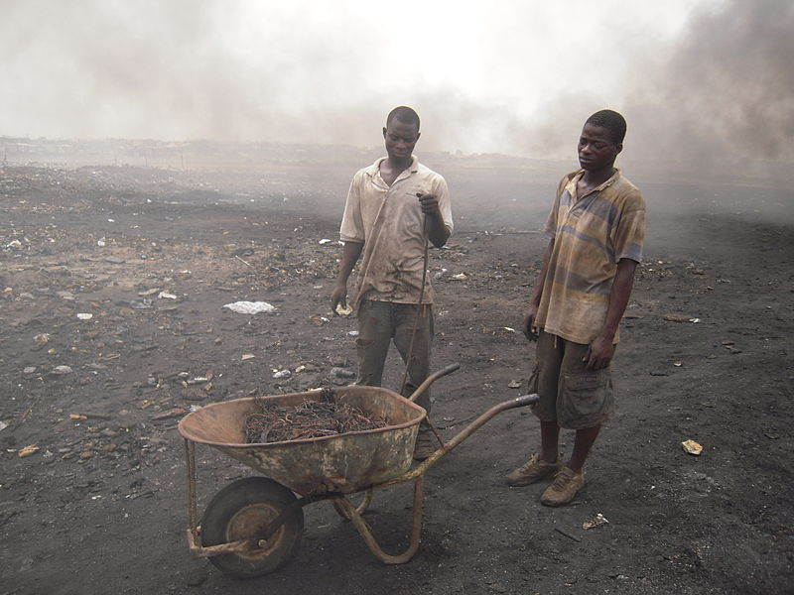
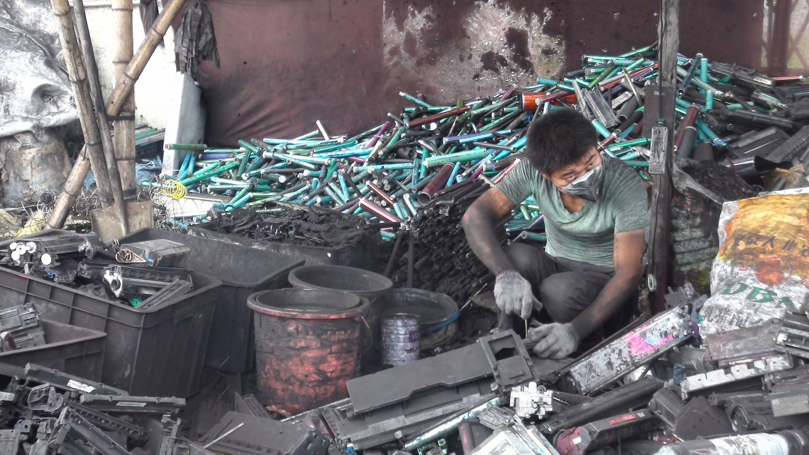
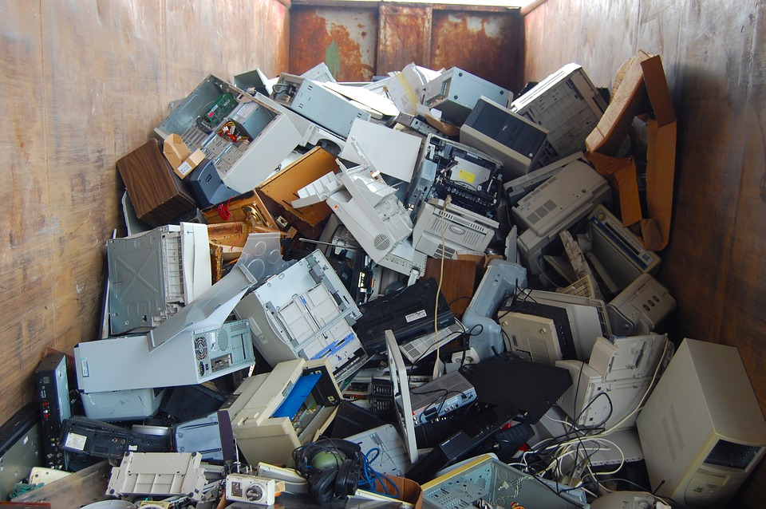
By Jcaravanos (Own work) [CC BY-SA 4.0 (https://creativecommons.org/licenses/by-sa/4.0)], via Wikimedia Commons
Baselactionnetwork, https://www.flickr.com/photos/basel-action-network/9260717589 (CC BY-ND 2.0), via Flickr.com
Pixabay.com

Slide 13
(Green) IT
IT as an enabler
Narrow definition – sustainable hard- (and soft-)ware
Notes:
Source: Kals, Johannes: ISO 50001 Energy management systems - What managers need to know about energy and business administration, New York 2015, p. 213 – 215
Energy-related IT can be seen in two different ways, which are presented in the following.
In the narrower sense, it is about the environment and resource-saving design of information technology, its handling in the company and its disposal. Green IT in the context of operation means the use of energy efficient devices.
In a broader sense, IT - also in the context of the increasing digitization, the increasing possibilities which technologies offer today and in the future and the data generated thereby - is an enabler (ie a pioneer) for future developments and possibilities. What kind of developments and possibilities exist, is presented in this presentation.

Slide 14
Stand-alone solutions (e.g. Excel)
Cross-functional software such as ERP systems
Business Intelli-gence with Data Ware-houses and On-Line Analytic Processing (OLAP)
In-Memory Databases (IMDB), Big Data, "Internet of Things"
Cloud computing, mobile computing, ubiquitous computing, ambient intelligence
?
Notes:
Own representation basen od Kals, Johannes: ISO 50001 Energy management Systems, What managers need to know about energy and business administration, New York 2015, p. 70
Below is an explanation of the specific IT options:
They are classified according to the solutions shown here, which are explained in the following slides. This illustration also serves as a structure.

Slide 15
Stand-alone solutions
Independent of other applications and implementations
Inexpensive, fast and easy to create
Cross-functional or – application problems are complicated to handle
Derived figures are not comparable
Integration of data via interfaces is possible, but causes additional effort
Dependence on experts, who have developed the software
Notes:
Source: Kals, Johannes: ISO 50001 Energy management Systems, What managers need to know about energy and business administration, New York 2015, p. 69/70
Let's start with the stand-alone solutions, here is a subjective assessment in terms of existing IT solutions.
The stand-alone solution, for example, for collection and analysis of data with Excel offers advantages and disadvantages, which are described here on the slide.
Just a few years ago, there were tendencies to suspect that these stand-alone solutions are on the decline and will gradually become extinct. In fact, they are still an important part of the corporate practice. For example, even today, Excel-based energy controlling solutions are developed and programmed in large companies. The advantage is that within a relatively short period of 3-6 months, one person can create an application that will then be applied to companies. It stands independent of other applications and is initially inexpensive and fast/easy to create.
But in business practice there are also difficulties, as shown on the slide.
In the end, however, these stand-alone solutions are no longer the latest “update of the things”, the technological development shows other solutions, see next slide.

Slide 16
Seemingly, the disadvantages of stand-alone solutions are striking – but many large companies still implement such programs. Sometimes with the help of students writing their theses.
Sometimes:
Better quick (and dirty?) solution, than
much planning,
applying for budgets,
coordination and involvement of other departments,
bureaucracy,
time gone by.

Slide 17
IT Solutions
Stand-alone solutions (e.g. Excel)
Cross-functional software such as ERP systems
Business Intelli-gence with Data Ware-houses and On-Line Analytic Processing (OLAP)
In-Memory Databases (IMDB), Big Data, "Internet of Things"
Cloud computing, mobile computing, ubiquitous computing, ambient intelligence
?
Notes:
Own representation based on Kals, Johannes: ISO 50001 Energy management Systems, What managers need to know about energy and business administration, New York 2015, p. 70
Let us now talk about the cross-functional software such as the ERP systems.

Slide 18
Enterprise-Resource-Planning End-to-End (E2E)
Procurement
Maintenance
Distribution
Accountancy/Accounting
Human Resources
Production
ERP
Shared database
Notes:
Own representation
Here is shown the End-to-End solution: The operational functions (this is only a selection, which coud be extended arbitrarily) access the ERP system. Each and every one of the shown operational function departments let their data flow in the ERP system and can use/see data from other functional departments of the company. That means, there is a shared in-house database, that everyone uses. Important in this context, however, is that the generated data in one functional area is also being in use of the other departments, which means, that the individual deparments must also know which data and information, e.g. are relevant to the business or production planning, so that the common database can be used effectively and every department can benefit from it.

Slide 19
Graphical representation of numbers in a management cockpit or dashboard
https://www.flickr.com/photos/colalife/26786790491, Access 09.12.2016
Notes:
Source: https://www.flickr.com/photos/colalife/26786790491, Access 09.12.2016
This illustration shows, what is possible with a common/shared database. The data from the database is linked together and graphically processed, so key figures (KPI or EnPIs) can be displayed, e.g. energy consumption data, costs or data for the water use. It is an instrument for monitoring and controlling, but also for managing the current development of the key performance indicators and their achievement. An integrated planning is possible.

Slide 20
IT Solutions
Stand-alone solutions (e.g. Excel)
Cross-functional software such as ERP systems
Business Intelli-gence with Data Ware-houses and On-Line Analytic Processing (OLAP)
In-Memory Databases (IMDB), Big Data, "Internet of Things"
Cloud computing, mobile computing, ubiquitous computing, ambient intelligence
?
Notes:
Own representation basen on Kals, Johannes: ISO 50001 Energy management Systems, What managers need to know about energy and business administration, New York 2015, p. 70
Now we are taking it to the next level: Business Intelligence with data warehouses and Online Analytic Processing (OLAP).

Slide 21
Established production data acquisition
Recorded Exemplary Data | Measurement Tool / Method | Processing / Evaluation
Examples of general data
Order-related: Start of processing on a machine | Worker scans the bar code on the order documents | Work preparation for production control
Machine-related: Operating hours | Automatic detection/capture for computer-operated machines | Maintenance to observance the servicing intervals
Employee-related: Clock-in and -out | Time-recording system | Human resources department for the working time account
Material-related: Storage of an article | Radio Frequency Identification Device (RFID, Funk-Chips) | Warehousing for updating/refreshing the stocks
Energy data acquisition
Electrical power | Electricity meter | Procurement or own power plants for load management. All data is relevant for cost accounting.
Gas | Gas meter | Gas supplier for invoicing
Heating oil | Recalculation of the tank capacity | Procurement
Fuel at company petrol stations | Volume readout in the pump | Procurement, users/drivers of the vehicle
Grid-bound end-/final-energy such as steam, cold, compressed air, hot water, warm water produced in the company | Volume readout/Flow meters | Business producers or users of the energy
Notes:
The measurement of energy related data places demands on companies, which exceed the conventional production data acquisition.
„Instead of the working time of employees or the operating hours of the production machines, it is important to document the energy consumption of various energy carriers with different states of aggregation. Numerous measurment tools / methods are used in companies for this, as shown in the table above .“ (Krück p. 35)
Source:
-Representation of Kals, Johannes: Betriebliches Energiemanagement - Eine Einführung, Stuttgart 2010, p. 52.
-Cf. Krück, Dennis: Betriebswirtschaftslehre und Energie – Unterstützung für Veröffentlichungen und Projekte des betreuenden Professors im Bereich Energiecontrolling (Master Thesis), Heidelberg/Ludwigshafen 2015, p. 35.

Slide 22
Building up Data Warehouses to allow for Online analytic processing (OLAP-) cubes
Costs, Energy,
CO₂
Assets: from the hall to the components of a machine
Product, Components Cost units
Notes:
Source: Kals, Johannes: ISO 50001 Energy management Systems, What managers need to know about energy and business administration, New York 2015, p. 143
The figure illustrates an OLAP Cube. An OLAP Cube is a data cube, with whose assistance/help data is can be illustrated in 3D. The data can be chosen arbitrarily, in our example, we have the quantity on the X-axis, the costs on the Y-Axis and a product, a machine or a customer on the Z-axis. In most of the cases, the Z-axis represents period/time. It depends on the context, in which you want to analyze the data and explain with the help of the cube.
This example is about the relationship between the amount of a production factor (for example, energy consumption, CO2 emissions) that is related to the cost and the product. It covers the cost of manufacturing a specific product or process and includes the amount of energy required for the production process or the carbon footprint. The OLAP cube offers the possibility to navigate within its boundaries, e.g. reduce costs, increase quantities etc. Various statements can be made, e.g. at which point in time, which product was produced on which machine with which production speed, at what cost with which energy consumption or CO2 emissions. An analytical tool with which multidimensional data can be analyzed.

Slide 23
IT Solutions
Stand-alone solutions (e.g. Excel)
Cross-functional software such as ERP systems
Business Intelli-gence with Data Ware-houses and On-Line Analytic Processing (OLAP)
In-Memory Databases (IMDB), Big Data, "Internet of Things"
Cloud computing, mobile computing, ubiquitous computing, ambient intelligence
?
Notes:
Own representation based on Kals, Johannes: ISO 50001 Energy management Systems, What managers need to know about energy and business administration, New York 2015, p. 70
Now follows the field of In-memory Databases (IMDB), Big Data and Internet of Things / Internet of Things. These are buzzwords that are often heard and confronted nowadays.

Slide 24
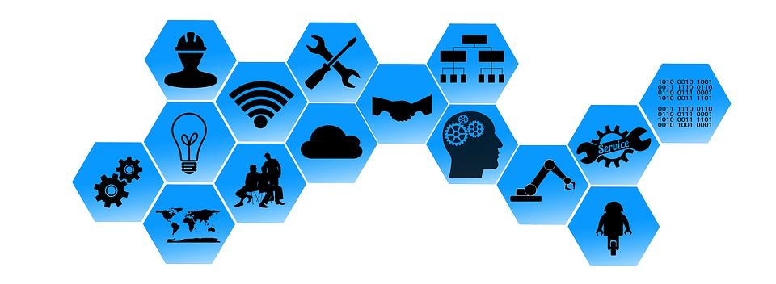
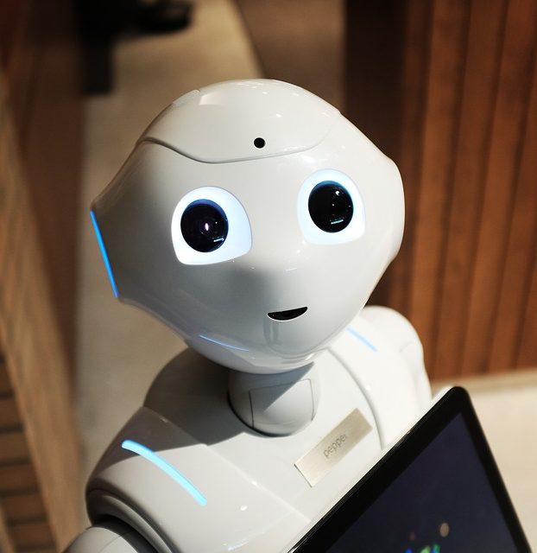
Game Changer:
Production data acquisition with Industry 4.0 (I4.0), Internet of Things (IoT), Internet of Energy
Pixabay.com
Examples of data acquisition within the company through
Automation of machines of all kinds
Robotics
Artificial intelligence
GPS
Smart Metering
Radio chips (RFID)
Etc.
Data processing via In-Memory Databases (IMDB), e.g. SAP HANA
Pixabay.com

Slide 25
Where does the (energy) data come from?
Even more detailed here
Big Data
Internet of Energy
Availability of Data
Production: Automation, Robotic, Numerical Control, 3D-print, Sensors, Online measurements like Smart Meter, Smart Factory
Facility Management: Building control, Smart Home/ Ambient Intelligence
E-Business: E-Bay, Amazon Public, covisint protected
Logistic: Radio chips RFID (Radio Frequency Identification Device), GPS (Global Positioning System)
Social networks, Social Media, Smart City
Internet: Databases of OECD, IEA, Ministries to Wikipedia
Legality Issue: Darknet, Hacked Data, Mobile Transaction Data, Cashless Payment, etc.
Internet of Things
Internet of
Everything
Notes:
Own representation
Where does the data come from? So where does, actually, the energy data come from?
Terms such as Big Data, Internet of Things or, in our case, Internet of Energy are familiar and used in a variety of ways. Due to the advancing technology, the ever-increasing connection of machines to the Internet (Internet of Things), in which machines generate data (keyword Big Data), which then have to be processed, both the Internet of Things and the data volumes increase. This development can also be transferred to energy: smart metering means that data is no longer read but constantly retrievable and fed directly into databases where they are processed. Everyone can think for themselves, how it would be at home, if every device was connected to the Internet and sending data. On the graph above, we can see, where in the company the data comes from.
In the production: Every form of automation leads to data, because a computer controls the process and requires this data for control. Robotics, numerical control (computer-controlled machine tools), 3D printing, everything related to sensors and, as we have already seen, the developments from smart metering to smart factories (everything in the company is networked, connected to the Internet and generates data).
In the logistics: radio chips (RFID) that can be mounted on any pallet or product. This means that in the logistics a product can be automatically assigned to the "right" volume for the right destination and then logged out of the system on arrival. In logistics: radio chips (RFID) that can be mounted on any pallet or product. This means that in logistics a product can be automatically assigned to the "right" volume for the right destination and then logged out of the system on arrival. Libraries also work with radio chips and allow books to be returned independently via recording devices. Also the Global Positioning System (GPS), which is equipped in almost each and every vehicle.
Facility Management: Building control technology, which is centrally controlled and with which concrete influence on the energy consumption can be taken. The aforementioned smart home / smart factory technologies and ambient intelligence, which stands for the networking of everyday objects, sensors, wireless modules, etc., with the goal of improving of our daily life. That means a device detects that the room temperature is too high and automatically throttles the heating or ventilation.
If we go outside of a company, we come to the social networks, social media and the networked city (smart city).
Everything that has to do with e-business, where data is generated, public or rather network-protected. Internet itself with its numerous databases, which in turn are subdivided into public databases and restricted databases. An unbelievable amount of data that is available only through the internet and that can be searched through search queries in search engines.

Slide 26
Costs and benefits of collecting and evaluating data („Granularity“): Which indicators should be defined, measured, and planned with?
Marginal cost of data collection and evaluation
Marginal utility for better decision-making
Optimal level of IT based applications for metrics
Notes:
Own representation
“Who defines an optimal level of IT and EnPIs application? The marginal cost of data acquisition and processing has to be evaluated against the marginal benefit of better decision making. It is up to managerial accounting to decide which of these masses of indicators should be defined and interpreted. As explained before, the costs of data logging and processing are going down rapidly, consequently, the number of indicators that should be used is increasing. Hierarchies of indicators offer the option to supply the managers only with few numbers at first, but the management accountants themselves have the possibility to go into detail and to help managers do likewise.”
Cf. Kals, Johannes: ISO 50001 Energy Management Systems – What managers need to know about energy and business administration, New York 2015, p. 144/145

Slide 27
Decrease of (marginal) costs especially via IoT, I4.0 etc.:
Flexibility in the evaluations through Business Intelligence
Increase of (marginal) utility, especially through energy transition:
Volatility through renewables
More speed and memory via IMDB
Data visualization through energy cockpits
Automatic data acquisition by smart meter
Company as a prosumer
Complexity of energy related networks
Notes:
Own representation
IT and its evolution to Industry 4.0, Business Intelligence and IMDB provides the funds/remedy to reach a new level of (energy) metrics that can support management decisions as well.
Cf. Krück, Dennis: Betriebswirtschaftslehre und Energie – Unterstützung für Veröffentlichungen und Projekte des betreuenden Professors im Bereich Energiecontrolling (Master Thesis), Heidelberg/Ludwigshafen 2015, p. 110
Which energy key system is actually used, is also related to the existing technology and IT infrastructure. To determine reliable indicators, measuring systems are necessary. The collected data (whether manually or automatically via smart meters) must be processed, visualized and integrated. Appropriate software or hardware solutions enable, that the metrics system and processes are automated and work efficient.
Data visualizations through energy controlling software or energy cockpits
IT solutions, e.g. BI offer flexibility in the evaluation; IMDB simplifies access, speed, and storage of data.

Slide 28
Big Data and predictive analytics
Big Data and Business Intelligence enable future-oriented („predictive“) questions:
Online-Marketing und Customer Relationship Management (CRM) as the common field of application field of Big Data:
How is it possible: After searching information about the latest smartphone, on a whole different web-page, e.g. hotel bookings, offers about smartphones are shown/displayed?
Should we really endorse this trend?
As a possibly emerging global society?
Is this really value creation?
Notes:
Collecting data only makes sense if this data is evaluated and analyzed. The two examples on the slide show that data can be used for very different purposes. For example, for marketing or when talking about our topic “Energy”, active management by the knowledge of the consumption behavior in households, in the industry, etc.
This is the main difference between Business Analytics and ERP systems. While ERP systems plan concrete steps in the future with past values, future-oriented questions can be answered by BIG Data and Business Analysis.
The two examples on the slide above represent two possible forms of these predictive questions.
Analysis of internet surf profiles, the exchange of data between different providers, in order to offer individual advertising, tailored to the user, is a standard application in the context of big data. So the main sense in the sentence is: "Is something for free or is a service for free, then you are the product“. We pay the free services in the Internet with our personal data.
The energy-related possibilities of Big Data are to know consumption behavior and to be able to derive consumption forecasts under inclusion of the weather in order to utilize the energy-grid or to counteract any overloads / peaks. If there is a weather-change with a lot of wind or a high pressure area with a lot of sun, then more renewable energies will be fed in again. By combining this knowledge of consumption behavior, weather and consumption forecasts, energy networks can be balanced. These are opportunities, which can be further developed.
Also other processes in companies such as production, logistics / supply chain management, facility management, etc. are now part of Big Data and allow the analysis of data for future issues.

Slide 29
Energy-related possibilities of Big Data and predictive analytics may help to balance smart energy grids involving:
consumption forecast in consideration of the aggregate behavioral patterns of households,
the production program of companies and
the weather predicting generation by solar cells and wind power stations
Setting prices and incentives for energy production of utility companies
And load management for companies or even private households.

Slide 30
IT Solutions
Stand-alone solutions (e.g. Excel)
Cross-functional software such as ERP systems
Business Intelligence with Data Ware-houses and On-Line Analytic Processing (OLAP)
In-Memory Databases (IMDB), Big Data, "Internet of Things"
Cloud computing, mobile computing, ubiquitous computing, ambient intelligence
?
Notes:
Own representation based onn Kals, Johannes: ISO 50001 Energy management Systems, What managers need to know about energy and business administration, New York 2015, p. 70
Where can that lead to, what has just been presented?

Slide 31
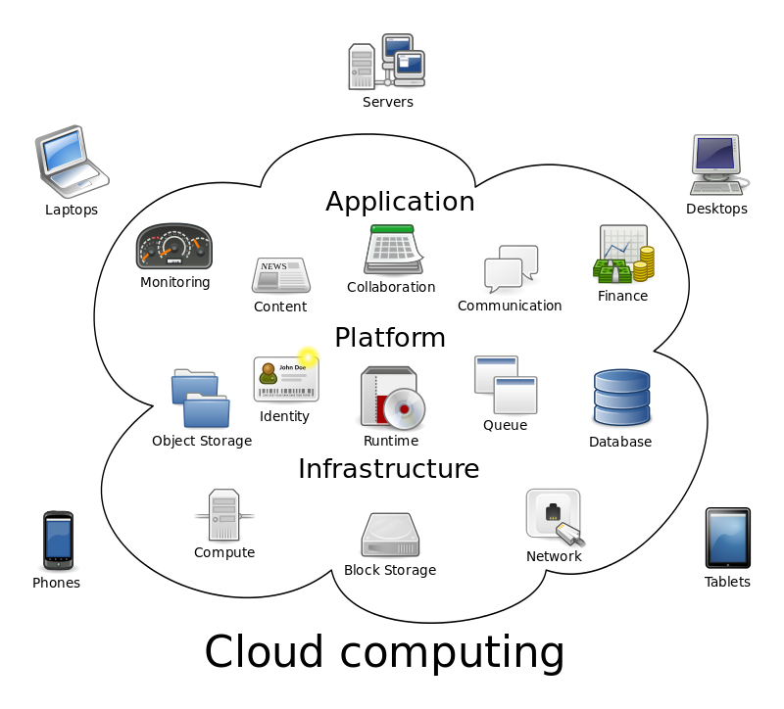
What are the current trends for all of us?
Ubiquitous computing means IT support everywhere and any time by new technical devices
Mobile computing
Ambient intelligence of
Homes (refrigerators, stoves, heating, shutter, carpets, beds …)
Autonomous vehicles/ cars
Clothes
Glasses
Etc.
CC by By Sam Johnston
.CC BY-SA 3.0, https://commons.wikimedia.org
Notes:
Source: CC by By Sam Johnston - Created by Sam Johnston using OmniGroup's OmniGraffle and Inkscape (includes Computer.svg by Sasa Stefanovic)This vector image was created with Inkscape., CC BY-SA 3.0, https://commons.wikimedia.org/w/index.php?curid=6080417; https://commons.wikimedia.org/wiki/File%3ACloud_computing.svg, Access 12.12.2016
Data is no longer only being stored on our personal devices, but data is also stored in “The Cloud”. The devices are supplied by “The Cloud” with data. Especially in times with limited storage space on personal devices, this development will increase and become more important.

Slide 32
What could be
emerging trends
In companies and business?

Slide 33
A closer cooperation of the functional departments in a company – some of them merging and breaking the walls between organizational units?
Manufacturing Execution System (MES) Production
Building Control System (Building Services Management System – Facility Management)
Supply Chain Management (SCM)
Accounting / Controlling, (Financial) Accounting, Reporting, Disclosure
Energy Management
Condition-dependent maintenance, Predictive maintenance
…
Notes:
Own representation
The possibilities of IT, that have already been introduced, make a closer cooperation of the functional departments in a company feasible. The figure shows functions, that are IT based and that could grow together with other features. The list here is not complete, many more are conceivable.

Slide 34
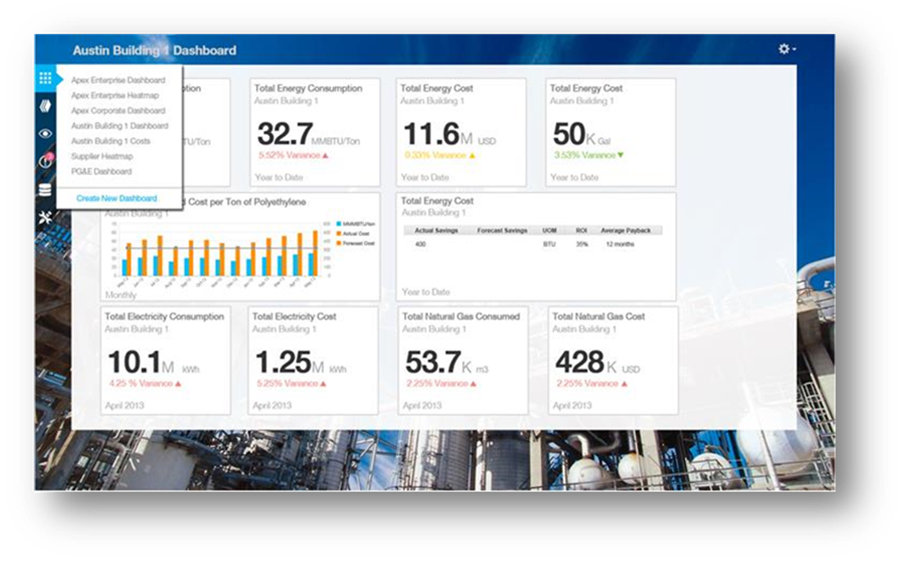
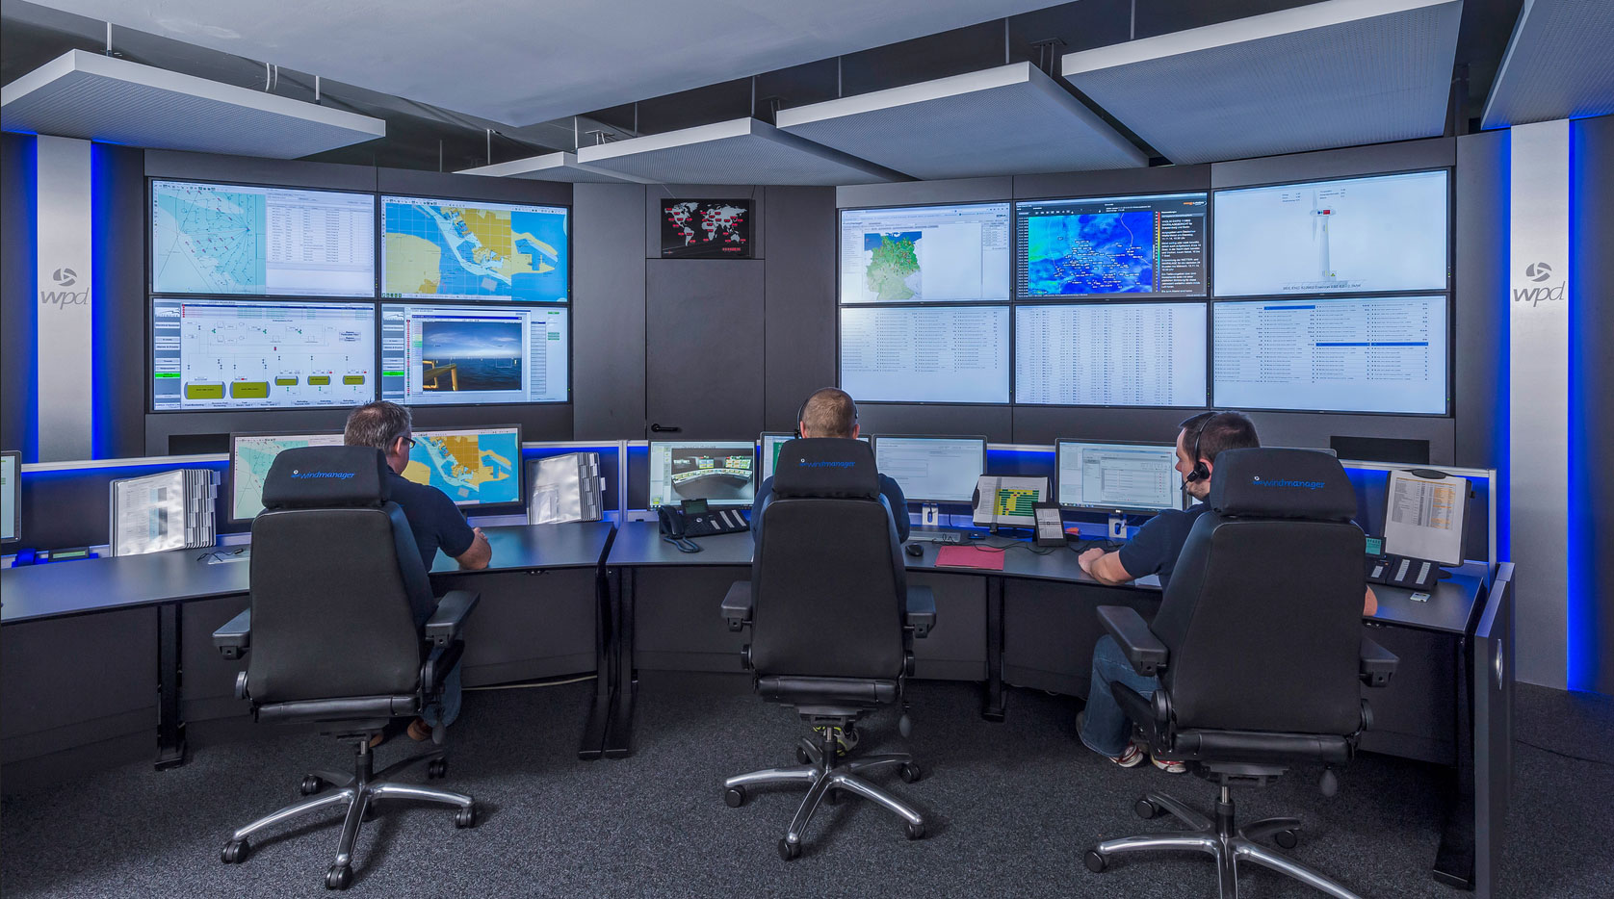
Analogy of business management and technical control:
Acceleration of the management cycle (PDCA-Cycle)
A control room of wind turbines
Source: www.windmanager.de ; Author: wpd windmanager
Management cockpit (courtesy SAP)
Notes:
Photo source: Source: www.windmanager.de ; Author: wpd windmanager (with the friendly use permit of wpd windmanager GmbH & Co. KG.).
The merging of business management and technical control, which was already addressed in the economics lecture, will be recalled here. This means that the PDCA cycle accelerates, resulting in a consolidation/concentration of planning, control and management. The technical planning and control and the business planning and control are becoming more and more similar.

Slide 35
Closer cooperation in business networks
Own generation of energy
Offsetting via external initiatives
Small district heating system
Fossil power generation
Energy provider and exchange
Following steps
Wholesale and retail
Use and maintenance
Renewable power generation
„our“ production
Initial production
Following steps
Wholesale and retail
Use and maintenance
Preceding steps
Initial production
Subcontractors
Smart cities and commuting
Energy contractors
Logistics provider, IT-services including cloud computing, consultants and auditors, maintenance service companies, authorizes of (e-)government, affiliated companies of the concern …
Source: Kals, Johannes: ISO 50001 Energy Management Systems – What managers need to know about energy and business administration, New York 2015, P. 130.
Notes:
Source: Kals, Johannes: ISO 50001 Energy Management Systems – What managers need to know about energy and
business administration, New York 2015, P. 130.
Figure 13.7: Energy oriented value network with closed loops.
The figure illustrates how to apply boundries and explain the closed-loop supply chain as a step toward sustainability value networks.

Slide 36
IT Solutions
Stand-alone solutions (e.g. Excel)
Cross-functional software such as ERP systems
Business Intelligence with Data Ware-houses and On-Line Analytic Processing (OLAP)
In-Memory Databases (IMDB), Big Data, "Internet of Things"
Cloud computing, mobile computing, ubiquitous computing, ambient intelligence
?
Notes:
Own representation based on Kals, Johannes: ISO 50001 Energy management Systems, What managers need to know about energy and business administration, New York 2015, p. 70
Where are we currently standing on this staircase? What is practiced in the company? And what else is coming? What is imaginable and feasible?
Actually, all levels are relevant. The stand-alone solutions such as Excel for example or in-house software solutions still exist in large companies. Small and medium-sized companies certainly rely on ERP systems in order to work more efficiently within the company. Major companies are more likely to venture into areas related to digitization and Industry 4.0. The last step/level is certainly not very widespread, but is definitely discussion topic in the companies. On the one hand companies ask themselves how they can stay on the ball/keep a finger on the pulse, but also which decisions and investments they have to make now. Many ask themselves the question, what comes next, should we now invest in the networking of our machines or in smart technologies, even if we know, that the next "revolution" is coming in 2 years.
A few years ago, all of us were expecting an end of the era of technological developments. In the meantime, the knowledge level about the IT opportunities is so big that we are just curious about what is coming in the next 5-10 years. If technical progress develops just like in the last 5 years, then today we can only guess, what "normal“ will be after 5 years. That‘s why there is a „ ? „ and an arrow in the illustration above. But companies seem to be overwhelmed and are already asking for the limits.

Slide 37
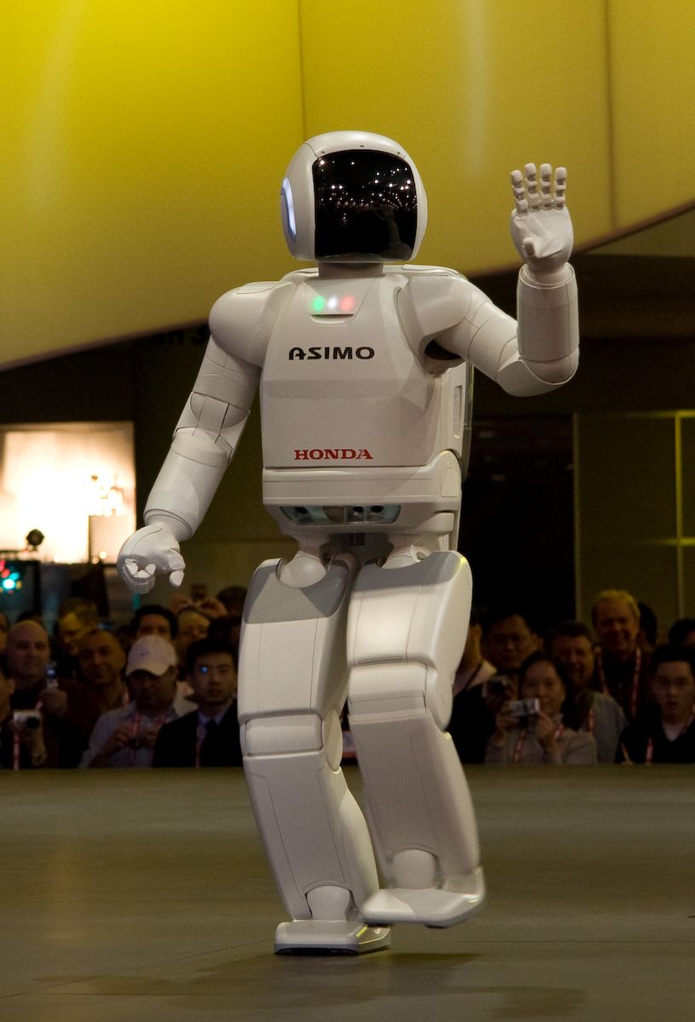
Where are the limits? It‘s not the IT.
In the companies / business
Methods
Organizational limits
Mindset→ The human as a factor
Throughout the whole economy and society:
Forecasts predict, that 15 to 82 percent of all jobs will disappear.
Do we really want to move forward so quickly?
What are the positive future perspectives of „sustainable globalization“?
CC-by https://www.flickr.com/photos/sugarmonster/3248217917
Notes:
Photo source: CC-by https://www.flickr.com/photos/sugarmonster/3248217917
Where are the limits of technological development, do they even exist/do we have one? As already indicated, it’s not the IT.
Which limits/boundaries currently exist:
Methods: The methods that are currently available and that are taught and used do not suit the most of the developments, what are currently available. For example, stand-alone solutions are still widely used while IT offers far more effective solutions.
Organizational limits: Power struggles between the different functional departments in a company and the demarcation to competitors can be mentioned here as a limit.
Mindset: deadlocked/stuck/ thinking among employees should also be seen as a barrier/limit to innovations and new developments. Keyword here is the “human” a factor.
Throughout the whole economy and society:
Forecasts predict that 15-82% of all jobs will dissapear. This is an enormous range. If we assume only with 50%, it’s still enormous and the question is, how is this loss going to be replaced? In the future, the most of the employees will and want to work in the IT industry, which is going to be the only without, where people will not worry about losing their job. Otherwise, digitization and automation will simplify many things.
Electromobility: an electric car comprises much fewer parts than a car with an internal combustion engine. Are these cars even made here in Germany? What happens with the suppliers of these parts? The automotive supply industry, which is really important in/for Germany, will have to change massively, electric cars are probably going to be less susceptible to repairs, which means that maybe we won’t need so many car repair shops, etc. This is just one example that can be applied to other industries.
So ask yourself the question: Do we really need and want all that? Do we really want to move forward so quickly and let us overrun? Can our society handle so much change at all?
And which positive prospects for the future result from digitization, networking and the rapid progress? The keyword here is Fair Globalization, which should not be discussed further in this context.

Slide 38
Knowledge
Heating and facility management in the corporate (energy) strategy
Information
Maintenance needs
User behavior
Data
Heating consumption
Heating utilization
Heating costs
Potential consumption and cost reduction
Integration of the company in the energy transition
Wisdom
Ethical-moral funding of the energy strategy
Rationality beyond profitability

Slide 39
References
Kals, Johannes:
ISO 50001 Energy management Systems, What managers need to know about energy and business administration, New York 2015
Kals, Johannes: Betriebliches Energiemanagement: Eine Einführung, Stuttgart 2010

Slide 40
Internet Sources
http://www.heise.de/tp/artikel/13/13565/1.html
http://www.bfee-online.de/bfee/informationsangebote/publikationen/energieeffiziente_produkte/energielabels_computer.pdf
https://www.flickr.com/photos/colalife/26786790491
https://commons.wikimedia.org/wiki/File%3AMoores_law_(1970-2011).PNG
http://www.bfee-online.de/bfee/informationsangebote/publikationen/energieeffiziente_produkte/index.html
https://commons.wikimedia.org/w/index.php?curid=6080417

Slide 41
https://commons.wikimedia.org/wiki/File%3ACloud_computing.svg
https://www.fairphone.com/de
https://www.heise.de/ct/artikel/Fairphone-2-Das-Smartphone-fuers-gute-Gewissen-3043164.html
http://greenbyte.ch/14536/der-nachhaltige-schweizer-pc
https://whyopencomputing.ch/de/44-tablet
http://www.et.tu-dresden.de/etit/index.php?id=889

