Slide 1
Energy Oriented Business Administration Prof. Dr. Johannes Kals 3.4 Management Accounting

Slide 2
Managerial accounting, financial accounting (in German „Controlling“): Advisor, consultant, pilot, mate, steersman of management (captain)
Pixabay.com

Slide 3
Making use of the established management system
(only number cruncher?)
Evolving the management system, sharing responsibility for EVERYTHING (see next chart)

Slide 4
Consequently, managerial accounting is involved in many presentations of this course and all business domains
Energy oriented management accounting
Balances
Advising all domains
Data acquisition and processing IoT, I4.0
Profitability, strategy, ethics
Key Performance Indicators (KPIs)
Cost accounting

Slide 5
Here concentration on energy performance indicators (EnPIs) as part of key performance indicators (KPIs). How to derive EnPIs from energy balances?
Group or company
plant 2
plant 1
Production
Logistics
Facility Management
Cost-center 1
...
Device 1...
Cost-center 2
...
...
Notes:
Source: Kals, Johannes: ISO 50001 Energy Management Systems – What managers need to know about energy and
business administration, New York 2015, P.140.
Figure 14.3: Hierarchy of EnPIs according to company´s organization.
Energy reviews and balances offer a great opportunity to determine and classify a broad variety of EnPIs. A first structure of indicators should be the hierarchy going down from the company level to that of individual equipment (Figure).
This simple hierarchical structure can be viewed from different perspectives offering multiple opportunities to define EnPIs:
An important and indispensable view consists of differentiating according to energy carriers and forms like oil, gas, electricity, and so forth.
To distinguish between renewable and fossil energy is an important perspective
Modeling EnPIs can concentrate on energy consumption (concentrating on liter, kilowatt, etc.), carbon (kilograms, tons) or costs and revenues (monetary units)
Additionally, procedures cutting through the functions, cost-centers, and devices in the hierarchy of the figure have to be described by EnPIs. The conversion of energy in different forms throughout the plant has to be followed.
For example: from electricity to compressed air to operations of a screw driver (energy supply or transformation chain).
Doing so, in every energy application, the efficiency and losses may be calculated. Furthermore, the operations to produce parts, semi finished goods, and products deliver many EnPIs.
Enhancing this gate-to-gate figure to life-cycle assessment and value networks, many more energy-related indicators could come into existence linking to the models of cooperating companies and other partners.

Slide 6
How to structure KPIs? Balanced Scorecard (BSC)
Values and strategies
Financial perspective or dimension (revenues, costs, profits …)
Customers (number key accounts, domestic or foreign, loyalty …)
Internal business processes (physical operations, percentage scrap, quality control …)
Learning and growth (staff qualification, absenteeism, training measures ...)
Notes:
Eigene Darstellung:
Vgl. Krück, Dennis: Betriebswirtschaftslehre und Energie – Unterstützung für Veröffentlichungen und Projekte des betreuenden Professors im Bereich Energiecontrolling (Masterarbeit), Heidelberg/Ludwigshafen 2015, S. 109:
„Schon deutlich besser eignet sich ein flexibles Kennzahlensystem wie z.B. die Balanced Scorecard (BSC), welche sich heute in vielen Unternehmen als strategisches Instrument etabliert hat. Die BSC liefert einen strukturierten Überblick über den Status quo und ist traditionell in vier Perspektiven (in der Regel in finanzielle Perspektive, Kundenperspektive, interne Prozessperspektive sowie eine Lern- und Entwicklungsperspektive) untergliedert. In diesen Perspektiven sind sowohl quantitative als auch qualitative Kennzahlen kausal miteinander verknüpft. Die Vorteile liegen im integrativen Charakter, in der raschen Reaktionsfähigkeit durch eine stetige Befassung mit Zielen und Kennzahlen. Auf einen Blick erhält man so eine Übersicht über Kennzahlen, ihre Zielsetzungen, Vorgaben und notwendige Maßnahmen, die je nach erreichtem Kennzahlenwert umzusetzen sind.“
Vgl. Lingnau, Volker: Sustainability Accounting - Möglichkeiten und Grenzen der Berücksichtigung von Nachhaltigkeitsaspekten im Rechnungswesen, in: Hauff, Michael von/Lingnau, Volker/Zink, Klaus J. (Hrsg.): Nachhaltiges Wirtschaften - Integrierte Konzepte, Baden-Baden 2008, S. 93.
Vgl. Kals, 2015, S. 141f.

Slide 7
Energy-oriented balanced scorecard with examples
Mission and
strategies
Finance:
Customers:
Operations:
Learning/ staff:
Total hours of training in sustainability, environment, and energy in a company and per employee
Employee suggestions concerning energy improvements per year and premiums granted
Energy consumption and carbon emission per plant, cost-place, and product
Standard indicators in the functions: Energy per surface of buildings in facility, fuel consumption per distance in logistics, energy consumption per operational unit in production, and so forth
Energy consumption and carbon emissions per outgoing delivery transport and the total amount for key account customer
Percentage of customers involving sustainability, environment, and energy in their buying decision
Monetary evaluation of every other EnPI as far as possible and calculating time indexes
Linking energy managerial accounting to financial accounting, for example, energy costs in the profit- and -loss account
Notes:
Source: Kals, Johannes: ISO 50001 Energy Management Systems – What managers need to know about energy and
business administration, New York 2015, P.142.
Figure 14.4 Energy-oriented BSC.
There are three options to combine EnPIs and BSC:
1) Elaborate EnPIs as a stand-alone solution besides BSC. If a BSC is the established system of KPIs in a firm, this option only makes sense as a tentative transition period.
2) Integrate energy as part of sustainability as a fifth perspective into BSC. In most companies, energy and sustainability do not have the importance to be equally lined in. 3) Integrate EnPIs into the established perspectives. This is in most cases the appropriate, long-lasting method meeting the importance that energy has in the given surroundings.

Slide 8
Three principal possibilities to include EnPIs or KPIs of sustainability in a Balanced Scorecard (BSC)
New sustainable BSC standing alone
EnPIs clear and structured
Difficult integration into existing system
Amending the existing BSC by a fifth dimension
Only reasonable if sustainability and/ or energy play a vital role for the company (e.g. utilities)
Recommended: Integration in existing BSC
In most cases the reasonable solution (as demonstrated in the previous chart)
Notes:
Eigene Darstellung
Vgl. Krück, Dennis: Betriebswirtschaftslehre und Energie – Unterstützung für Veröffentlichungen und Projekte des betreuenden Professors im Bereich Energiecontrolling (Masterarbeit), Heidelberg/Ludwigshafen 2015, S. 109
„Verwenden Unternehmen bereits ein Kennzahlensystem wie die BSC, bestehen drei grundsätzliche Möglichkeiten, um Energiekennzahlen darin zu integrieren:
Man leitet eine vollkommen neue BSC ab, die sich auf verschiedene Energieperspektiven fokussiert (1)
Man erweitert die BSC um ein Art „Nachhaltigkeitsperspektive“ (Stichwort: Sustainability Balanced Scorecard) als fünfte Perspektive, in die auch EnPIs als Teilbereich eingehen (2)
Man integriert Energiekennzahlen in die bestehenden vier Perspektiven (3).“
Vgl. Lingnau, Volker: Sustainability Accounting - Möglichkeiten und Grenzen der Berücksichtigung von Nachhaltigkeitsaspekten im Rechnungswesen, in: Hauff, Michael von/Lingnau, Volker/Zink, Klaus J. (Hrsg.): Nachhaltiges Wirtschaften - Integrierte Konzepte, Baden-Baden 2008, S. 93.
Vgl. Kals, 2015, S. 141f.

Slide 9
Fixing energy baselines as exemplary EnPIs to measure the cost-cuts of investments
Energy baseline
Investment in energy efficiency
Time
Notes:
Source: Kals, Johannes: ISO 50001 Energy Management Systems – What managers need to know about energy and
business administration, New York 2015, P.139.
Figure 14.1: Energy baseline.
Energy consumption of a building as the X axis shows the time of investment of energy and Y axis shows the energy cost per period in 1000 Dollars.

Slide 10
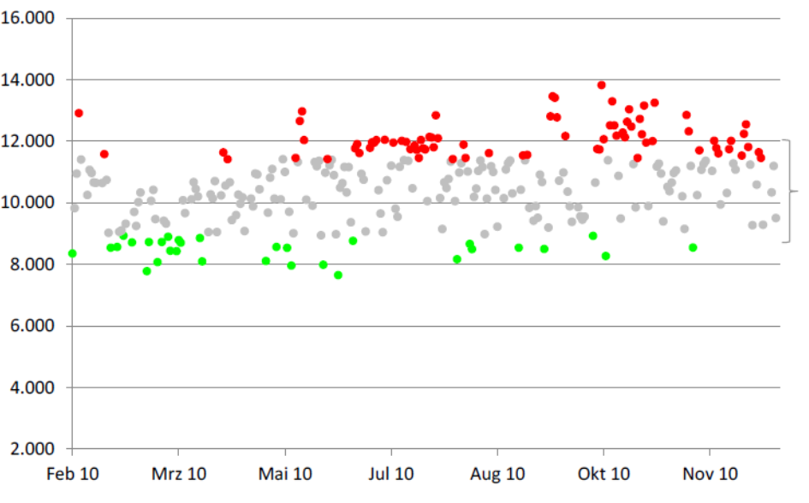
Baseline volatility of energy cost as statistical information
Source: Nutreon Engineering, 2014
Notes:
Source: Nutreon Engineering, 2014
Figure 14.2: Baseline with volatility of energy cost per day.
The interpretation of the figure leads us to volatile energy consumption from food industry.
The spread between 8,000 and 14,000 euros energy cost per day has to be analyzed with the help of technical parameters, as explained, to gain hints in measuring energy conservations.

Slide 11
Context of EnPIs and IT will be detailed in the next presentation, here is just one crucial idea
Marginal cost of data acquisition and data processing decreasing due to Internet of Things (IoT) and Industry 4.0 (I4.0)
Marginal benefit of better decision making increasing because of the energy transition
Decision about deployment of IT and EnPIs by managerial accounting
Notes:
Source: Kals, Johannes: ISO 50001 Energy Management Systems – What managers need to know about energy and
business administration, New York 2015, P.144-145.
Who defines an optimal level of IT and EnPIs application? The marginal cost of data acquisition and processing has to be evaluated against the marginal benefit of better decision making. It is up to managerial accounting to decide which of these masses of indicators should be defined and interpreted. As explained before, the costs of data logging and processing are going down rapidly, consequently, the number of indicators that should be used is increasing. Hierarchies of indicators offer the option to supply the managers only with few numbers at first, but the management accountants themselves have the possibility to go into detail and to help managers do likewise.

