Slide 1
Energy Oriented Business Administration
Prof. Dr. Johannes Kals
2.3 IT and Energy
Content
Digitalization, IoT, I4.0 and Co
Smart Meter, Smart Grids, Business Models
Next Industrial Revolution

Slide 2
Digitalization supports more and more operations – some catchword
Internet of Things (IoT) Internet of everything, including energy
Industry 4.0 (I4.0)
Smart (intelligent) Meter, Home, Factory, City, Grid, Energy …
Ambient Intelligence, Artificial Intelligence, Ubiquitous computing
Big Data

Slide 3
All this became possible because of
Moore's law (1965):
Number of transistors in a dense integrated circuit doubles approximately every two years.
Basis for data processing and
In-Memory Databases (IMDB)

Slide 4
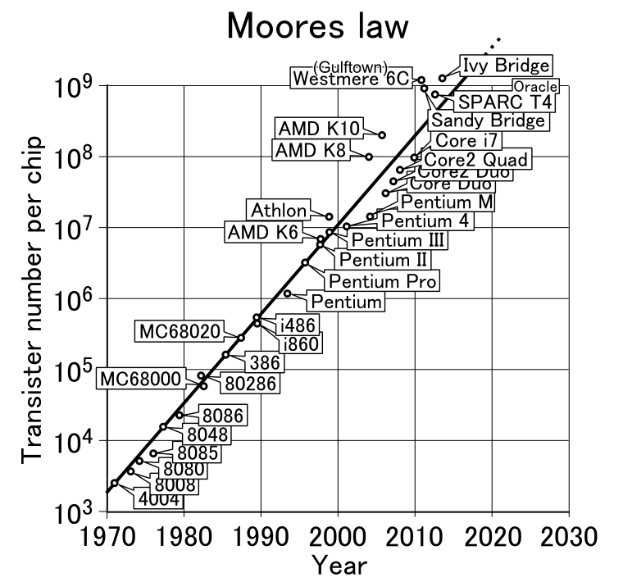
Source: https://commons.wikimedia.org/wiki/File%3AMoores_law_(1970-2011).PNG
Notes:
Quelle: CC-by https://commons.wikimedia.org/wiki/File%3AMoores_law_(1970-2011).PNG, Zugriff 12.12.2016
G. E. Moore: Cramming more components onto integrated circuits. In: Electronics. Band 38, Nr. 8, 1965, S. 114–117.
Woher kommen diese Schlagworte? Was steckt dahinter?
Das Mooresche Gesetz wurde bereits 1965 von Gordon Moore formuliert, es ist eine Faustregel beruhend auf empirischen Beobachtungen. Angenommen wird, dass sich die Komplexität der Schaltkreise mit minimalen Komponentenkosten (z.B. auf Computerchips) regelmäßig verdoppelt. Die Grafik zeigt verschiedene Prozessoren auf der Zeitachse und die auf ihnen befindlichen Transistoren/pro Chip. Das bedeutet also, dass unsere IT alle 1-2 Jahre doppelt so leistungsfähig wird. Dies führt zu einer exponentiellen Entwicklung.
Heute ist diese Gesetzmäßigkeit anerkannt und bildet die Grundlage für die digitale Revolution.
Interessant ist, dass man früher dachte, irgendwann an die Grenzen der Leistungsfähigkeit von Prozessen zu stoßen. Doch heute erkennt man, dass diese Grenzen nicht so schnell erreicht werden, denn immer neue Technologien bringen auch neue Leistungsfähigkeiten hervor. Statt einer eher langsameren Entwicklungsgeschwindigkeit erleben wir gerade noch schnellere Entwicklungen und eine Grenze des Machbaren ist derzeit nicht zu erkennen.

Slide 5
Availability of data surges
Automation
Numerical control (NC)
Robotics
GPS
RFID
E-Business
Sensors
Meters

Slide 6
Content
Digitalization, IoT, I4.0 and Co.
Smart Meter, Smart Grids, Business Models
Next Industrial Revolution

Slide 7
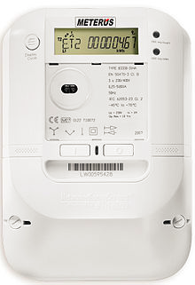
Smart meter:
Logging of consumption every 15 minutes or even online and constantly
May be read out by IT-devices of home owners or company employees (via laptop, cell phone …), detecting demand changes when switching on or off devices
May transfer the data to utilities and grid managing companies supporting load curve prediction and grid balancing activities
May support measures of load management (switching on dishwashers at times with abundant power, decharching e-car-batteries while electricity is expensive …)
EVB Energy Ltd via Wikimedia Commons
Notes:
By Deutsch: EVB Energie AG (keine Nennung des Fotografen erforderlich)
English: EVB Energy Ltd (no mention of the photographer required) [CC BY-SA 3.0 (https://creativecommons.org/licenses/by-sa/3.0)], via Wikimedia Commons

Slide 8

Data security and privacy:
the exact load curve of a household may tell which TV channel is switched on
Pixabay.com

Slide 9
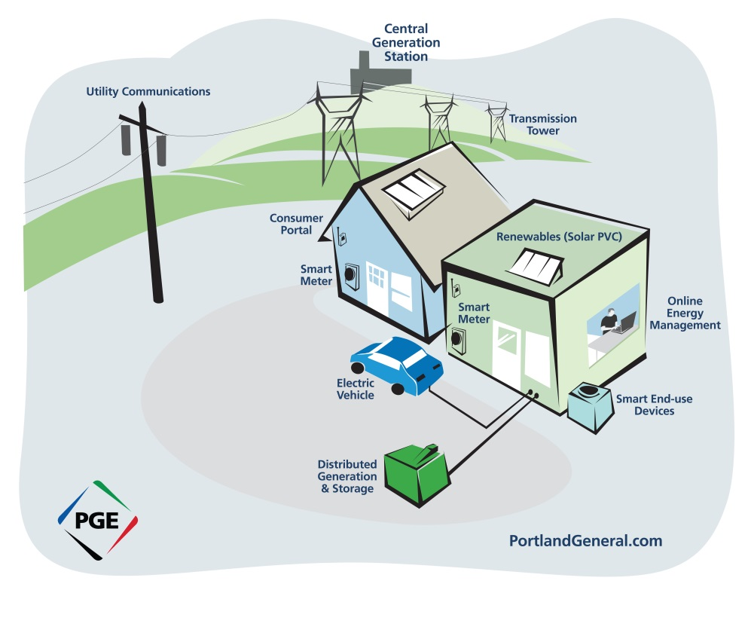
Smart grids:
Balance the power grids, difficult because of volatile generation of solar and wind power – overflow versus dead dark calm
Law of energy conservation, feed-in and demand have to be balanced at any time
Electricity as pivotal energy form linked to other grids and energy carriers:
  Conventional generation, part of supply-side management
  Load management, demand-side management
  Power-to-x (gas, liquid, vehicle …) and shutting power stations off
Abb.com
Portland General Electric, https://www.flickr.com/photos/portlandgeneralelectric/5227101367

Slide 10
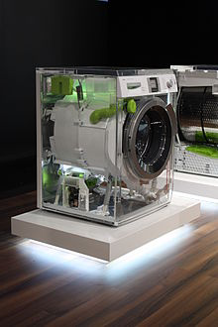
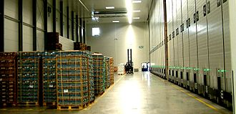
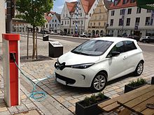
Examples of load management, demand-side management, controlling machinery and devices according to scarcity and prices at energy exchange and in smart grids:
Washing machine
Cold storage house
Rechargeable batteries of e-car
Industrial mills etc.
Source: Wikipedia
Source: Wikipedia
Source: Wikipedia
Co-ordination of many small assets and devices:
Virtual power stations and swarm energy

Slide 11
Players in a new energy market
Demand
Trade and transmission
Supply/ Generation
Companies as part of supply chains and value networks
Quantities: Grid managing companies, smart grids, internet of energy
Utility companies with large plants, micro generation of other companies and households as prosumer, energy associations of citizens
Energy project developer etc..
Procurement and selling of energy, load and demand side management, , storage, procurement services, IT-providers
Price and costs: Energy exchange and energy trade
Notes:
Source: Kals, Johannes: ISO 50001 Energy Management Systems – What managers need to know about energy and
business administration, New York 2015, P. 58.
Figure 6.3: Actors in new energy related markets
Important players in the new rising markets an their interaction. Nonutility companies act on three sides. First on the demand side, like traditional energy markets.
Second, they appear on supply side as prosumers. Third, they have a chance to balance supply and demand through demand-side management, load management
Or energy load balancing.

Slide 12
Example: Google Acquires Nest
In 2014, Google bought Nest, a vendor of thermostats and specialist for home automation, for over $3 billion. The generation of data should be the driving factor for Google to enter this market. The trend toward smart homes and energy conservation involving smart grids pushed this decision. From the side of energy controlling, interesting features are developing:
Temperatures of different rooms can be remote-controlled even by cell phones from a large distance.
If Global Positioning System (GPS) indicates that an inhabitant is approaching his home, heating or air conditioning may provide the desired temperature automatically.
Intelligent systems will learn about the habits and calculate an optimal setback temperature, concluding if the person leaves the house for work or for a short errand.
Different forms of load management can be affected, involving batteries of cars, microgeneration by block heat and power plants, or photovoltaic cells.
Predictions of energy demand or even generation are important information for grid operators.
Notes:
Source: www.nrel.gov
Figure 6.2: Photo renewable energy technology.
Attached is a video explaining how solar panels work and transfer sun energy to electric energy.

Slide 13
Example TWL (Technische Werke Ludwigshafen):
From a traditional public utility company
to
managing flexibilities and IT cloud services

Slide 14
Content
Digitalization, IoT, I4.0 and Co.
Smart Meter, Smart Grids, Business Models
Next Industrial Revolution

Slide 15
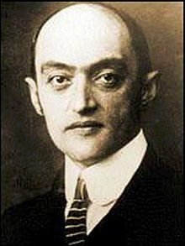
Kondradjew (or Kontradieff) in 1926 :
Inventions lead to innovation and may cause cycles of economic growth over 40 to 60 years (Kondradjew-waves or –cycles)
First and most striking example: Steam engine.
Josef Schumpeter (1883 - 1950)
coined the term industrial revolution: technical innovation surging the economy in a revolutionary, disruptive way changing society, politics, etc.
Source: Wikipedia

Slide 16
Industrial revolutions (number disputed, Industry 4.0 counts four)
Biotech. & IT
6th wave
TV, Planes
& Computer
5th wave
Resource Productivity,
Renewable Energies
4th wave
Electricity, Chemistry
& Automobile
Innovation and growth
3rd wave
Steel & Railroad
2nd wave
Mechanization
1st wave
1785
1845
1900
1950
1990
2020
Time
Source: Kals, ISO 50001 Energy Management Systems – What managers need to know about energy and business administration, New York 2015, P. 50.
Notes:
Source: Kals, Johannes: ISO 50001 Energy Management Systems – What managers need to know about energy and
business administration, New York 2015, P. 50.
Figure 5.4: New industrial revolutions.
This graph shows that for each era, there is a new industrial revolution.

Slide 17
Next revolution:
Only making the digitalization fruitful for economy?
Or a decisive energy turnaround
as element of
sustainable economy and way of life?

Slide 18


Complexity/ pillars of sustainability
Sustainability 2.0
(ecology): internalization of externalities, carbon, water, waste, soil, biodiversity,
next industrial revolution (renewable energy, overall sustainability)
Sustainability 3.0
(social justice): global community and governance, people as cosmopolitans , happiness, peace. Revolution of awareness and consciousness
Sustainability 1.0 (economy): traditional resource management with ERP-systems, material, money, machinery, persons (for the alliteration: men) industrial IT revolution
$
Pre-IT-phase sustainability 0.0
1990
?
1960
Adapting the three pillar concept of sustainability to industrial revolutions
Source: Kals, ISO 50001 Energy Management Systems – What managers need to know about energy and business administration, New York 2015, P. 69
Notes:
Source: Kals, Johannes: ISO 50001 Energy Management Systems – What managers need to know about energy and
business administration, New York 2015, P. 69.
Figure 7.2: The Big picture of sustainability and IT.
The figure links the three columns of sustainability (economic, ecologic and social) to the type of resources tackled by IT tools.
Ever since it was the aim of business (the profit dimension of sustainability) and ERP to provide the means to use material, money, machinery, and manpower (persons) effectively, economic success was ensured → sustainability 1.0 (economy)
We are now in a second wave (planet dimension) integrating ecological resources systematically → sustainability 2.0 (ecology)
It will be an exciting challenge for the future to find a way of living on earth, conserving resources for our children while living a happy life (people dimension) → sustainability 3.0 (social justice)

Slide 19


Change in the style of thinking is needed:
From supply-chains with a beginning and an end
Pixabay.com
… towards industrial ecology, grids, networks, systems approach,
cradle-to-cradle, heading for
a circular economy with closed loops
Pixabay.com

Slide 20
Circular economy with zero waste:
Refuse - reduce - reuse - recycle - rot
means CO₂-neutrality or even a carbon-free economy in the energy field.

Slide 21
Hands-on challenges of digitalization for companies
New challenges | New tools in the box
Rising prices and costs for resources Volatility of prices and speed of business Emerging business networks | Internet of things Ability to process information Evolving methods and application
Redefining R in ERP
Notes:
Quelle: Eigene Darstellung in Anlehnung an Kals, Johannes: ISO 50001 Energy management Systems, What managers need to know about energy and business administration, New York 2015, S. 68)
Wir wenden uns jetzt dem Bereich IT als Enabler zu.
Diese Abbildung zeigt Ergebnisse eines Workshops mit SAP Mitarbeitern zu Herausforderungen und neuen Möglichkeiten im Zusammenhang mit IT
Auf der einen Seite haben wir als neue Herausforderungen:
Steigende Preise und Kosten für Ressourcen, also vor allem Umweltressourcen (wozu Energie auch gehört). Hinzu kommt die Volatilität der Preise, mit der auch die Unsicherheit im Bereich des Ressourceneinkaufs zunimmt. Die Geschwindigkeit mit der sich die Geschäftsumwelt entwickelt nimmt stark zu, Unternehmen müssen sich stetig an neue Geschäftsmodelle anpassen. Gleichzeitig gibt es eine stark zunehmende Vernetzung der Unternehmen und eine Zusammenarbeit über Unternehmensgrenzen hinweg in Supply Chains, value networks etc.
Diese Herausforderung ist enorm, aber die technologische Entwicklung hat eine Menge an Werkzeugen und Methoden auf den Markt gebracht, mit denen Unternehmen diese Herausforderungen auch stemmen können. Hier einige Beispiele:
Das Internet der Dinge ermöglicht eine Vernetzung und die Kommunikation aller Ressourcen eines Unternehmens. Die Fähigkeit Informationen zu verarbeiten wird durch neue IT auf ein neues Level gehoben. Mehr Informationen können schneller verarbeitet werden. Außerdem bietet die IT neue Methoden und Anwendungen, welche das sammeln und auswerten von Daten in neuen Dimensionen ermöglicht.
Es geht darum das R (was für Ressource steht) in ERP (enterpries resource planning) neu zu definieren.

Slide 22
We will follow this thread of evolving tools of IT in presentation 4.1 Green IT
Stand-alone solutions (e.g. Excel)
Cross-functional software such as ERP systems
Business Intelligence with Data Ware-houses and On-Line Analytic Processing (OLAP)
In-Memory Databases (IMDB), Big Data, "Internet of Things"
Cloud computing, mobile computing, ubiquitous computing, ambient intelligence
?
Notes:
Own representation basen od Kals, Johannes: ISO 50001 Energy management Systems, What managers need to know about energy and business administration, New York 2015, p. 70
Below is an explanation of the specific IT options:
They are classified according to the solutions shown here, which are explained in the following slides. This illustration also serves as a structure.

