Slide 1
Energy Oriented Business Administration
Prof. Dr. Johannes Kals
2.2 Energy Transition
Outline
Governmental Climate Policy and Strategies
Can the energy transition succeed?
Background theories

Slide 2


Global climate policy
COP – „Conference of the Parties“
Success of Kyoto-Protocol organized by United Nations, important outcomes of the COP in Paris 2015:
2-degree goal
Alliance for coal exit
Climate insurance for developing countries

Slide 3

Climate policy European Union
Goals until 2020 (20-20)
Reduction of GHG emissions by 20 percent compared to 1990
Share of renewables up to 20 percent
Improving energy efficiency, reduction of primary energy by 20 percent
Notes:
Die EU will als Vorreiter für die Bekämpfung des Klimawandels agieren. Bis 2020 will die EU zahlreiche Ziele einhalten, damit die Emissionen verringert werden. Die Ziele der EU sind: Einsparen der Emissionen von Treibhausgasen um bis zu 20 Prozent gegenüber 1990, Steigerung des Anteils der regenerativen Energien um bis zu 20 Prozent und das Voranbringen der Energieeffizienz, um einen Rückgang von 20 Prozent des Primärenergieverbrauchs zu verzeichnen.
Quelle:
- http://europa.eu/pol/clim/index_de.htm
Bilderquelle:
- pixabay.com

Slide 4

Climate policy in Germany
Leading ideas of energy concept until 2050
Independence from fossil energy carriers
Reduction of consumption of primary energy by half
60 percent renewables
Notes:
Die Leitziele des Energiekonzepts bis 2050 der deutschen Politik ähneln den Zielvorgaben der EU stark. Deutschland will den Bedarf an Primarquellen im Vergleich zu 2008 halbieren. Darüber hinaus soll der Anteil an erneuerbaren Energien auf 60 Prozent ansteigen. Das dritte Hauptziel des Energiekonzeptes ist die Unabhängigkeit der Energieversorgung von fossilen Energieträgern. Es soll eine umweltfreundliche, sichere und wettbewerbsfähige Energiewirtschaft geschaffen werden.
Quelle:
- https://www.umweltbundesamt.de/themen/klima-energie/klimaschutz-energiepolitik-in-deutschland
Bilderquelle:
- pixabay.com

Slide 5
Twofold energy turnaround in Germany:
Withdrawal from nuclear energy after the disaster of Fukushima in Japan in 2011
AND covering the demand by renewables.
Need to involve the supply-side (renewable energy generation)
AND and the demand-side (improve energy efficency and reduce demand)

Slide 6
Reducing GHGs in Germany – past and projections
Millionen tons CO₂-equivalent
2005 2012 2015 2020 2025 2030 2035
Energy sector
Industry
Traffic
Households
Agriculture
Other
Commerce, trade, services
Source: Deutscher Projektionsbericht 2015 zur Entwicklung der Treibhausgasemissionen in Deutschland gemäß Verordnung 525/2013/EU
Notes:
In dieser Grafik ist die sektorale Betrachtung der Entwicklung der Treibhausgase von 2005 bis 2035 in Deutschland zu sehen. Es findet ein konstanter Abwärtstrend statt. Die Energiewirtschaft verursacht den größten Anteil an den Treibhausgasen. Die Reduktion wird vor allem durch die Politik und die konsequenten Auflagen für die Wirtschaft erzeugt. Bei Fehlverhalten der Unternehmen ist sogar mit Strafen zu rechnen.
Quelle:
- http://www.bmub.bund.de/fileadmin/Daten_BMU/Pools/Broschueren/klimaschutzbericht_2015_bf.pdf

Slide 7
Energy transition as turnaround of electrical energy?
2017 one third of the electrical energy in Germany came from renewables, but only 13 percent of primary energy demand (see following charts).
Primary energy demand/ consumption means the supply of every original energy source (oil, gas, coal, wind, solar, water etc.). Through transformation generation of secondary energy (power, heat, fuel …)

Slide 8
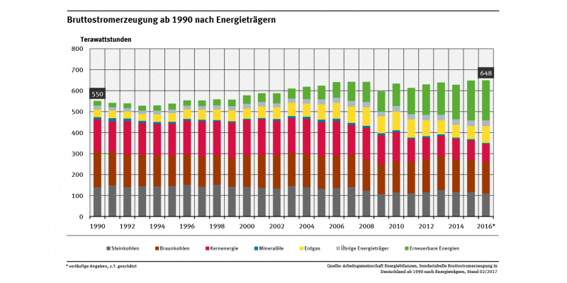
Part of green electrical energy (power)
https://www.umweltbundesamt.de/daten/energie/stromerzeugung-erneuerbar-konventionell#textpart-3, Abruf 12.1.18

Slide 9
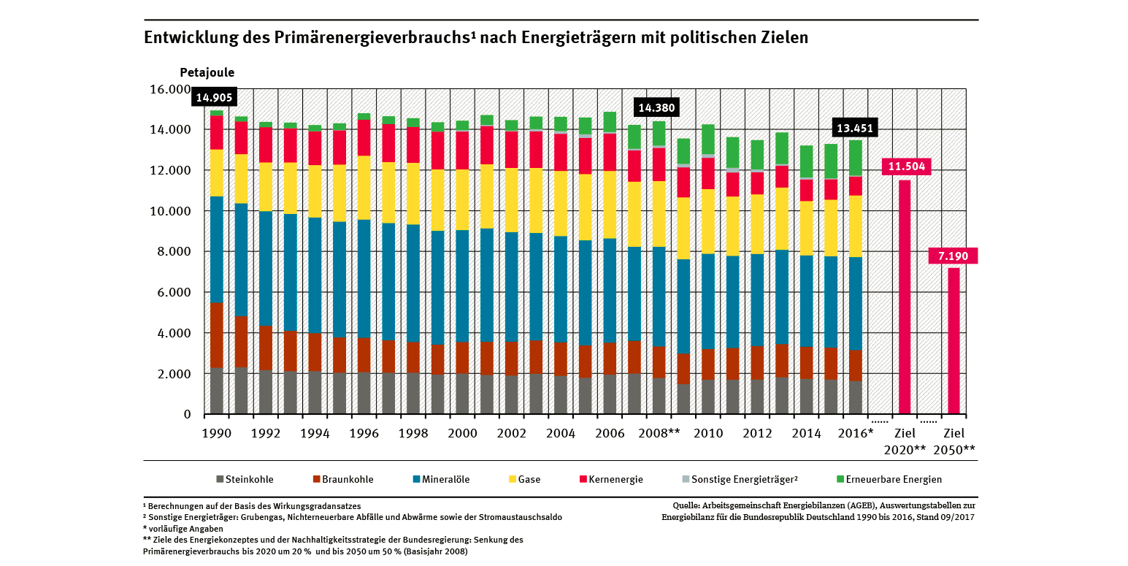
Part of green primary energy
https://www.umweltbundesamt.de/daten/energie/primaerenergieverbrauch#textpart-2, Abruf 12.1.18

Slide 10
Negative: The energy transition has to comprise all energy forms and carriers (gas for heating, fuel for cars …)
Positive: Electric power is the pivotal energy form. It is easy to generate in a sustainable way and extremely flexible in use (from transportation over industrial machinery to IT or a coffee machine). Unfortunately complicated to store.

Slide 11
Outline
Governmental Climate Policy and Strategies
Can the energy transition succeed?
Background theories

Slide 12
Supply-side, green energy generation:
Is enough energy available?
Important sources of renewables
Solar
Wind
Biomass
Terrestrial heat
Water

Slide 13
World demand of renewable energy sources
Solar energy
Wind energy
Hydropower and
ocean energy
Biomass
Geothermal heat
Potenziale erneuerbarer Energien im Vergleich zum jährlichen Weltenergiebedarf (http://www.fv-sonnenenergie.de/fileadmin/bildarchiv/grafiken_und_charts/­Erlaeuterung_zu_Grafik_EE-Potenziale.pdf nach Fischedick u.a. 2000)
Notes:
Source: Kals, Johannes: ISO 50001 Energy Management Systems – What managers need to know about energy and
business administration, New York 2015, P. 53.
Figure 6.1: Annual world demand for renewable energy.
Power plants of different scales are generating energy from renewable sources. This figure illustrates the global energy demand in comparison to the potential.
Renewable Energy demand used mostly from the Sun, then comes the wind energy.

Slide 14
Energy form | Overall availability compared to global demand | Technical accessible
Solar | 2.850 | 3,8
Wind | 200 | 0,5
Biomass | 20 | 0,4
Geothermal heat | 5 | 1,0
Wave and sea currents | 2 | 0,05
Water | 1 | 0,15
Sum | 3.000 | 5,90
Kals, Betriebliches Energiemanagement, 2010

Slide 15
2 Potenziale regenerativer Energien
Energy conversion chain from sun, earth and moon
(following Pehnt/ Militz 2007, S. 2)
Basis | Manifestation | Natural energy conversion | Technical energy conversion | Useful energy
Sun | Biomass | Biomass-production | Cogeneration plant/ Conversion plant | Heat, electricity, fuel
 | Hydropower | Evaporation, precipitation, melting | Hydroelectric power station | Electricity
 | Wind power | Atmospheric motion | Wind power plants | Electricity
 |  | Wave movement | Wave power plant | Electricity
 | Solar power | Currents | Marine current power | Electricity
 |  | Warming of surface and atmosphere | Heat pumps | Heat
 |  |  | Ocean thermal energy conversion | Electricity
 |  | Solar radiation | Photolysis | Fuel
 |  |  | Solar cells, photovoltaic system | Electricity
 |  |  | Collector, solar­ thermal power | Heat
Earth | Geothermal power | Geothermal heat | Geothermal plant, heat pump | Heat, electricity
Moon | Gravitation | Tides | Tidal power plant | Electricity

Slide 16
Example Solar Cells on Rooftops
In our home, we invested in rooftop photovoltaic cells in 2006. The panels cover about 20 m² with a capacity of 3.4 kW peak. The peak means that 3.4 kW are produced when the solar radiation is most intensive.
We harvest about 3,500 to 4,000 kWh per year, covering our demand, which is typical for a household in Germany. The investment is projected to pay off in about 12 years given a static calculation; if we have to replace the inverter module, the timespan could be extended. The lifespan of solar panels can stretch over decades, because most components are not exposed to mechanical stress.
Thus, it is a profitable investment—and it feels good to achieve our family’s electricity needs in a carbon-free way.
Notes:
Source: www.nrel.gov
Figure 6.2: Photo renewable energy technology.
Attached is a video explaining how solar panels work and transfer sun energy to electric energy.

Slide 17
Green energy generation is cheaper than fossil sources in more and more countries, even without subsidies:
Solar energy in Dubai 0.058 Dollar per kWh (cheaper than natural gas)
Wind park in Morocco with 3 Dollar cent per kWh
https://www.theguardian.com/sustainable-business/2016/feb/13/renewable-energy-investment-fossil-fuel-divestment-investor-summit-climate-change

Slide 18

Former Saudi oil minister Sheikh Zaki Yamani:
“The Stone Age did not end for the lack of stones, and the
oil age will end long before the world runs out of oil.”
Pixabay.de

Slide 19
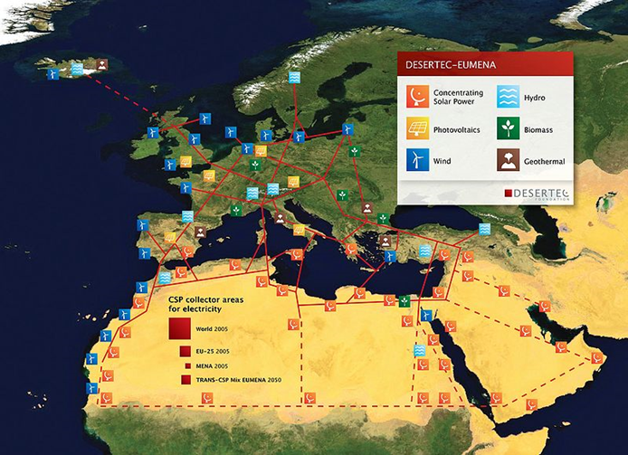
Desertec initiative
Source: Desertec Foundation. www.desertec.org
Notes:
Source: Desertec Foundation. www.desertec.org
Figure 6.5: Smart grid planned covering continents.
Desertec is a renewable energy project in the area of European union, Middle east and North Africa (EUMENA). The aim is to offer a sustainable production of energy and transport the energy from MENA to Europe. Desertec is supported by large companies planning a grid from Iceland to Arabia, by different forms of energy generation.
The project was lunched in 2009. with a surprising turnover, in 2013 the foundation revealed that the plan has fallen. The reasons for this turnover are:
Due to the political situation in MENA, especially after Arabic spring.
Two of the biggest companies backed down Siemens and Bosch.
Due to the economic costs which require billions and billions of euros. On the other hand not enough investors at the moment.

Slide 20

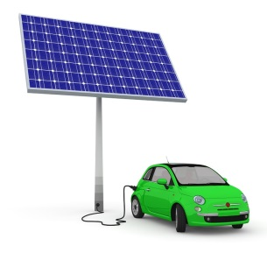
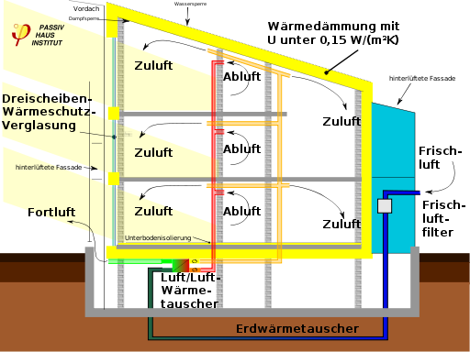
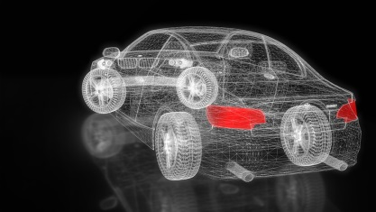


Summing up demand-side opportunities boosting energy-efficiency:
Pixabay.com

Slide 21
Comparing supply and demand, European Energy Exchange (EEX) in Leipzig:
New years day 2018, storm „Burghild“ over North Sea and Germany, renewables cover 100 percent of demand of 41 GW, 35 GW thereof wind energy.
Intraday spot prices (EPEX) are negative.

Slide 22
What do scientists and their studies say?
Strong contradictions:
Hans-Werner Sinn: „Energy Turnaround fading into nothingness“
But
Agora Energiewende, Big Picture: It is possible.
NGOs like Greenpeace optimistic anyway,
Stanford University (next chart)

Slide 23
”100 % clean in 139 countries”
Jacobson et al., Joule 1, 1–14, September 6, 2017 ª 2017 Elsevier Inc., http://dx.doi.org/10.1016/j.joule.2017.07.005

Slide 24
Hints whether the energy transition will succeed:
Scientific studies say yes, 100 percent green energy is possible
Technological progress goes on
Even large companies, also in the energy sector, are calling for a turnaround under defined and reliable conditions
Renewable sources are abundant and can be used with available technology
Already decoupling of growth and energy consumption (kWh/GNP) – dematerialization
Turning into a sustainable way of business and life brings about more quality of life
Yes

Slide 25
But looking at Germany …
Think-Tank Agora-Energiewende, Director Patrick Graichen:
„In 2017 we had a great development in the field of generation and cost reduction. But looking at climate protection, the pioneering country Germany is close to failing. Three main reasons:
More emissions in the transportation sector, namely freight transport,
Industry progress in energy efficiency didn´t keep pace with rising production,
the most harmful energy carrier brown coal wasn´t reduced.
If government does not counter steer, Germany will miss its climate goals for 2020 and as well for 2030 by far.
https://www.agora-energiewende.de/de/presse/agoranews/news-detail/news/gemischte-energiewende-bilanz-2017-rekorde-bei-erneuerbaren-energien-aber-erneut-keinerlei-fortschritte-beim-klimaschutz/News/detail/ (veröffentlicht 5.1.18, abgerufen 6.1.18, own translation)

Slide 26
How do these three figures relate regarding to climate protection?
2ºC
2 t
2 m
Notes:
Worin liegt der Zusammenhang zwischen diesen Zahlen und dem Klimawandel? (Frage in das Publikum)
Eine Erhöhung der globalen Durchschnittstemperatur um 2 Grad Celsius ist die akzeptierte Zielgröße des Temperaturanstieges im Vergleich zum vorindustriellen Niveau. Bei einem Anstieg von 2 Grad Celsius sind die Auswirkungen überschaubar und haben noch weitgehend keine katastrophalen Folgen. Das Bewältigen wäre für die Menschheit machbar.
2 Tonnen ist der gewünschte jährliche Pro-Kopf-Ausstoß an Treibhausgasen, der erzielt werden soll. 2013 lag die Emission in Deutschland bei etwas mehr als 9 Tonnen pro Kopf.
Experten gehen davon aus, dass ein Meeresspiegelanstieg um 2m im Jahr 2100 durchaus eintreten kann und dadurch viele an der Küste liegende Städte, Menschen, Tier- und Pflanzenwelten zerstört werden können. Schon bei einem Anstieg um 1m verliert die Niederlande zwischen 30 – 50 Prozent der Landfläche. Auf dem folgenden Link kann man bestimmte Meeresspiegelanstiege auswählen und erhält gleichzeitig dazu eine Weltkarte mit den möglichen Überschwemmungen. http://flood.firetree.net/?ll=48.3416,14.6777&z=13&m=7
Quellen:
- http://www.bmub.bund.de/themen/klima-energie/klimaschutz/nationale-klimapolitik/
- http://www.wbgu.de/fileadmin/templates/dateien/veroeffentlichungen/factsheets/fs2009-fs3/wbgu_factsheet_3.pdf
- http://www.de-ipcc.de/de/174.php
- http://ocean.nationalgeographic.com/ocean/critical-issues-sea-level-rise/

Slide 27
Outline
Governmental Climate Policy and Strategies
Can the energy transition succeed?
Background Theories

Slide 28
Externalities have to be included in a market economy:
Three theoretical ways of avoiding or internalizing external costs
Direct control of behavior
Regulation of prices (charges, fees, tolls, or Pigovian taxes)
Regulation of quantities (certification trading systems & emission allowances)

Slide 29
Direct control of behavior - examples:
Threshold values for the maximum energy demand a building may have per surface unit
Ban on conventional light bulbs, which have only an energy efficiency of 5 percent
The European Union (EU) energy-efficiency guideline for production technology
Limits of CO₂ emissions per distance, for a car or a fleet of cars from a manufacturer

Slide 30
Supplementary Measures of Legislation:
Information obligations (informing the customer about key energy indicators of the goods which they intend to purchase)
Organizational duties (chimney sweeper once a year)
Label initiatives (“Energy star” for IT devices)
Tax relief on the basis of nongovernmental certifications and initiatives (e.g ISO 50001)

Slide 31
Externalities have to be included in a market economy:
Three theoretical ways of avoiding or internalizing external costs
Direct control of behavior
Regulation of prices (charges, fees, tolls, or Pigovian taxes)
Regulation of quantities (certification trading systems & emission allowances)

Slide 32
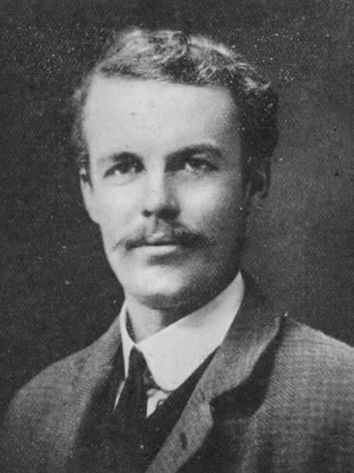
Arthur Cecil Pigou was a British economist who published
“The Economics of Welfare” in 1920
Source: Wikipedia

Slide 33
Internalizing external costs – Pigou-tax
Price
Supply curve with formerly external costs included
Supply curve without external costs
Demand curve
Quantity
Notes:
Source: Kals, Johannes: ISO 50001 Energy Management Systems – What managers need to know about energy and
business administration, New York 2015, P. 40.
Figure 5.1: Market diagram including external costs.
The figure demonstrates what happens to the market when external costs are included. The figure describes the market of any good
Causing carbon emissions. As supply curve become steeper, market equilibrium is found at higher price and low quantity.

Slide 34
What to do with the funds of a Pigou-tax?
Doing nothing is more expensive (see Stern-report)
Original idea: repair the damage caused by an environmental effect or to indemnify the affected party
Redistributing “energy money” to the population by capita
Combine the ideas: funding the „clean energy mechanism“ of international climate treaties with a global tax on greenhouse gases
GHG-internalization fees:
Optimize the allocation of resources,
Fosters new technologies and chances for export,
Implements the principle of causation,
Helps to meet the mitigation challenges,
And adds to justice.

Slide 35
Approaching an appropriate price:
Threshold for a real impact on behavior $40 per ton (about 30€)
German Center for Aerospace (DLR sets the price of CO₂ at $80)
Summing up several investigations range between $18 and $330 per ton
Willingness-to-pay method …
Marginal cost method approaching tipping-points …

Slide 36
Renewable Energy Act in Germany goes the other way round:
Subsidizing new green technologies, learning-curve, and competitiveness:
Prices per KW peak for solar cells in Euro
Notes:
Source: Kals, Johannes: ISO 50001 Energy Management Systems – What managers need to know about energy and
business administration, New York 2015, P. 48.
Figure: 5.3‘: Learning curve solar cell.
Green energy technology becomes cheaper according to the experience or learning curve. In empirics and economic theory, costs per unit are
going down 25 to 33 percent when cumulated production doubles. This effect can be observed in figure 5.3. Low prices for renewable energy
can be explained by their free extraction (costless sun, wind,…), while coal, oil, or gas have to be mined with increasing expenditures.

Slide 37
Externalities have to be included in a market economy:
Three theoretical ways of avoiding or internalizing external costs
Direct control of behavior
Regulation of prices (charges, fees, tolls, or Pigovian taxes)
Regulation of quantities (certification trading systems & emission allowances)

Slide 38
Certification trading system - terms and abbreviations
Cap and trade
EAU – Emission Allowance Units
According to economic theory, best way, but:
Not working globally
Prices too low (see CARBIX – Carbon Index)
First assigned without cost
Only industry with high emissions

Slide 39
European Emission Allowance (EAU)
at
European Energy Exchange (EEX) in Leipzig
Figured in Carbix (Carbon Index)
is too low:
Below 10 Euro per EAU (1 Ton CO₂-Emission)!

Slide 40
What do the low prices for EAUs mean in practice?
1 liter fuel oil or diesel
causes
2.6 kilograms of carbon dioxide.
Given a price of $10 per EAU,
a liter would cost
$0.026 (2 to 3 cent) more.

Slide 41

Summing up and conclusions:
Advantages of an energy turnaround
Consequences of climate change can be mitigated
New sustainable economic growth
Independence from energy imports
Decentralization reducing vulnerability
Cheap (when investments are made), sustainable, reliable energy for future generations, meeting the key energy policy objectives (economy, ecology, safety)
Triggering an new industrial revolution (see next presentation about IT)
Pixabay.de

Slide 42
Literatur
In der Präsentation verwendete Literatur:
Heintz, A., Reinhardt, G.A. (1996): Chemie und Umwelt. 4., aktualisierte und erweiterte Auflage. Braunschweig/Wiesbaden.
Deutscher Wetterdienst: www.dwd.de
Deutsches Klimaportal: http://www.deutschesklimaportal.de/DE/Home/home_node.html
Umweltbundesamt: www.umweltbundesamt.de
Intergovernmenal Panel on Climate Change: www.ipcc.ch
Europäische Umweltagentur: www.eea.europa.eu/de
Klimaforschung Helmholtz-Zentrum für Umweltforschung UFZ: http://www.ufz.de/index.php?de=37935
Bundeszentrale für politische Bildung: https://www.bpb.de/gesellschaft/umwelt/klimawandel/
Greenpeace: https://www.greenpeace.de/themen/klimawandel
WDR: http://www1.wdr.de/mediathek/video/sendungen/eins-zu-eins/video-eins-zu-eins---klimaschutz-und-energiepolitik-welche-kosten-kommen-auf-den-buerger-zu-100.html
Klimafakten: www.klimafakten.de
Witterung und Klima: Eine allgemeine Klimatologie, Ernst Heyer, 9. Auflage, Leipzig 1993)
Klett Verlag: http://www.klett.de/alias/1016053
Wiki Bildungsserver: http://wiki.bildungsserver.de/index.php/Hauptseite
BMUB: http://www.bmub.bund.de/themen/klima-energie
Ökoystem-Erde: www.oekosystem-erde.de/html/klimawandel-02.html
WBGU: http://www.wbgu.de/fileadmin/templates/dateien/veroeffentlichungen/sondergutachten/sn2009/wbgu_sn2009.pdf
NASA: http://svs.gsfc.nasa.gov/cgi-bin/details.cgi?aid=3998
Welt: www.welt.de/wissenschaft/article737613/Mit-dem-Klimawandel-kommen-neue-Krankheiten.html
Zeit: http://www.zeit.de/wirtschaft/2015-12/klimawandel-ressourcen-konflikt-migration-konsequenzen
Clisap: https://www.clisap.de/de/forschung/c:-klimawandel-und-soziale-dynamiken/crg-klimawandel-und-sicherheit/zusammenhang-zwischen-klimawandel-und-konflikten/
BAMF: https://www.bamf.de/SharedDocs/Anlagen/DE/Publikationen/WorkingPapers/wp45-klimamigration.pdf?__blob=publicationFile
Umwelt-im-Unterricht: www.umwelt-im-unterricht.de/hintergrund/klimawandel-und-migration
BMWI: www.bmwi.de/DE/Themen/Energie/Energiewende/koordinierung-energiewende.html
Klimaschutz: www.klimaschutz.de/de/programme
Ipb-bw: www.lpb-bw.de/klimaschutz_deutschland.html
Öko: www.oeko.de/oekodoc/2441/2015-598-de.pdf
Technische Universität Dortmund: wupperinst.org/uploads/tx_wupperinst/AF_AG2-2_Greiving.pdf
Bundesregierung: www.bundesregierung.de/Content/DE/StatischeSeiten/Breg/FAQ/faq-zum-klimaschutz.html
Notes:
Alle Bilderquellen sind laut pixabay.com zur freien kommerziellen Nutzung freigegeben und benötigen keinen Bildnachweis.
Alle Internetquellen wurden zuletzt am 15.07.2016 überprüft.

