Slide 1
Energy Oriented
Business Administration
Prof. Dr. Johannes Kals

Slide 2
Megatrends as challenges and chances
2.1 Global warming
2.3 Digitalization
2.2 Energy turnaround

Slide 3
Sustainability Reviews/ Balances
Environmental pillar
Social pillar
Economic
pillar
Environment
Energy
Greenhouse Gases
Carbon Dioxide

Slide 4
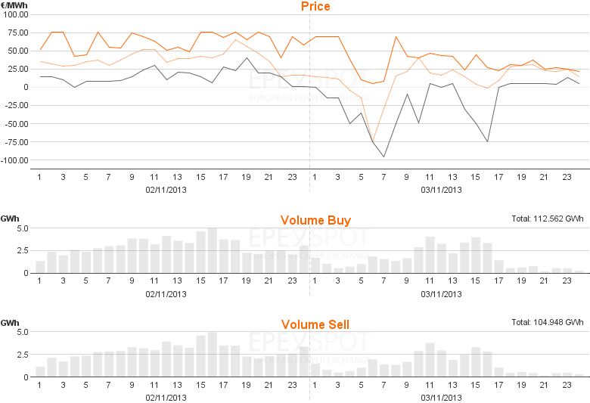
Negative prices of electricity at the European Energy Exchange

Slide 5
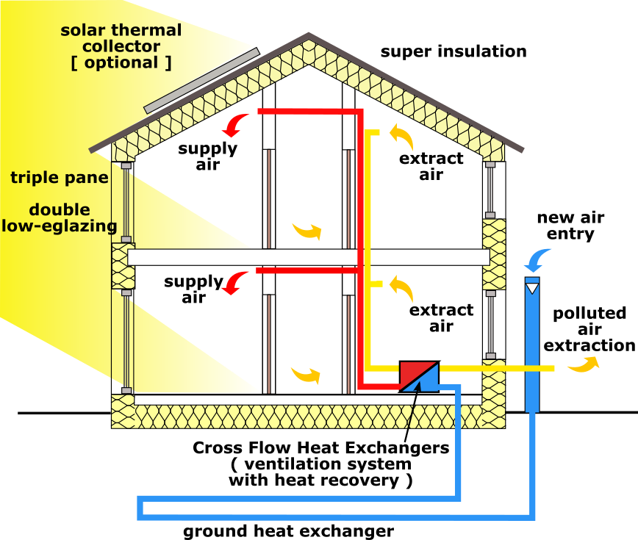
By Passivhaus_section_en.jpg: Passivhaus Institutderivative work: Michka B (talk) - Passivhaus_section_en.jpg, CC BY-SA 3.0, https://commons.wikimedia.org/w/index.php?curid=9586761

Slide 6
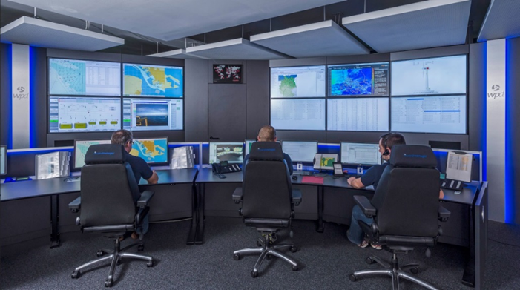
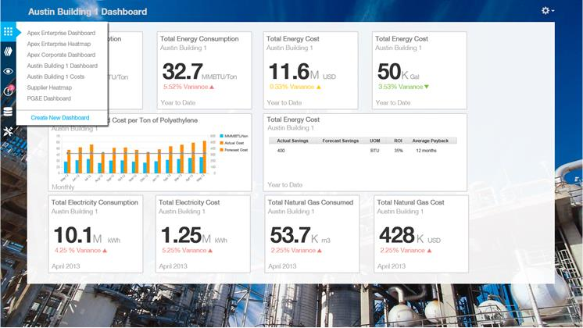
Analogy of technical control and business administration
Control room wind power park
wpd.de
management cockpits, dashboards
courtesy SAP

Slide 7

Opportunities for companies cutting cost and developing new business cases
Cutting-edge knowledge for faculty, students, and professionals
Von AWeith – own work,
CC BY-SA 4.0, https://commons.wikimedia.org/w/index.php?curid=52156647

Slide 8
6 Organizational implementation:
ISO 9000-series quality management
ISO 14000-series environmental management
- ISO 50000-series energy management
ISO 14060-series greenhouse gas management
5.1 Profitability and Investment Appraisal
5.3 Corporate strategy
5.3 CSR, business ethics, corporate culture
4 Management of business functions and domains:
4.1 IT
4.2 Facility Management
4.3 Logistics
4.4, 4.5 Procurement
4.6 Production Planning and Production
4.7 Maintenance
3.1, 3.2:
Balance sheets and review:
Sustainability
Environment
Energy
Greenhouse Gases, Carbon
3.3, 3.4 Managerial and financial accounting:
Cost-type accounting
Cost-center
Cost-object (calculation)
Life-cycle assessment (LCA)

